Slide 1
Driving Theory Workshop
Topic – 11 – Vulnerable Road Users PART 3

Slide 2
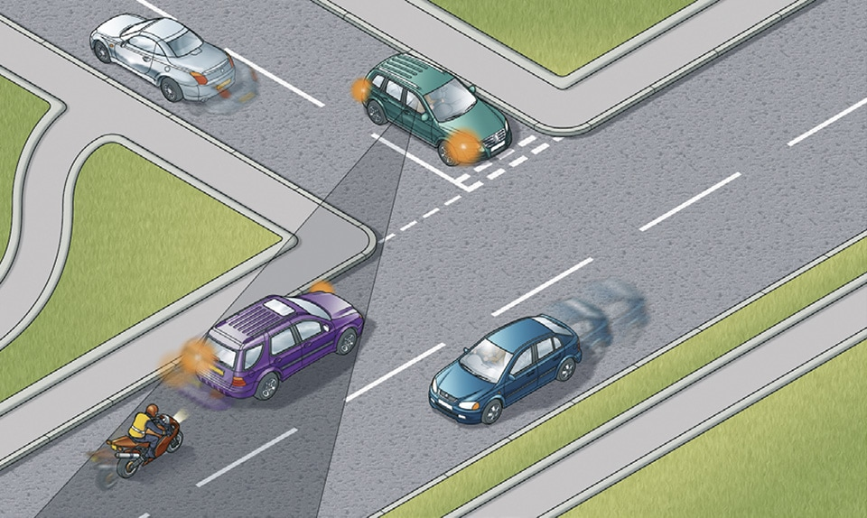
Vulnerable road users: Motorcyclists
Motorcyclists are similar to cyclists, and are also vulnerable.
They are hard to see
They are unpredictable, meaning they may move in any direction to avoid bumps in the road.
They can be affected by the wind which may blow them off the road.
Therefore, remember to leave plenty of room while overtaking a motorcyclist, especially if it is windy.
Look carefully for motorcyclists when at a junction, as they may be hidden behind other cars and are harder to see.
Give them plenty of room to when they are turning left or right at the end of the road.

Slide 3
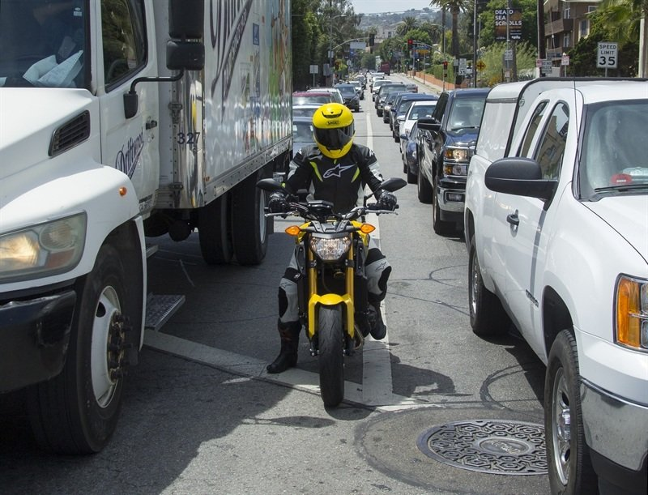
Motorcyclists
Also, remember that a motorcyclist can:
Move between lanes
Move in front of you
Move very close to you.
Therefore, Keep checking your mirrors to make sure you see cyclists and motorcyclists.
Motorcyclists may also wear helmets and leather clothing.
If you ever find a motorcyclist that has been injured at an accident, it is important to know that you SHOULD NEVER REMOVE THEIR HELMET UNLESS YOU HAVE TO.
This is because removing the helmet of an injured motorcyclist may cause more injury.

Slide 4
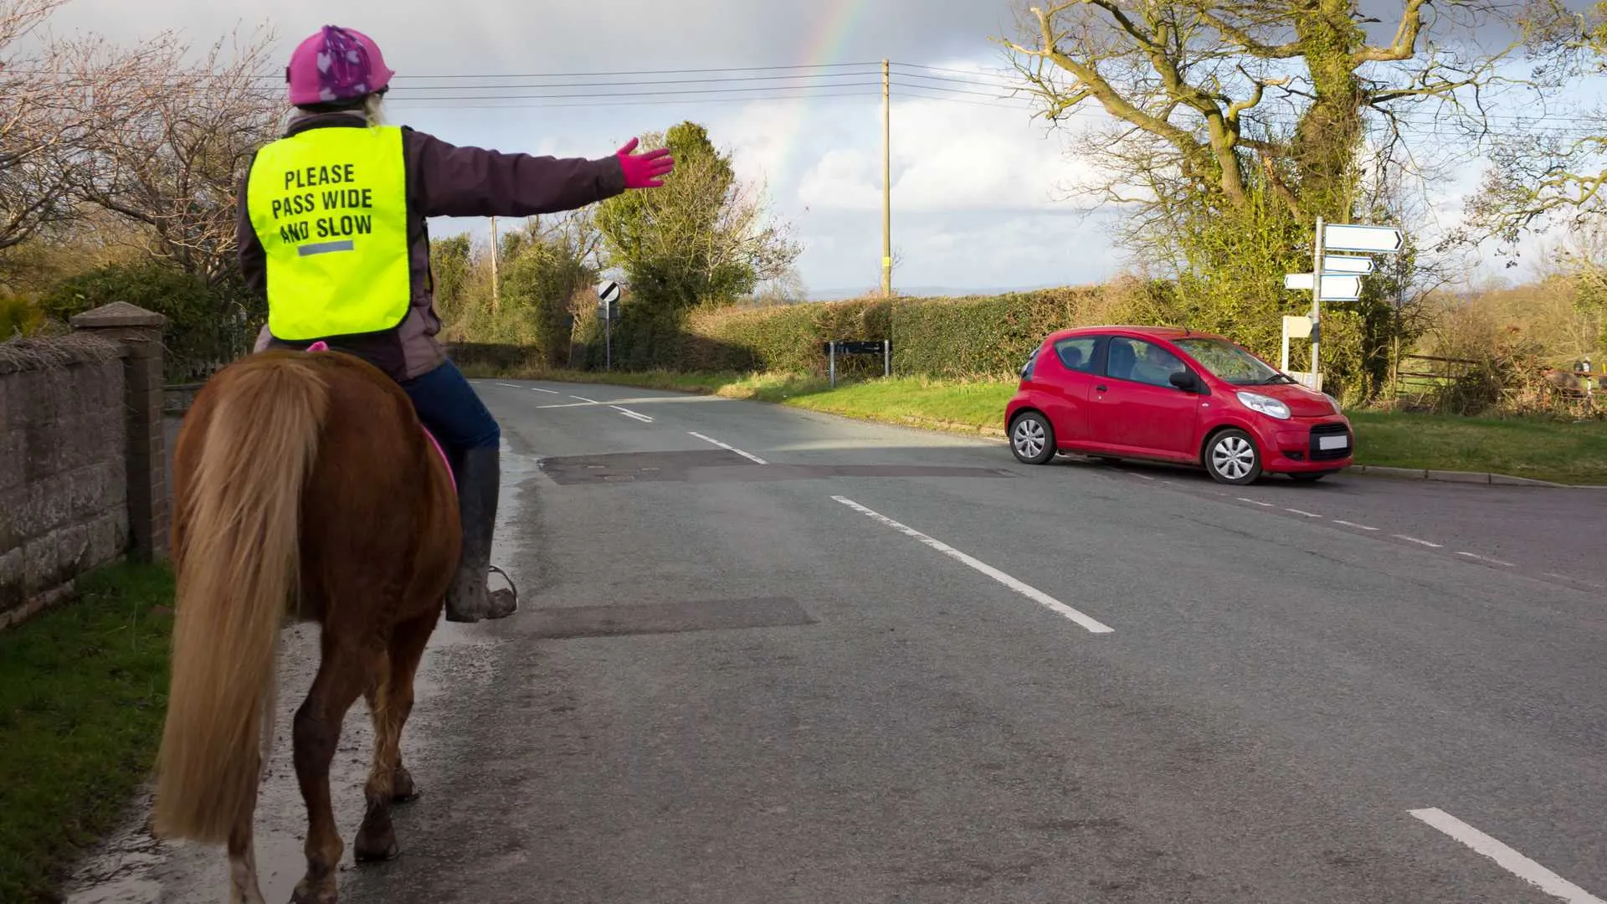
Vulnerable road users: Horses
Horses are vulnerable on the road because:
They are unpredictable – We do not know how they will act.
For example, they might get scared of the noise or speed of passing cars, and may run in any direction if frightened.
Remember to leave horse riders PLENTY OF ROOM and DRIVE SLOWLY near animals.

Slide 5
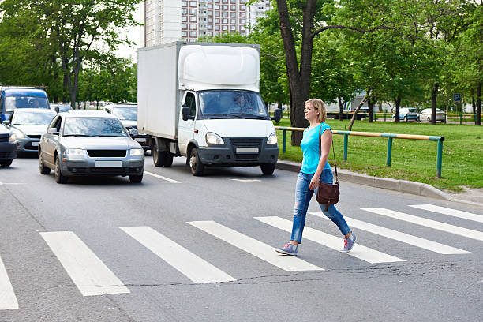
Pedestrian crossings - Zebra crossings
Zebra Crossing – You need to stop and wait if somebody is at the zebra crossing preparing to cross, as long as it is safe to do so.

