Slide 1
Driving Theory Workshop
Topic: Safety and Your Vehicle

Slide 2
Safety and your Vehicle
It is important to learn about your vehicle and how it works.
It is good to know:
How to carry out basic maintenance on your car
What to do if there is a fault in your car
How to use your car’s safety equipment correctly
How to make sure your car is safe
How to park safely
How to be aware of the environment.
How to avoid congestion.

Slide 3
Safety and your Vehicle
To make sure your car is safe to be on the road, you must make sure that your lights, brakes, steering wheel, exhaust system, seat belts, horn, speedometer, wipers and washers are all working.
Some of these items can be checked at home, but others need to be checked regularly by having your car serviced.
Doing this makes sure that your exhaust emissions and car fuel is used in an effective, money saving way.

Slide 4
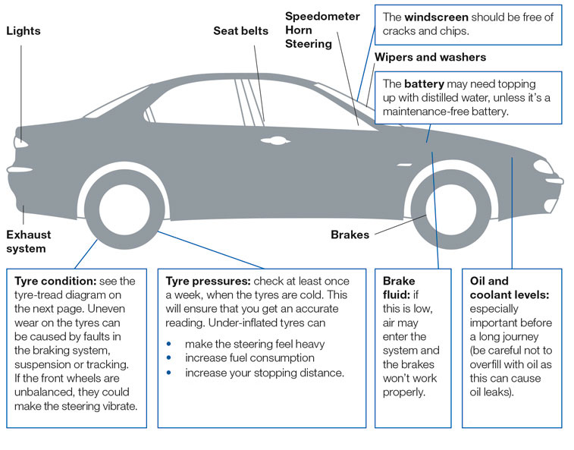

Slide 5
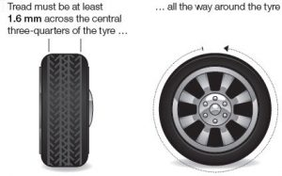
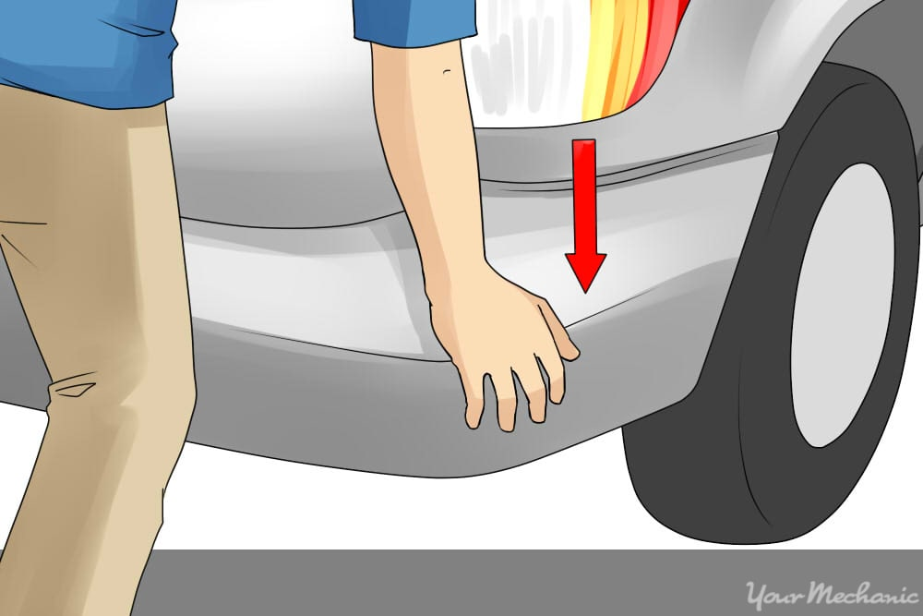
Tires
You need to check the tread on your car and trailer tyres.
The tire tread must be 1.6mm deep.
NEVER drive with tyres that have cuts.
You should always make sure your shock absorbers are working properly.
To do this, you should get out of the car and make sure no passengers are in the vehicle.
Then you push down hard over each wheel or try ‘bouncing’ the car. If the shock absorbers are working correctly, then there should be no more than one bounce when you release the car.

Slide 6
Faults:
A qualified mechanic should check your car on a regular basis. They should make sure that the brakes and steering are working correctly.
However, you should also have a good basic knowledge of how your car works, and its warning signs before they become dangerous.

Slide 7
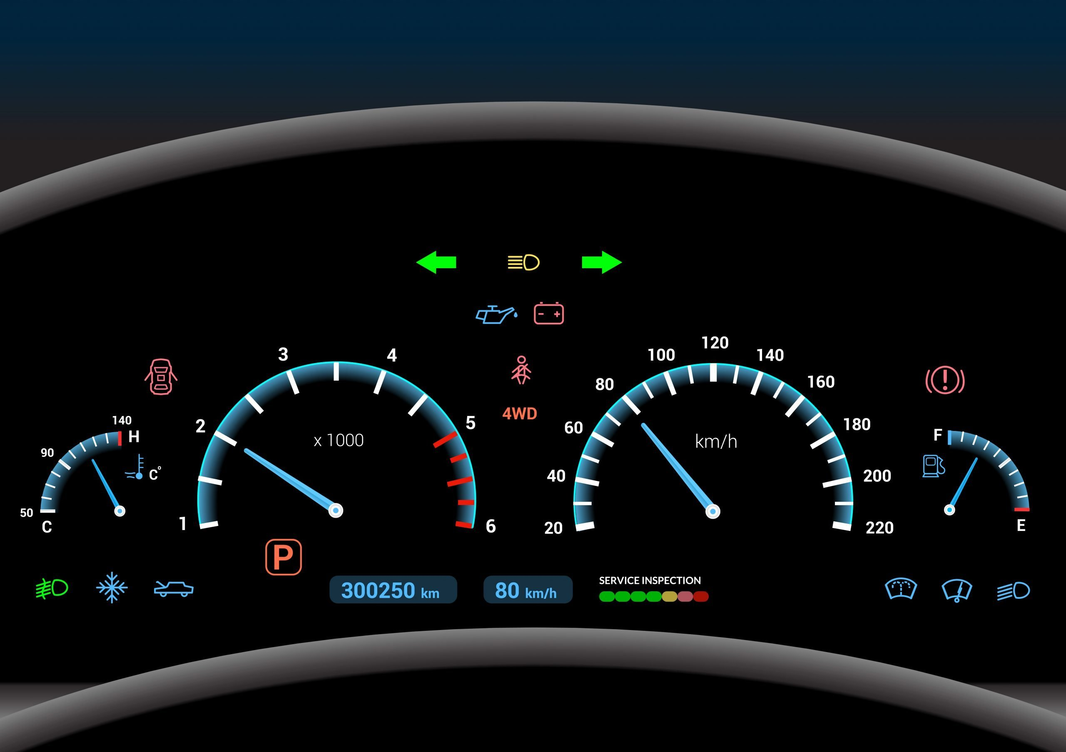
Checking for faults
One way to check that your car may tell you that there is a problem/fault is through warning lights on your dashboard. https://www.rac.co.uk/drive/advice/know-how/car-dashboard-warning-lights-meaning/
For example, the Anti-Lock Braking (ABS) warning light is important. If the ‘ABS’ symbol does not turn off by itself when your car is travelling at 5-10mph, you should have the ABS checked by a mechanic.

Slide 8
Breaks
Brakes are important and a regularly used safety feature on your car, so you need to look after them.
However, you need to be aware of ‘brake fade’.
Brake fade - means when your brakes become less effective because of overheating. This happens if you use your brakes too much or continuously.
When this happens you should use a lower gear, as driving in a lower gear will help you control your vehicle’s speed.
The issue should fix itself once the car cools down but it is good to have your vehicle checked if it doesn’t fix itself.
You should also get your vehicle checked if your steering wheel vibrates as this may mean you wheels need rebalancing as the wheels may not be level.
And it is good to get your vehicle checked if you brake and your car pulls to one side, as this may mean need your breaks need adjusting or fixing.

Slide 9
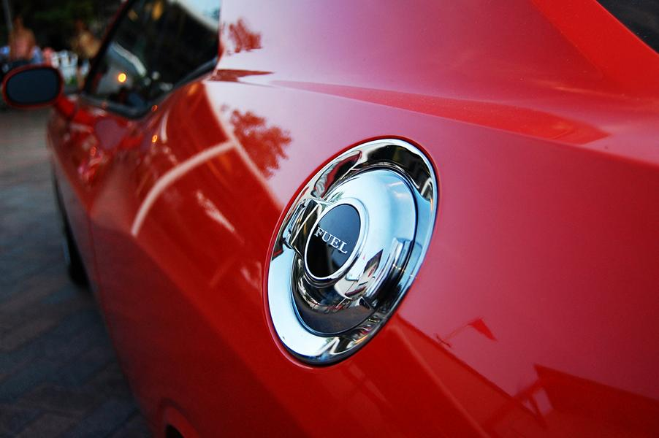
Keeping your car in good condition
When having your vehicle regularly serviced or checked this helps you save fuel and money.
If you are servicing your own vehicle you need to make sure that you know how to safely and correctly dispose of your old engine oil and batteries.
They should be taken to a local authority site or a garage. NEVER pour oil down the drain
Also, it is good to make sure that the fuel filler cap is securely fastened as this will prevent your car from spilling fuel.
Spilt diesel fuel makes the road slippery for other road users as well as wasting your fuel and money.

Slide 10
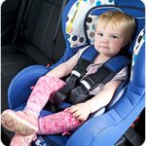
Safety Equipment: Seat belts:
Remember that you must ALWAYS wear your seatbelt unless you are allowed not to for medical reasons.
As a driver you also have the responsibility to make sure your passengers wear a seatbelt.
All passengers over 14 years of age must wear a seat belt.
if they’re between 3 and 12 years old, they MUST use a suitable child restraint.
If a suitable child restraint isn’t available in the back seat an adult seat belt MUST be used.
If a child is under 3 years old then they MUST use a suitable child seat. It is advisable to place a child in the back seat of the vehicle, however, if they need to be in the front seat it must NEVER be in a seat protected by an active airbag. You MUST have the airbag deactivated before allowing a child in the front seat.
This is because an airbag can potentially kill the child.

Slide 11
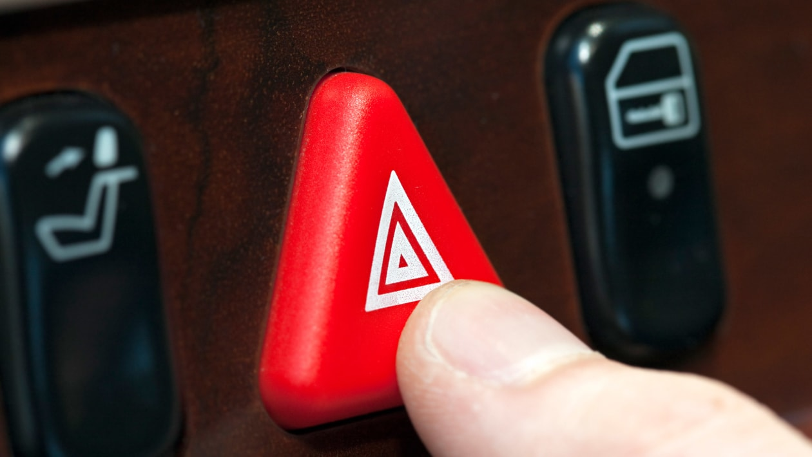
Lights
At times you will have to travel in conditions of poor visibility, such as in fog or heavy rain. You should use dipped headlight in order to allow other road users to see you clearly.
If the fog is too thick, you should use your fog lights but remember to switch them off when your visibility improves.
If the speed limit is more than 30 mph, and you need to leave your car at night on a two-way road, you should switch on your parking lights and park in the direction of the traffic.
This will make sure that other road users can see your vehicle.
You should use your hazard warning lights in order to warn road users that there is a hazard ahead, for example, if your car broken down.

Slide 12
Parking
When you are parking your car, it’s important to consider the safety of yourself and other road users.
Parking in a bad spot could stop other road users for seeing the road properly, and risk their safety.
Remember to never park:
In front of the entrance to a property or house.
At or near a bus stop.
At the top of a hill as this will make it harder for drivers to see if it is safe to pass or not on the road ahead.
At a dropped kerb, as this will make it harder for wheelchair and mobility scooters from getting onto the road or pavement.

Slide 13
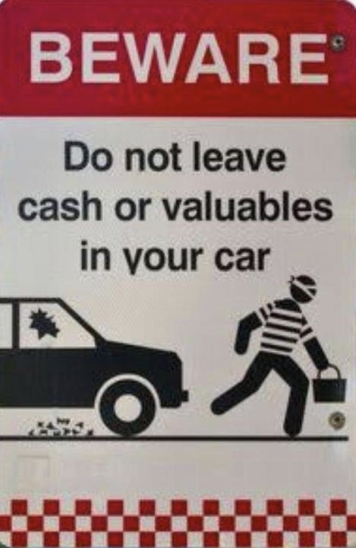
Leaving your vehicle.
If your engine is still running, you should NEVER leave your vehicle unattended. Instead, you should ALWAYS switch it off and lock your doors before leaving.

Slide 14
Helping the environment:
Driving is an activity which causes damage to the environment as most cars burn petrol. This causes pollution.
How to drive in a way that helps your car and the environment:
Do not leave the engine running when it doesn’t need to be. You should switch off your engine if you’re unlikely to be moving soon.
Cars driving at higher speeds use more fuel than cars driving at lower speeds. So drive at a lower speed when you are able to do so.
Don’t accelerate too fast.
You should walk, cycle, or use public transport when at possible
Some cars have catalytic converters which are designed to reduce a large percentage of toxic emissions. They work more efficiently when the engine has reached its normal working temperature.

Slide 15
Noise:
You should never make too much noise with your car in built-up areas.
You can use your horn, but never use your horn between 11.30 pm and 7.00 am. You can use your horn only if another vehicle poses a danger.

Slide 16
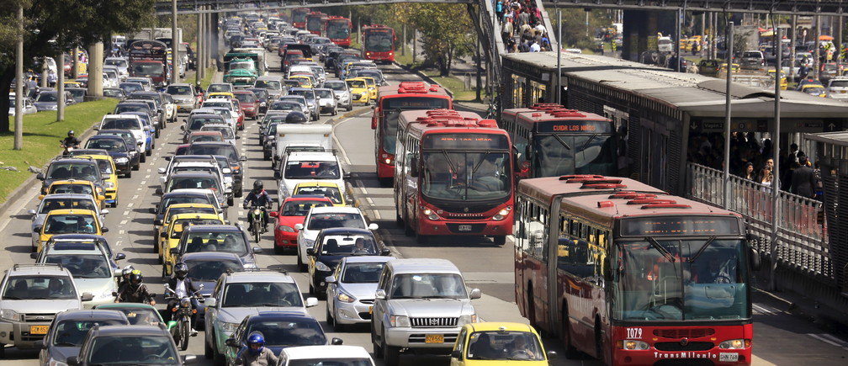
Congestion or heavy traffic
Remember to plan your journey ahead of time.
Avoid driving in rush hour or when it is really busy.
Some places have ‘red routes’ – these are lanes which help the flow of traffic and help it keep moving.

Slide 17
Practice
Safety and your vehicle study test (with hints) - Highway Code Tests

