Slide 1
Vehicle Loading

Slide 2
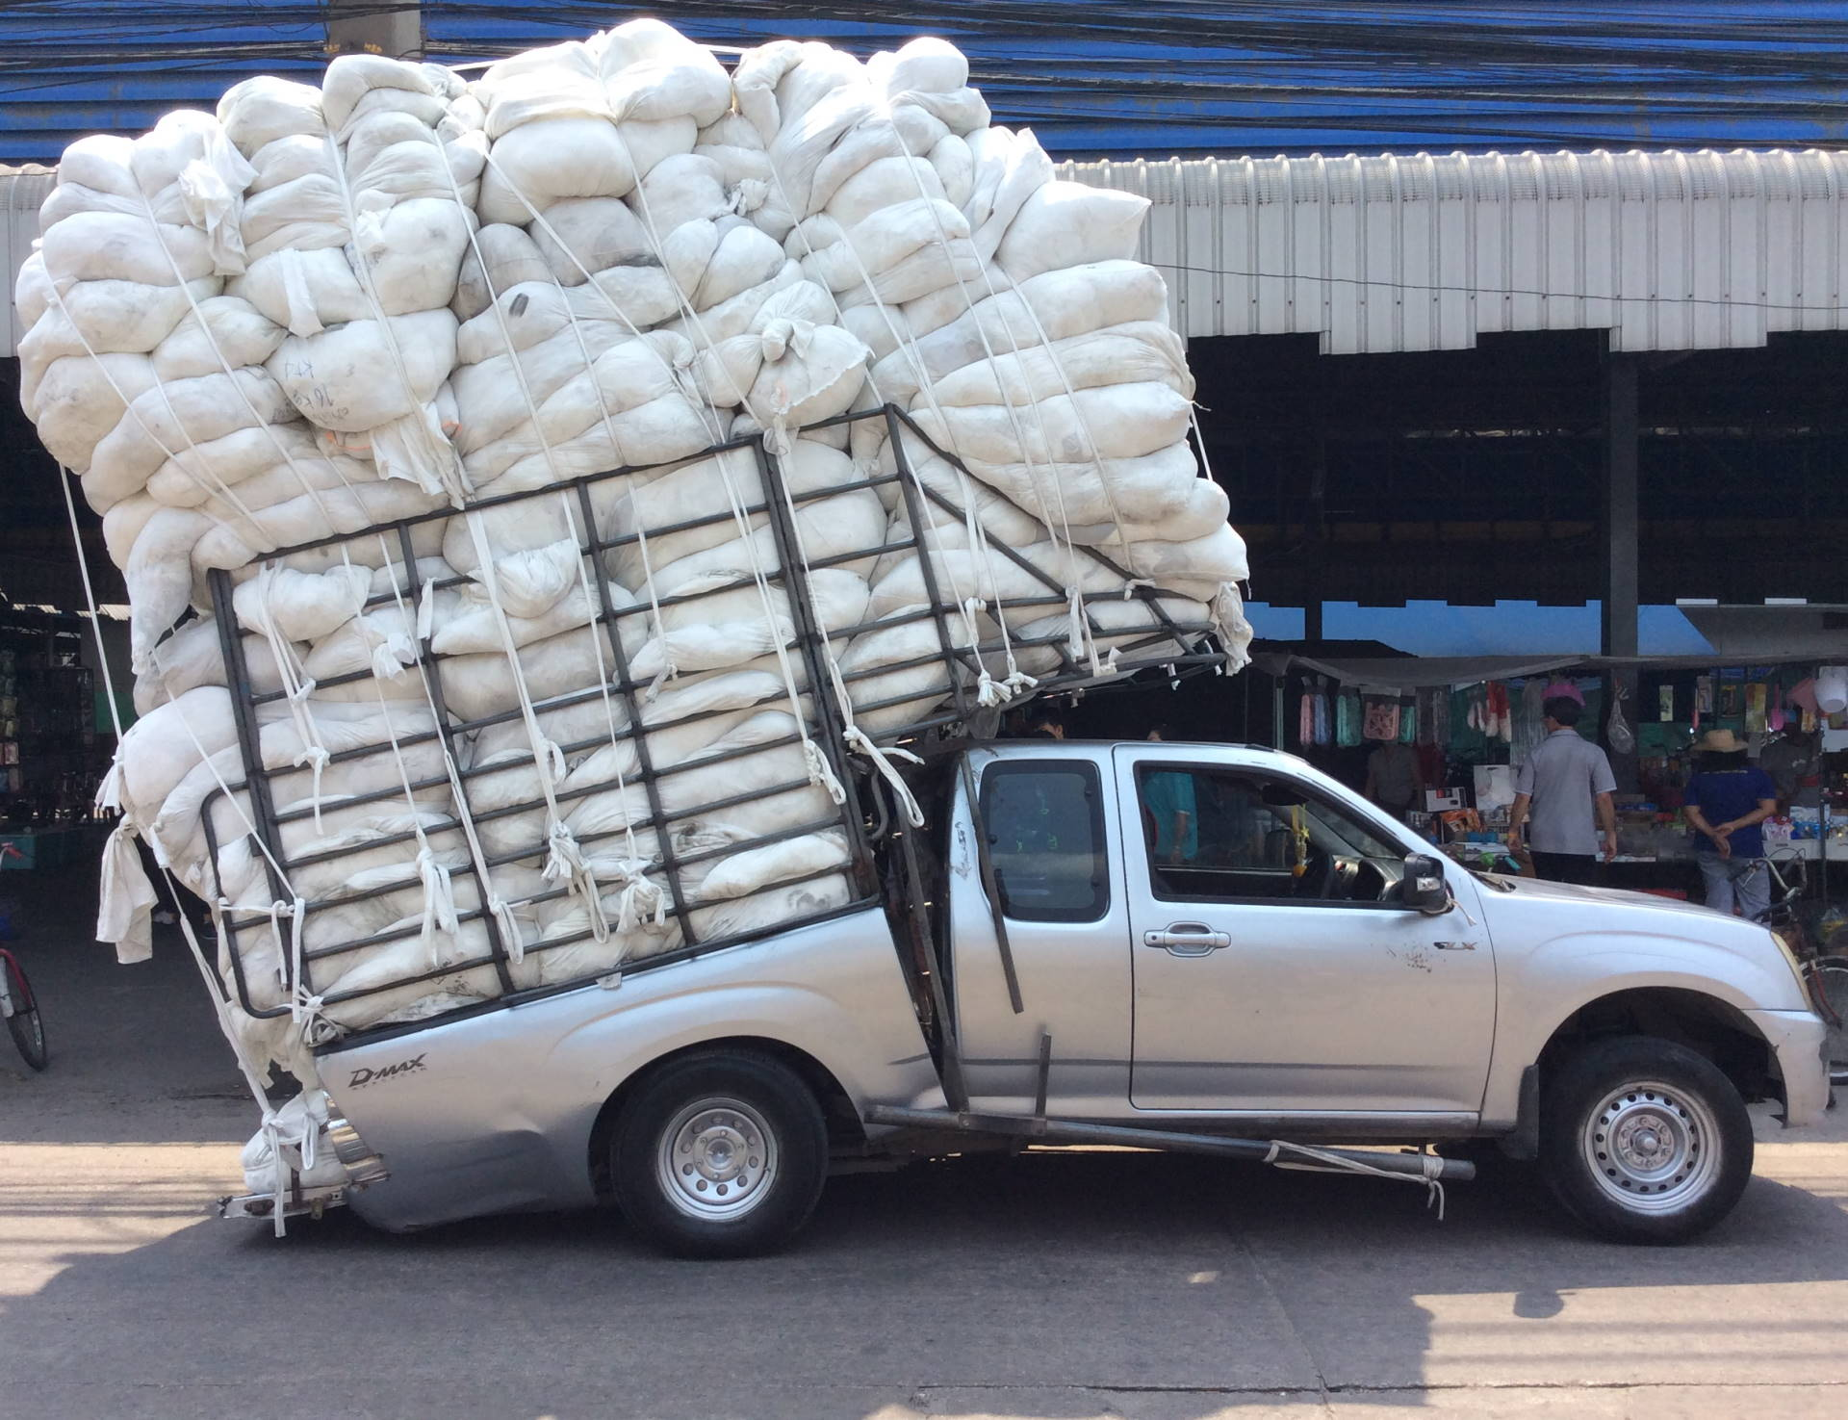
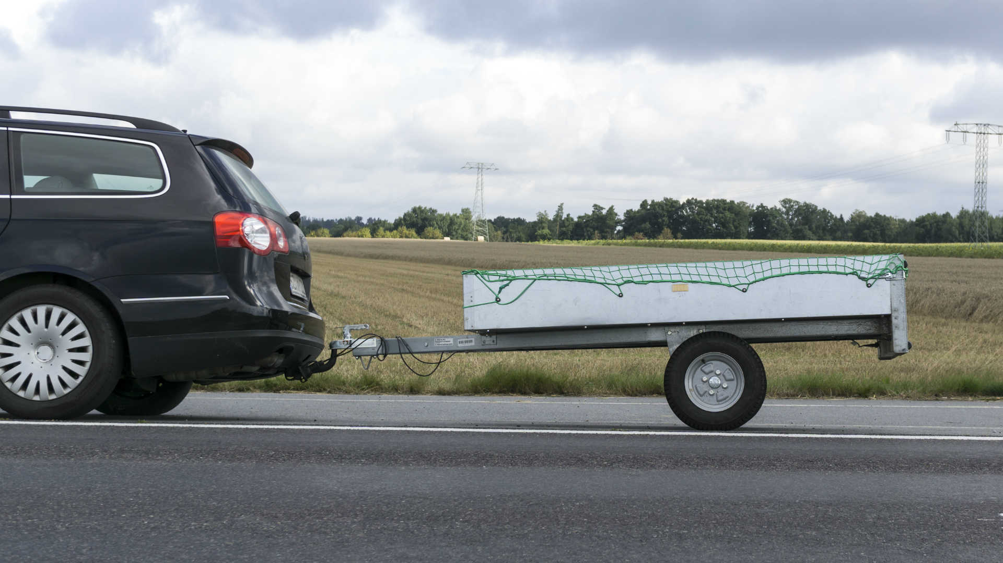
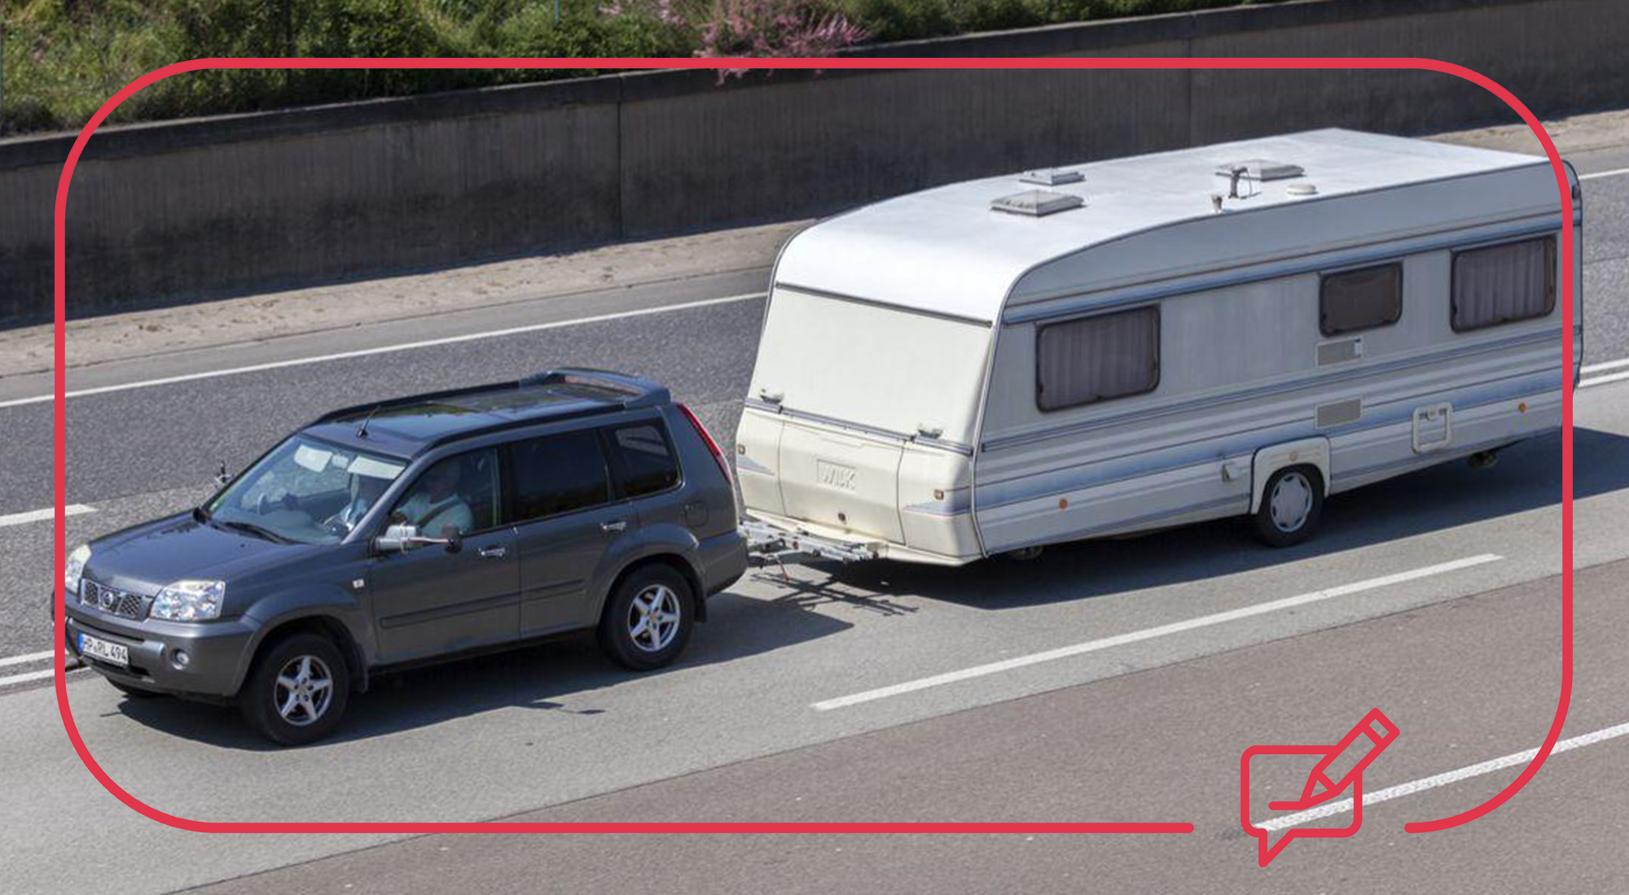
Vehicle Loading
This section of the Driving Theory test focuses on how to safely load your vehicle, towing trailers and caravans, and using roof racks.

Slide 3
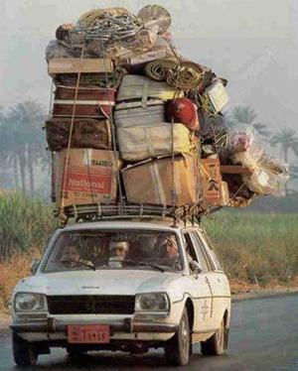
Carrying loads safely
Before loading your vehicle with people or goods, you should make sure you know how to do this safely, and what effect carrying loads may have.
We must be aware that we can ‘overload’ our vehicle. Overloading will affect our vehicle handling or control when steering or braking.
This makes it harder to drive smoothly and respond to road conditions or hazards in good time.

Slide 4
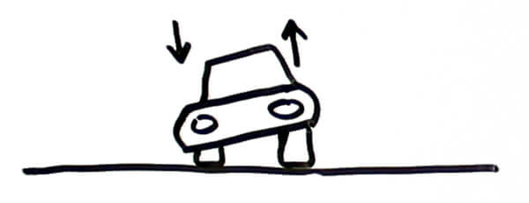
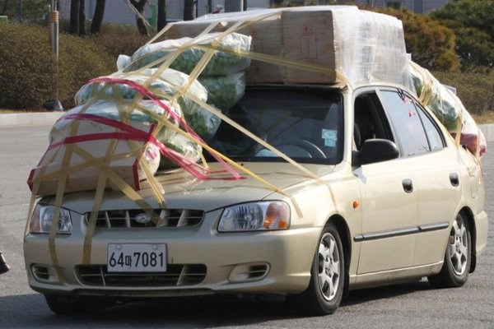
Carrying loads safely
Once you are sure that you have a suitable amount to load into your vehicle without overloading it, you need to make sure that you load your vehicle carefully to help with stability. For example:
Spreading the weight evenly so one side of your car isn’t heavier than the other.
Making sure everything is securely fastened with a rope so that it won’t move when you are braking or turning a corner.
Making sure that the items you are carrying do not get in the way of your view of the road when driving, or get in the way of other road users.

Slide 5
Carrying loads safely
When you carrying a heavy load, it might affect how your car’s handling and suspension.
The is because the weight of the items may push your car down.
This means when you are carrying or towing a heavy load, you need to make some changes to your car.
Increase the air pressure of the tires so that they are stronger.
Change the aim of your headlights.

Slide 6
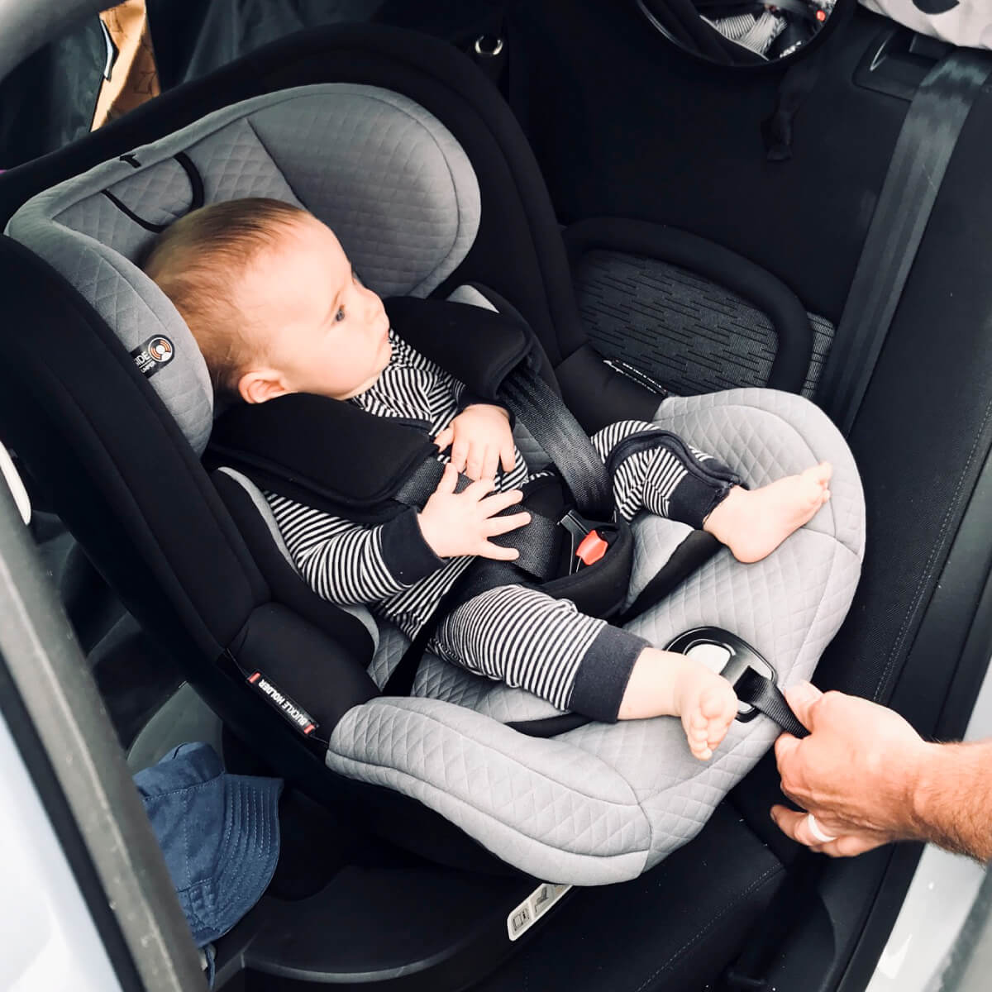
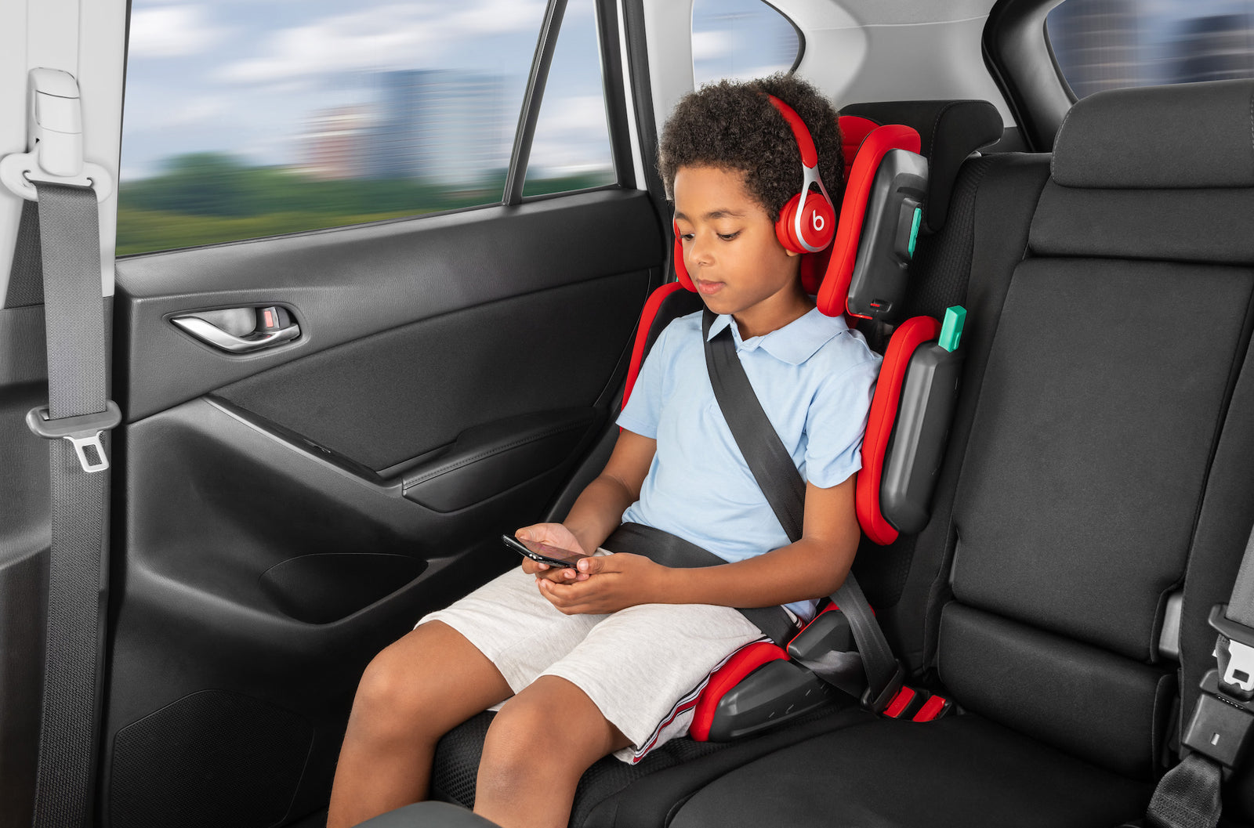
Carrying passengers safely
Making sure all passengers are safe is important.
All passengers of all ages MUST wear seat belts
If the passenger is under 14 years old, they must wear a suitable restraint when travelling in your vehicle.
The type of restraint depends on the age of the child, for example:
Baby carrier, child seat or booster seat.
The responsibility for wearing seat belts is YOU, the driver.
If you are towing a caravan, remember that passengers ARE NOT ALLOWED TO RIDE IN A CARAVAN THAT IS BEING TOWED.

Slide 7
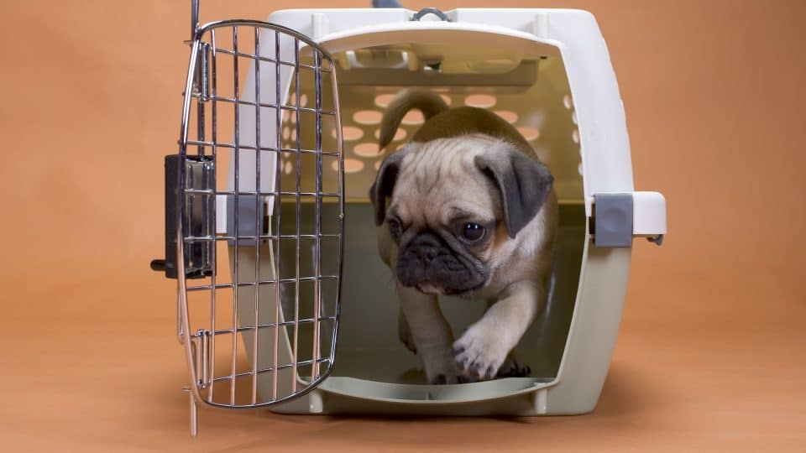
Carrying animals safely
Like children, animals should be safely restrained to make sure that they do not interfere with the driver or obstruct their view.
This restraint can be a special cage for smaller animals, dog guards, or pet carriers which can be secured with a seat belt.
When travelling with children or animals, it is important to keep your focus on the road.

Slide 8
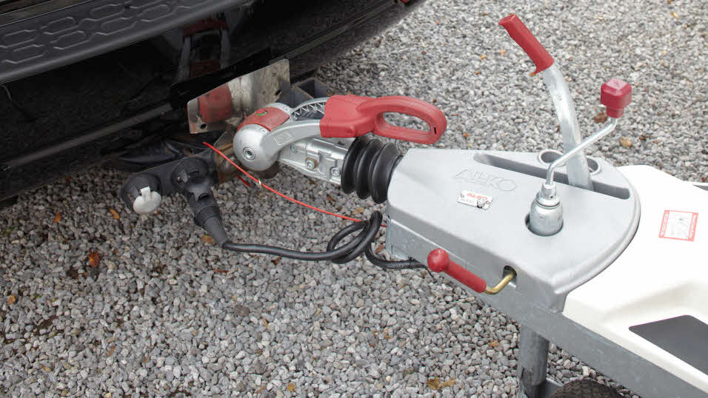
How to tow safely:
Towing trailers or caravans need to be fitted with a stabiliser fitted to your tow bar.
This will help the handling of your vehicle, especially if you are driving in areas where there are high side-winds.
You also need to be aware of the maximum amount of weight that your vehicle can safely tow.
The maximum weight that can be put on your vehicle’s tow bar can be found in your vehicle handbook.

Slide 9
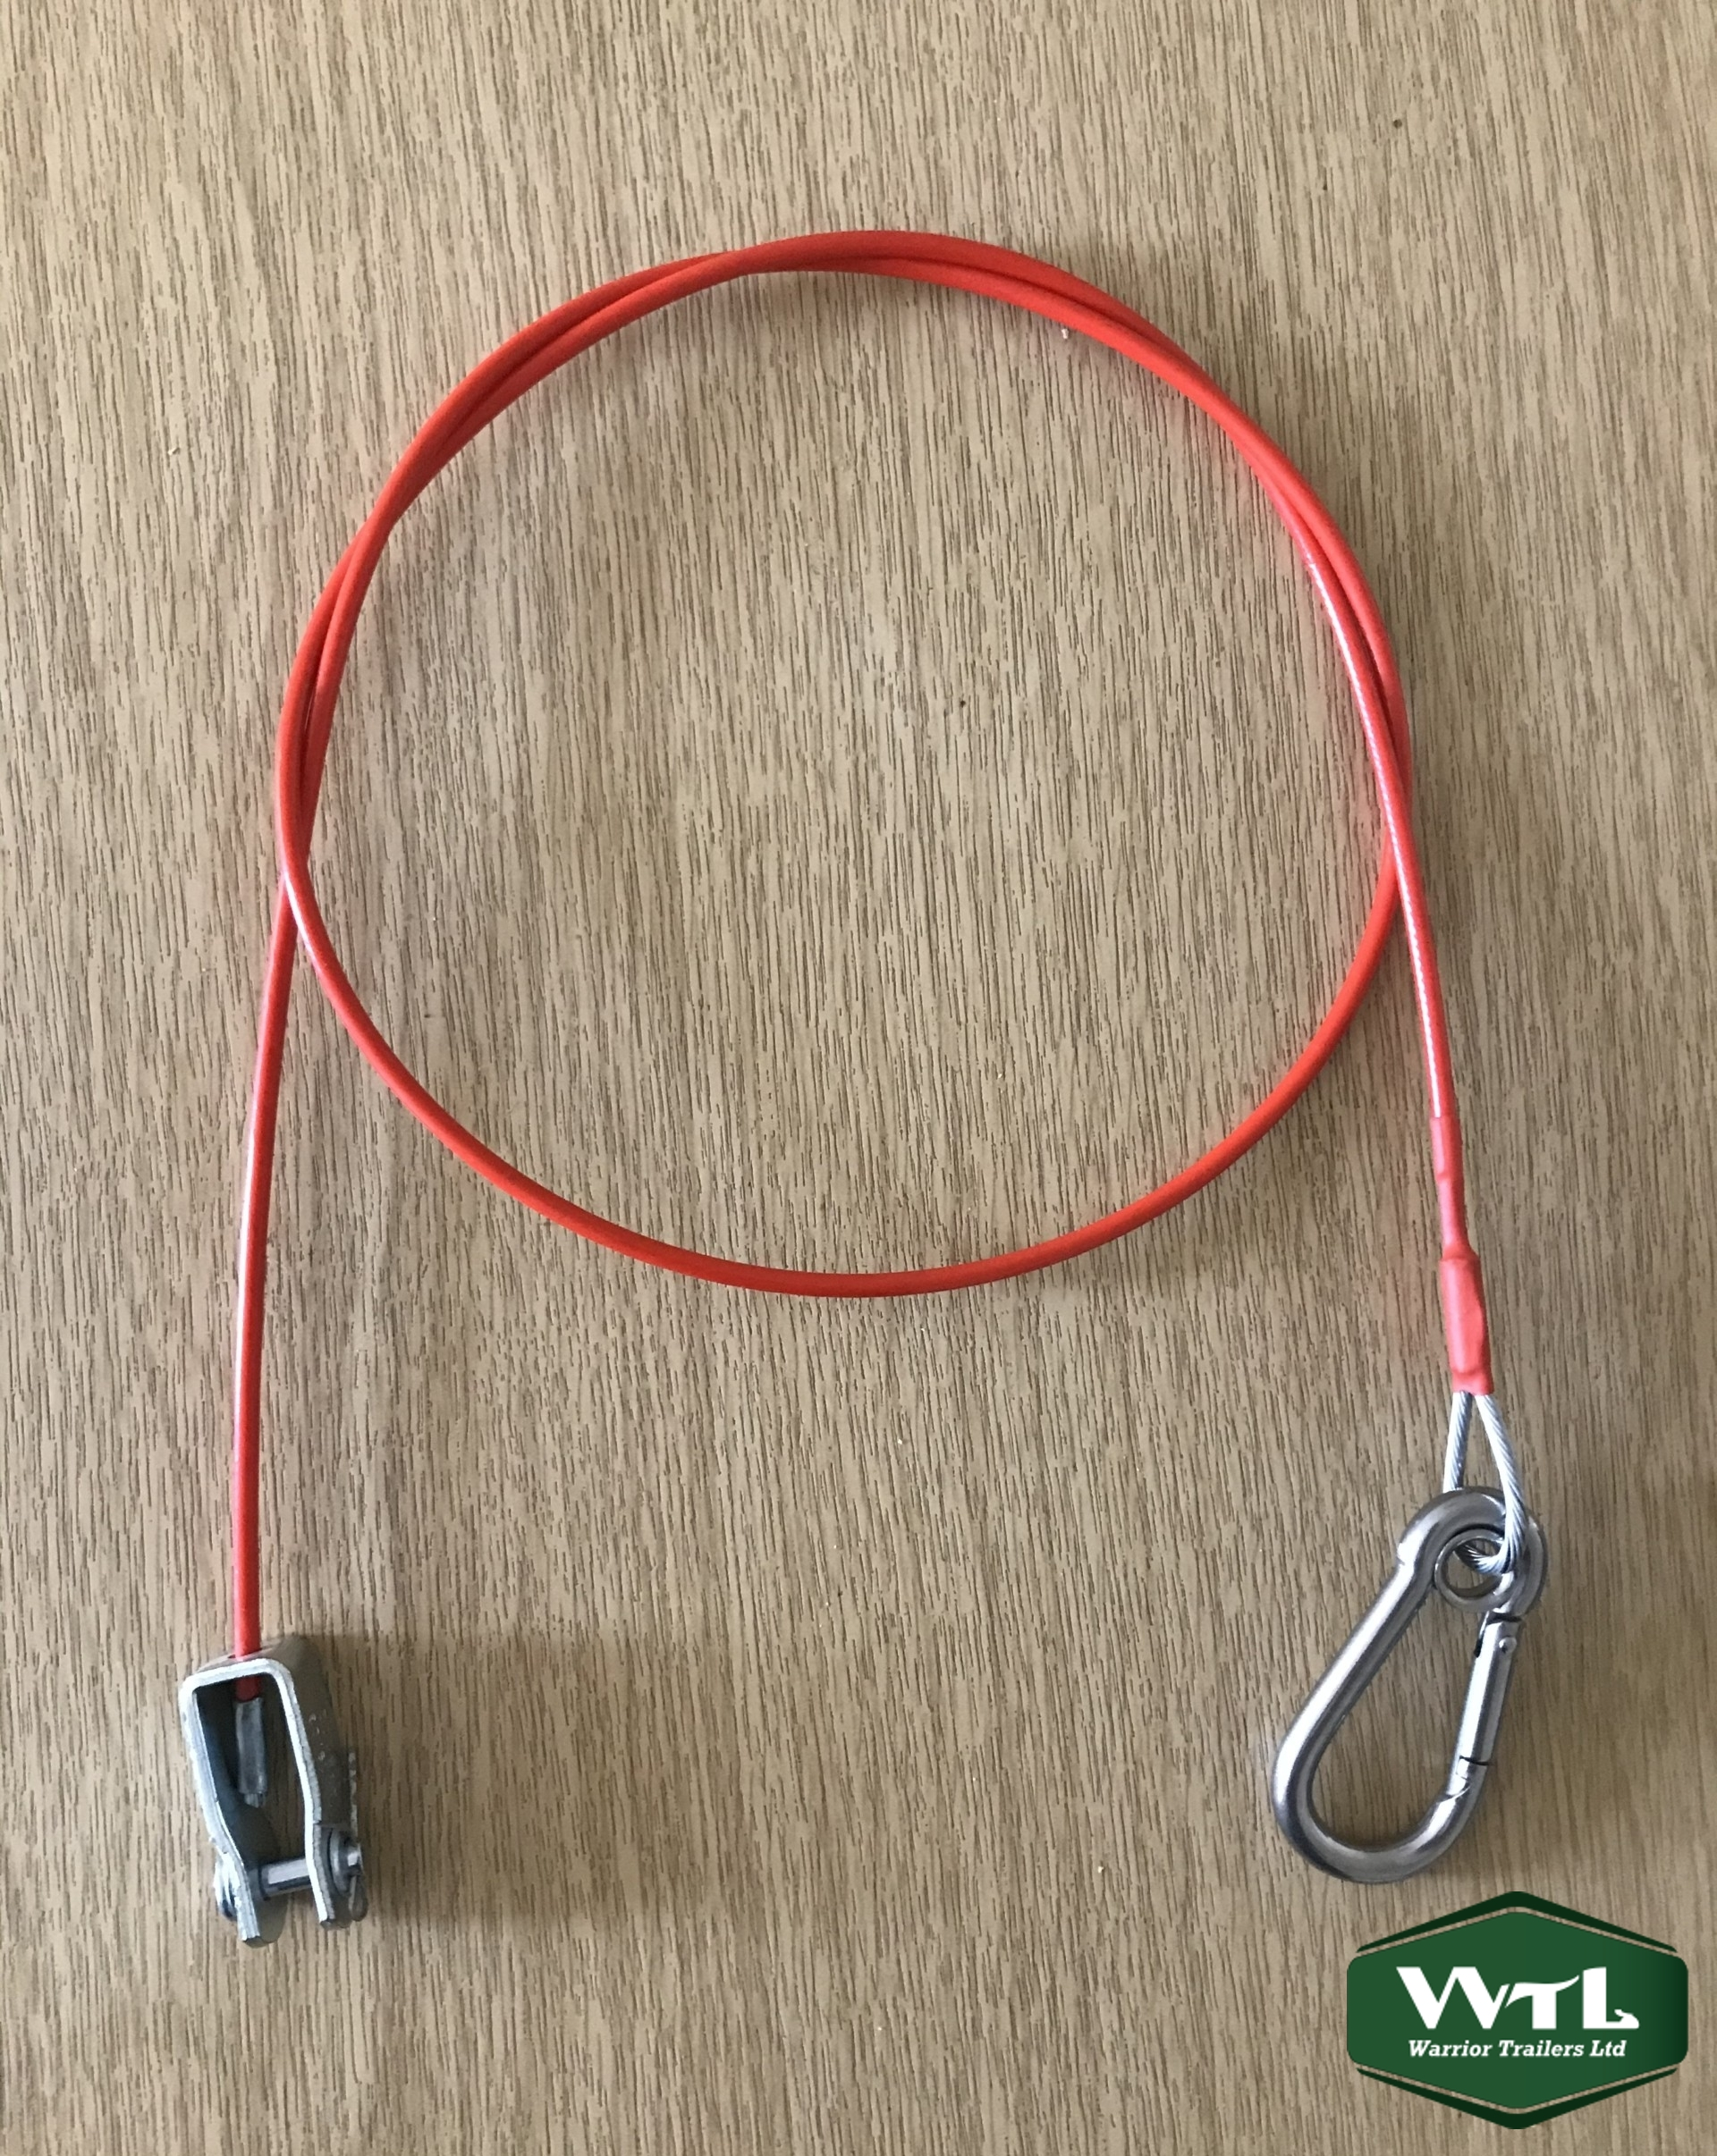
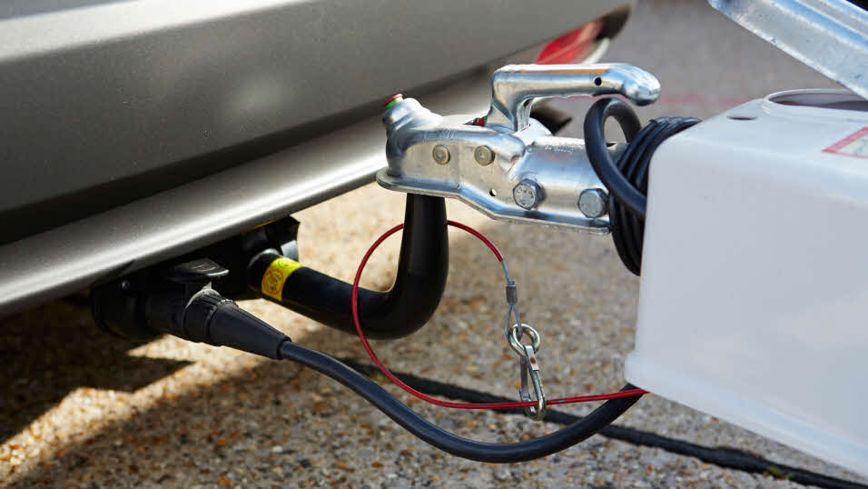
How to tow safely
Some caravans and trailers are fitted with a braking system.
If yours has this, then you need to make sure that you use a ‘breakaway cable’.
The breakaway cable will apply the trailer break and stops the trailer before the cable snaps and the trailer separates from the car.

Slide 10
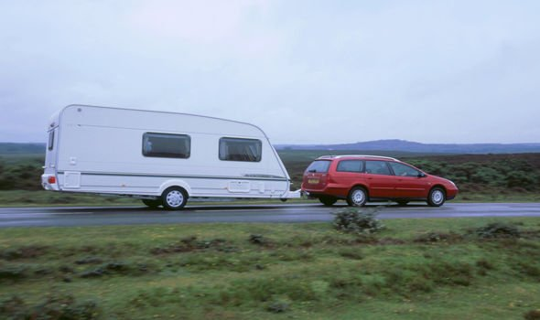
How to tow safely
You must keep an eye on your trailer or caravan and try to spot any problems before they become dangerous.
For example, if your trailer is swerving or shaking whilst you are driving, this could mean that your load is about become detached, fall over, or break away from your car.
If you notice this happening, you must ease off of the accelerator pedal and reduce your speed. This will help you regain control.

Slide 11
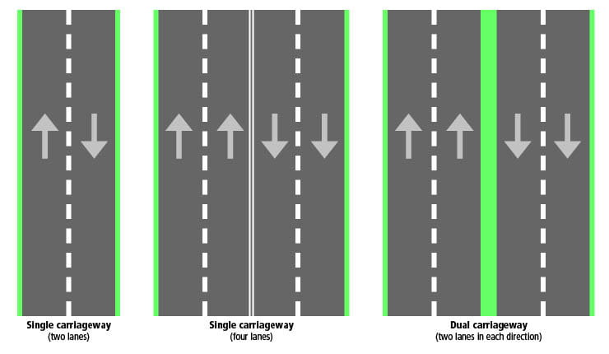
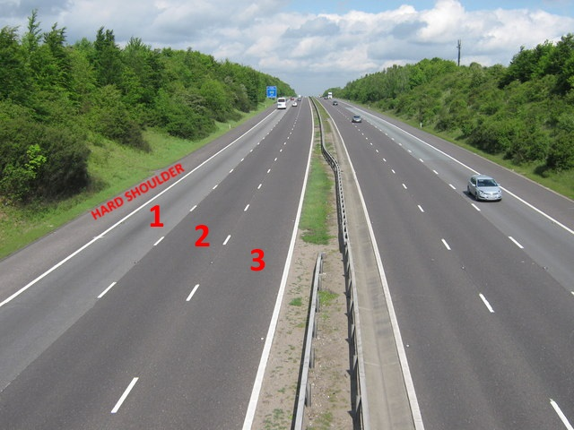
Towing a trailer on a motorway
When travelling on a dual carriageway or motorway, the maximum speed limit is 60mph.
You should also be aware that a vehicle towing a trailer on a motorway that has more than 2 lanes, MUST NOT DRIVE IN THE RIGHT HAND LANE unless they are told to by the police or road traffic agencies.
When travelling on a single carriage way, the maximum speed limit is 50mph.

Slide 12
Practice
Vehicle loading test (with hints) - Highway Code Tests

