Slide 1
Driving Theory Workshop
Topic 10: Safety Margins

Slide 2
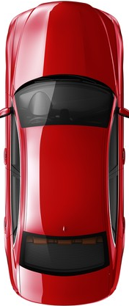
Safety Margins/Separation Distance
Safety Margin – Also called ‘separation distance’ - means the space we must leave between our vehicle and the vehicle in front of us.
This is so an accident does not happen if the vehicle in front of us suddenly stops or slows down.
Safety margins are important as weather conditions can affect the breaking or handling of our vehicle.
Safety Margin/ Separation Distance →

Slide 3
Thinking and stopping distance
Stopping distance is the ‘Thinking Distance’ and ‘Braking Distance’.
Thinking distance or reaction distance – means the time it takes for you to notice a hazard ahead of you.
Breaking distance – the distance a vehicle travels in the time after the driver has applied the brake.

Slide 4
Stopping distance
When travelling at higher speeds, our thinking distance and braking distance will be longer.

Slide 5
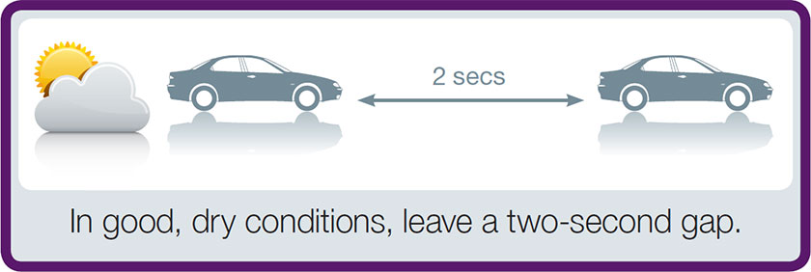
The Two-Second Rule
To keep a safe distance between cars when traffic is moving at normal speeds it is good to keep a 2 second gap.
In good and dry conditions, we should leave a 2-second gap between our car and the car in front of us.

Slide 6
The Four-Second Rule
In other weather conditions such as rain, we should leave a 4-second gap between our car and the car in front of us.
This is double the distance of dry weather conditions.

Slide 7
In Icy weather conditions…
In icy weather conditions, we need to leave a bigger gap.
In icy weather, it is good to leave a 20-second gap.
This is 10 times the distance of dry weather conditions

Slide 8
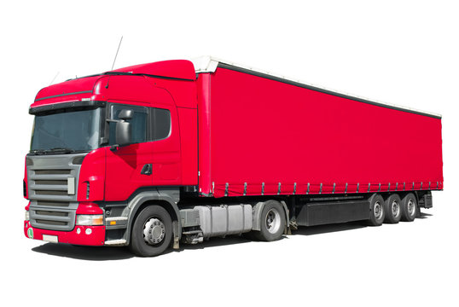
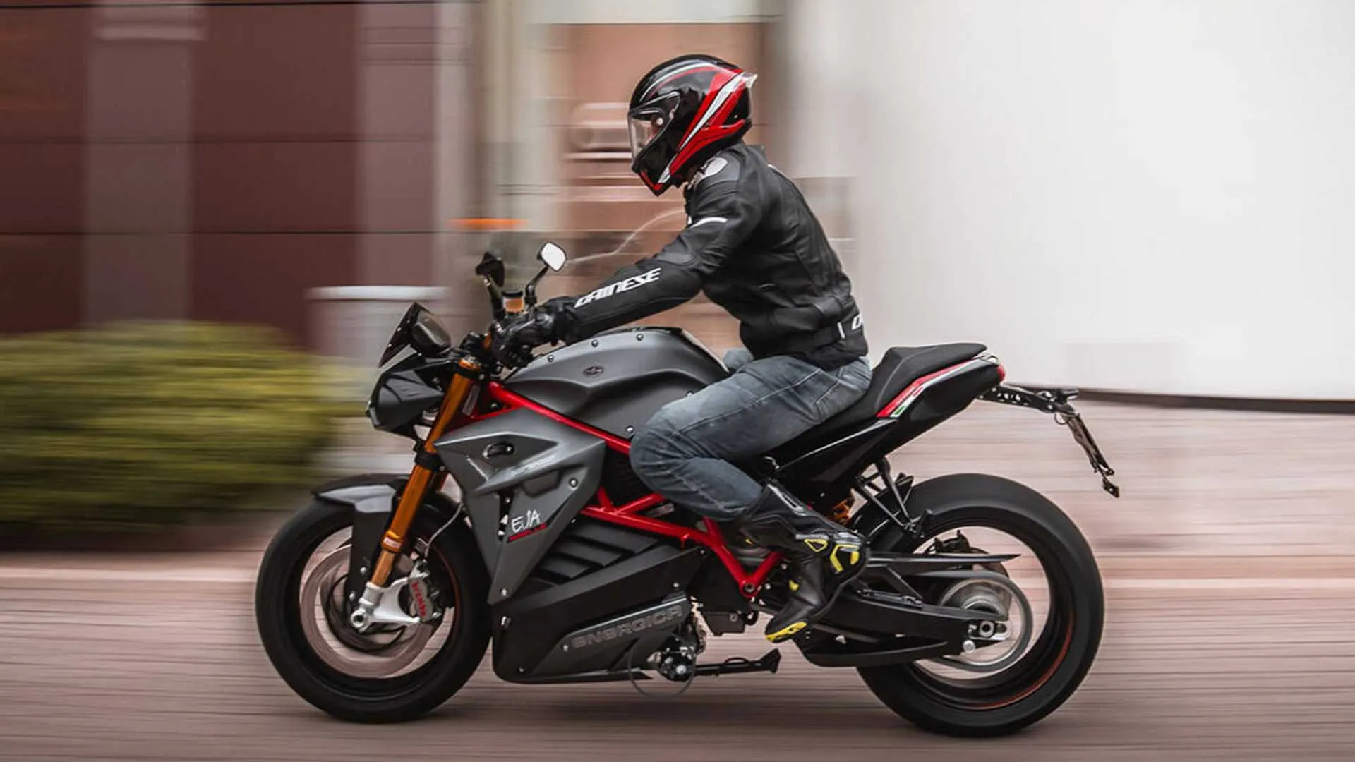
Stopping behind other vehicles:
When you are behind long vehicles and motorcycles, the safety margin needs to be larger.
This is because these types of vehicles need more space to stop – they have longer stopping distances.

Slide 9
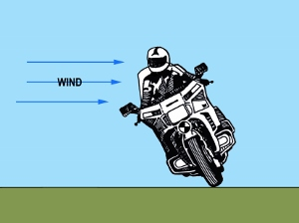
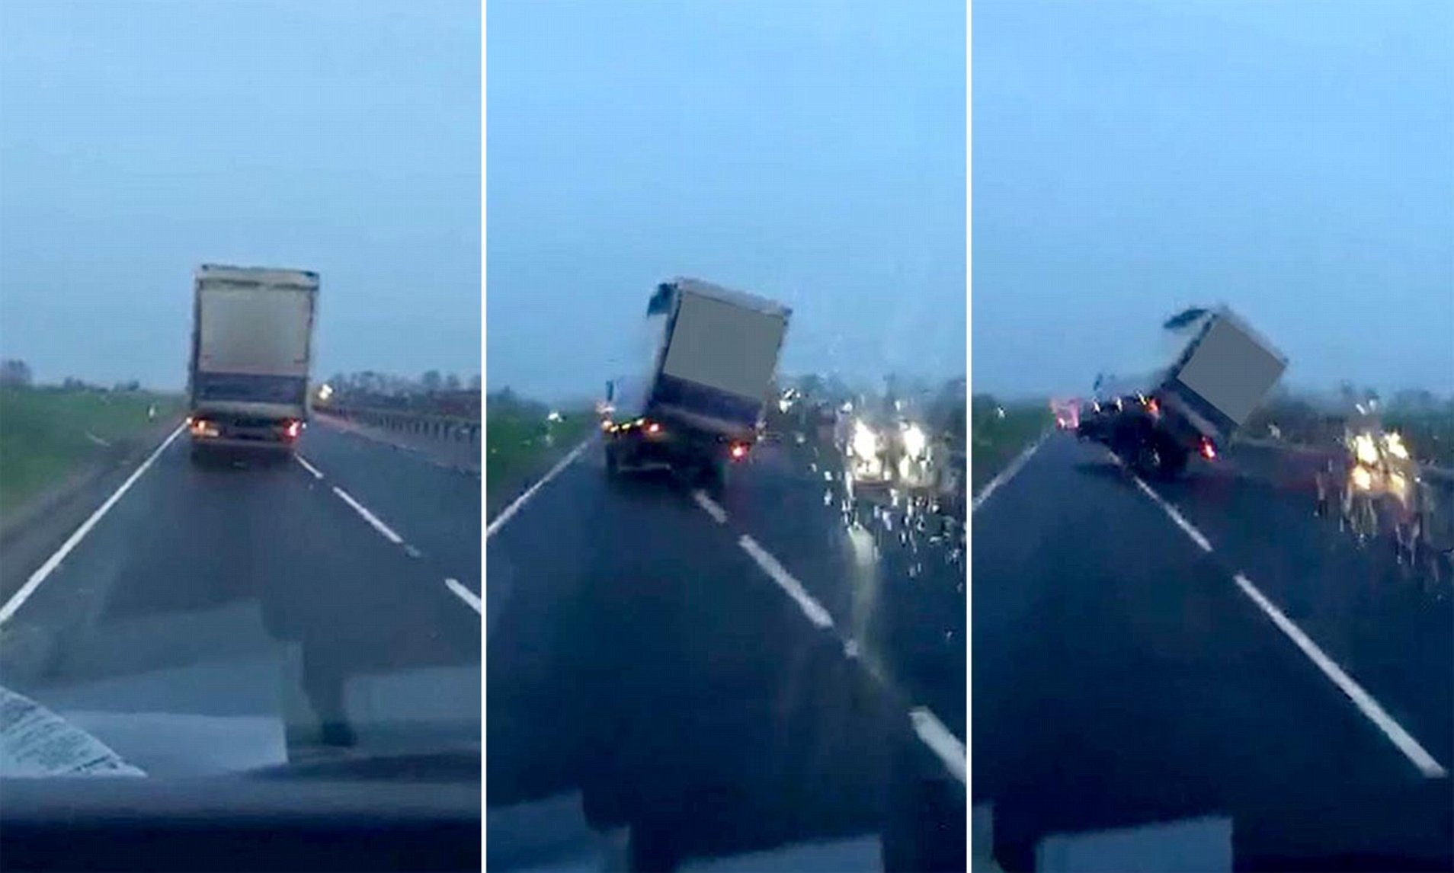
Driving behind other vehicles: Strong Winds
Also, when driving behind long vehicles or motorcyclists, you need to be careful when there are strong winds and why they can be dangerous.
Strong winds can be dangerous as the wind can throw long vehicles and motorcycles off the road.
This means you have to leave a larger safety margin, or separation distance.

Slide 10
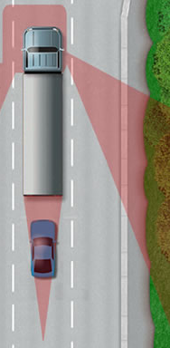
Driving behind other vehicles:
The long vehicle can’t see the blue car in his rear mirrors.
Long vehicles can also block your view of the road ahead of them.
This means if you drive too close, you may not see hazards that may be developing in front of the vehicle in front of you.
Also, driving too close to long vehicles means the driver of the long vehicle may not be able to see you.
This means you need to increase your safety margin or separation gap between your vehicle and the longer vehicle in front of you.
The blue car is driving too close and can’t see the road in front of the long vehicle.

Slide 11
Weather conditions
How you drive, your safety margin and stopping distance depends on weather conditions.
Remember that bad weather means you have to have a bigger safety margin.

Slide 12
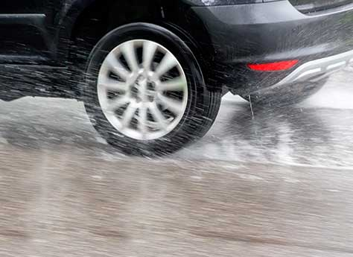
Heavy rain
Heavy rain can make the road slippery by reducing the grip of your tires on the road. This is because water can build up between your tires and the road.
This will make your steering very light and reduce your control of the car.
When this happens, you should:
Ease your foot off the accelerator to get rid of the water that has built up below your tire.
This allows your tires to regain their grip on the road.
After driving through deep water, you should test your breaks.
To dry them, you may need to press lightly on your break pedal as you drive on the road.

Slide 13
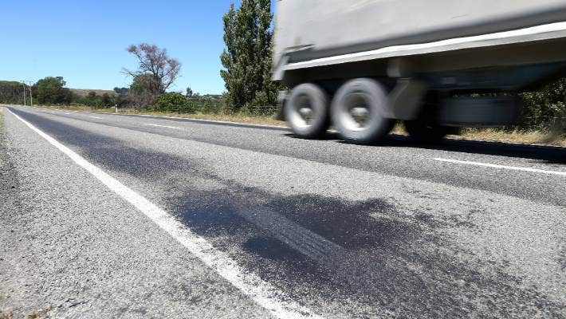
Hot/Bright Weather
Hot weather means the heat may soften the road surface. When the road gets too hot, this can affect your braking and steering.
Sometimes the road can melt!

Slide 14
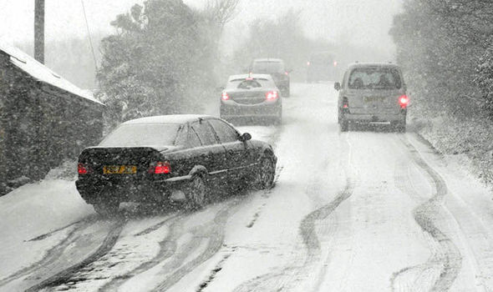
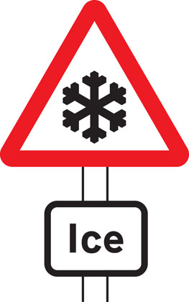
Freezing Weather
In freezing weather, roads can become slippery. This makes it harder to control your vehicle.
When driving off in snow, you should use a higher gear. This is to prevent your wheels from spinning (when your wheels turn but cannot move).
Braking on snow can be dangerous. When braking on snow, be gentle with both the accelerator and brake pedal to prevent wheel-spin.
When driving on ice, be careful as tyres will make no noise when driving on ice, the steering will feel light and you will lose control of your vehicle.
Braking on snow can be extremely dangerous. Be gentle with both the accelerator and brake to prevent wheel- spin.
When driving in freezing conditions, drive slow and gentle.
Wheel-spin

Slide 15
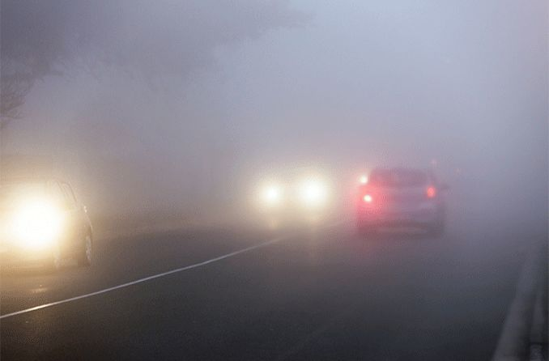
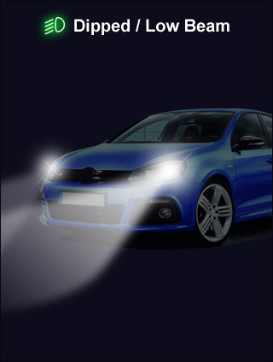
Foggy weather
Fog can be dangerous as it can reduce your visibility (fog makes it harder to see the road).
When driving in foggy conditions, remember to:
Plan for more time in your journey when travelling.
Increase the safety margin or separation distance between you and the vehicle in front of you.
Use dipped headlights
Use fog light lights if your visibility is reduced and you cannot see over 100 metres (328 feet)
This is about the length of a football pitch.
Fog lights

Slide 16
Dipped Headlights and Fog lights
Use dipped headlights to help you see the road
Fog lights
← Use fog lights if you cannot see over 100 meters (328 feet) →

Slide 17
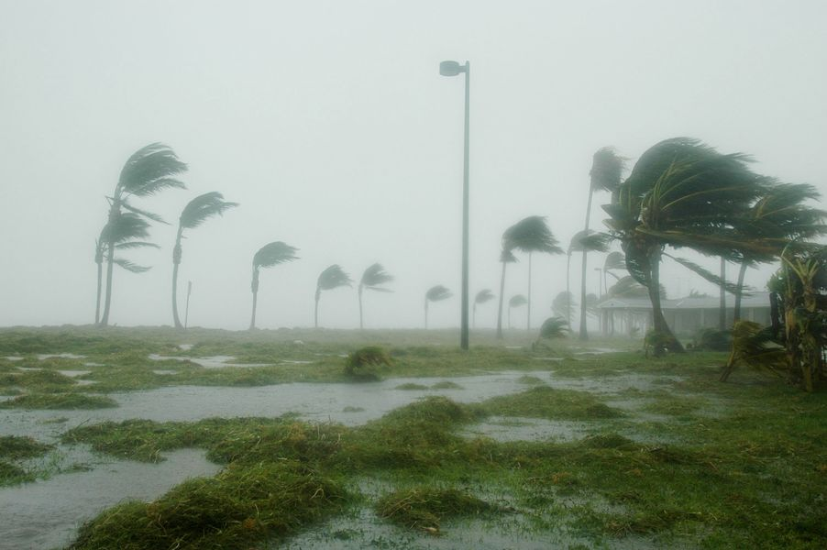
Windy weather
Strong winds on roads can be dangerous as they can blow vehicles off the road.
Wind highly affects the following road users:
High-sided vehicles
Vehicles towing caravans or trailers
Motorcycles
Bicycles
Therefore, pay attention when there are strong winds, and allow these road users extra room when you are passing or overtaking them.
This is because the wind can blow them off the road or in front you.

Slide 18
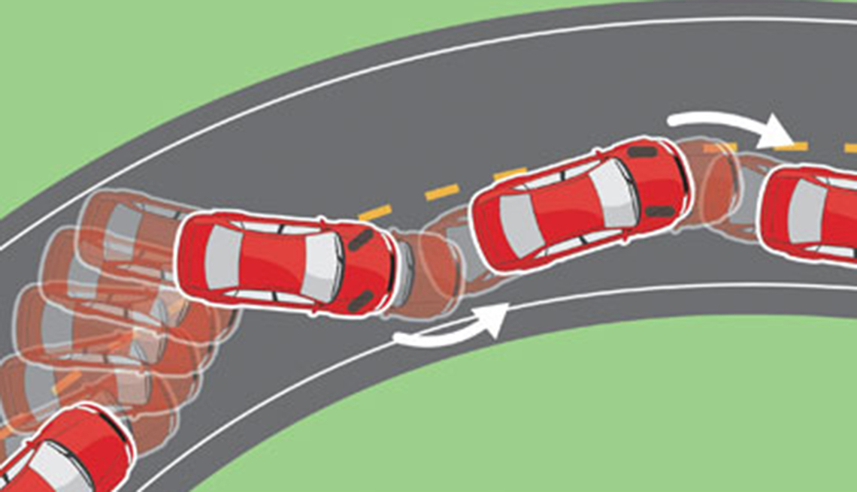
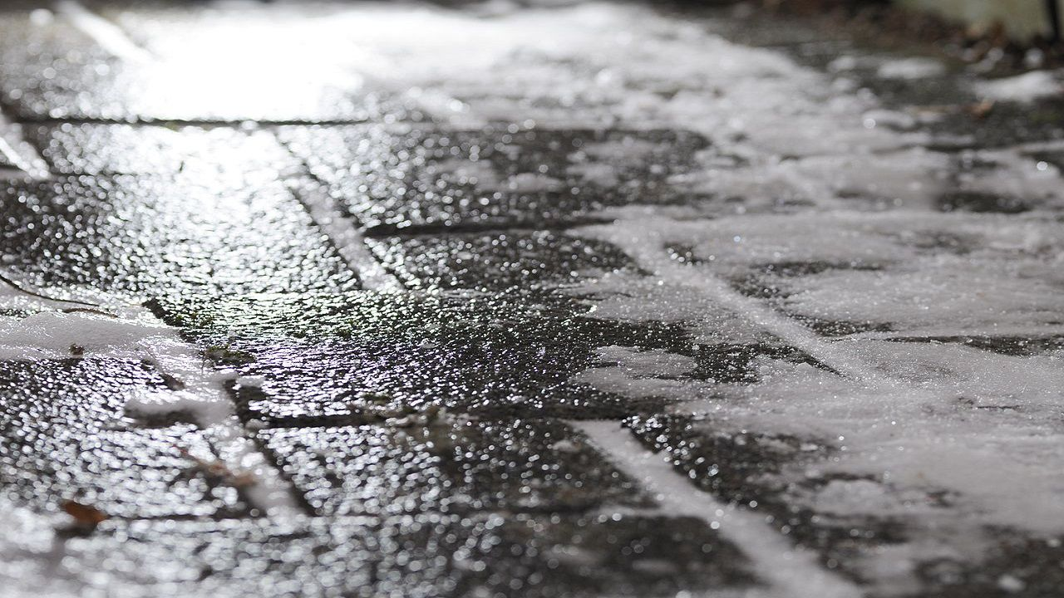
Skidding
Skidding is when your vehicle slides on the road when the road is slippery, or when you stop too quickly.
However while the condition of the road surface and tyres can make skidding more likely, skidding is mainly caused by the driver.
Skidding happens because of how the driver steers, accelerates, brakes and the speed they are driving at. This means the driver is responsible.
The risk of skidding get higher when the road is wet or icy.
In very cold weather, black ice (ice that you cannot see) can be hard to notice until you start driving on it. For example, when driving on ice, the steering will feel lighter.
Skidding
Black Ice

Slide 19
Skidding
In order to reduce the risk of skidding in wet or icy conditions:
Reduce your speed
Drive in the highest gear you can use
Also, you may start to skid if you brake too hard on wet or icy conditions. If this happens:
Remove your foot from the brake pedal, then gently press down again.
Steer in the direction of the skid. For example, if the back of the car skids left, steer the steering wheel to the left
By paying attention to the road ahead, you will be able see whether the road ahead is dangerous or not.
Remember to look out for road signs and markings, and signs from other road users (for example if they are slowing down, this may mean there is a danger ahead).
This can give you time to prepare for the hazard and plan your driving.

Slide 20
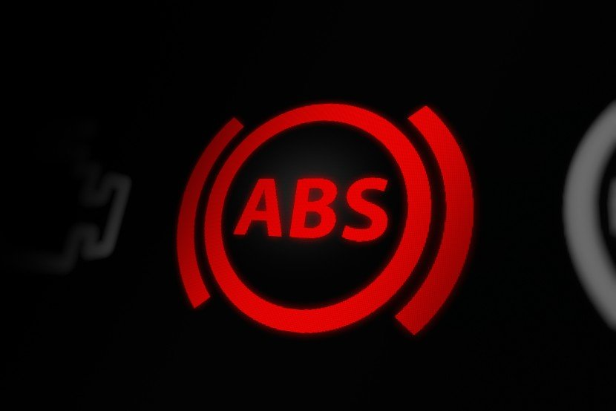
Anti-lock braking system
ABS is a system which prevents the wheels from locking, or stopping, in order to avoid a skid while braking.
ABS allows you to break and steer at the same time.
When braking suddenly in a vehicle with ABS:
Press down on the brake pedal quickly and firmly.
Keep the brake pedal pressed down until the vehicle has come to a stop.
Anti-Lock Braking System is most effective to stop you from skidding when the weather conditions are dry.
The Anti-Lock Braking System light

Slide 21
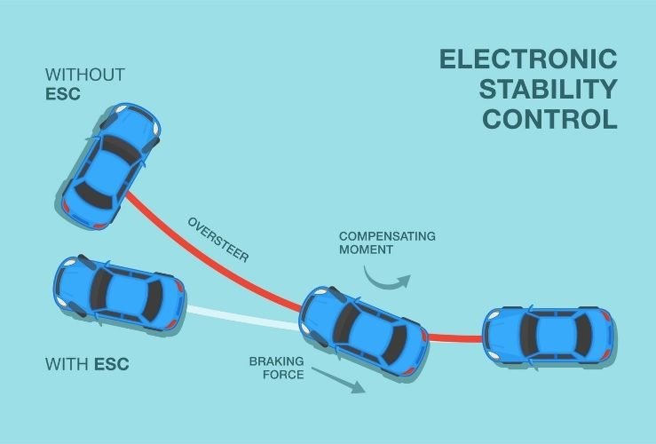
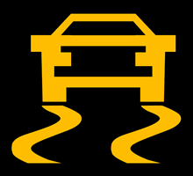
Electronic Stability Control
Electronic stability control (ESC) allows the driver to turn the vehicle whilst keeping the vehicle under control.
ESC uses wheel sensors to prevent your car from skidding or slipping sideways.
But even with ESC, there is a risk of the driver losing control if the driver is going too fast.
This means it is still the role of the driver to make sure that they can stop in time.
ESC is mainly to prevent your vehicle from skidding sideways. It is useful because it will:
Activate when the vehicle is about to skid.
Can help stabilise or keep your car under control if it starts to skid.
All new cars in the UK are now fitted with ESC.
If you see this symbol light up in your car whilst driving, this means the Electronic Stability Control has been activated.

Slide 22
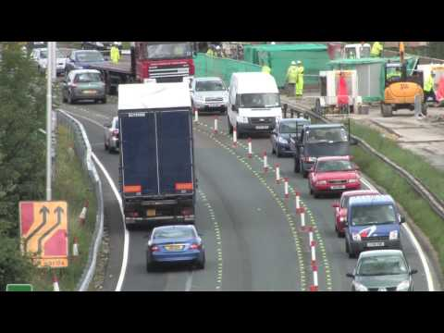
Contraflow systems
Contraflow system is when traffic in one or more lanes is going in a direction that is different from the rest of the carriageway.
This is another example of when road conditions are different from normal.
When entering a contraflow system:
Slow down in good time
Use the appropriate lane by paying attention to road signs.
Always maintain a safe safety margin or separation distance from the vehicle ahead of you

Slide 23
Practice questions
Safety margins test (with hints) - Highway Code Tests

