Slide 1
Rules of the Road
Topic 9

Slide 2
Speed Limits
Speeding or going over the speed limit is dangerous.
Always pay attention to the speed limit. Remember, if you see no speed limit, then you must follow the national speed limit.
The national speed limit for cars and motorcyclists is…
60mph on a single carriageway road.
70mph on a dual carriageway or motorway.
50mph on a single carriage way road when towing a trailer/caravan.
60mph on a dual carriageway or motorway when towing a trailer/caravan.

Slide 3
Speed Limits:
Remember, if you don’t see a speed limit, then there are other ways to know what the speed limit might be.
For example, if you are driving near an area with street lights, then the national speed limit in that area will be 30mph for all vehicles unless there is a speed limit sign that tells you what the speed limit is.
No matter what the speed limit is, remember to use your judgement. For example…
if the road is wet after it has been raining, then drive at a lower speed.
If there are parked cars and small space, then drive at a lower speed.
This is because pedestrians or children may suddenly walk onto the road and you might not have enough time to stop if you are driving too fast.
Some cars might move onto the road suddenly.
Some passengers might open their doors and if you are driving too fast, you might hit their door.
Also, there might me ‘temporary speed limits’ in areas where there are road works. These speed limits MUST be followed and are put in place by the police.

Slide 4
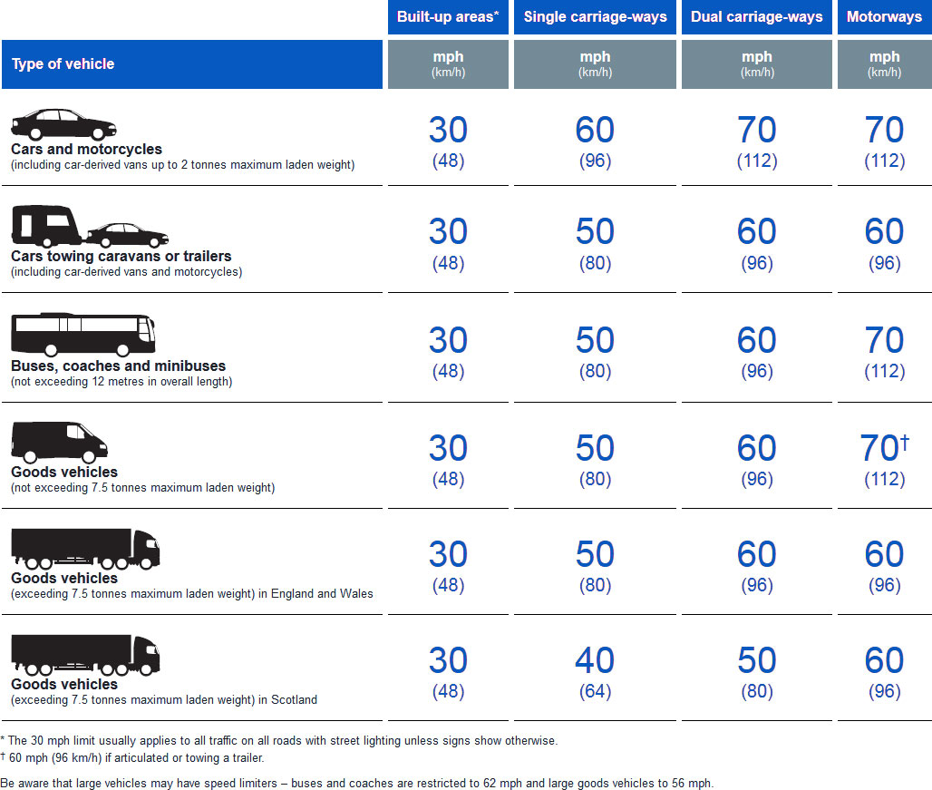

Slide 5
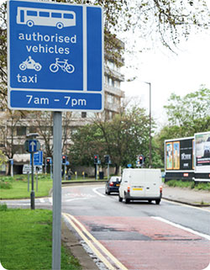
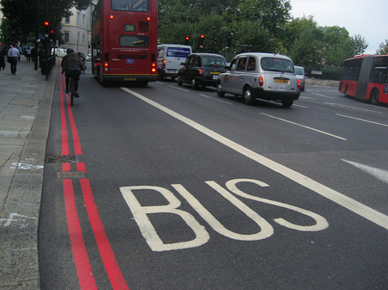
Lanes and Junctions
Sometimes roads have lanes that are marked by signs and road markings. These signs and road markings might be for specific vehicles. For example, the road might only be for cars, buses, or cyclists.
These signs should display their hours, or how long these vehicles can use that road for, and when you can or cannot drive on it.

Slide 6
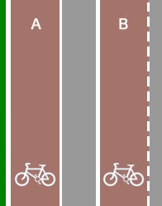
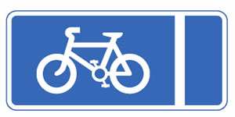
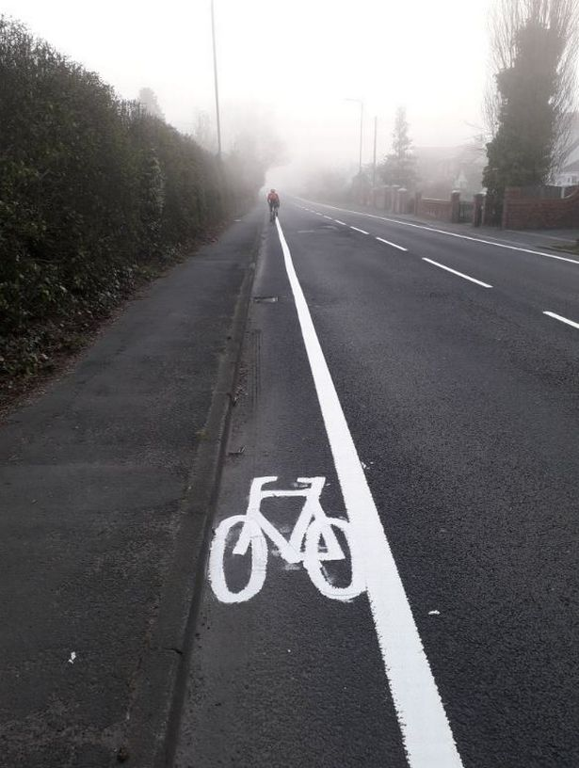
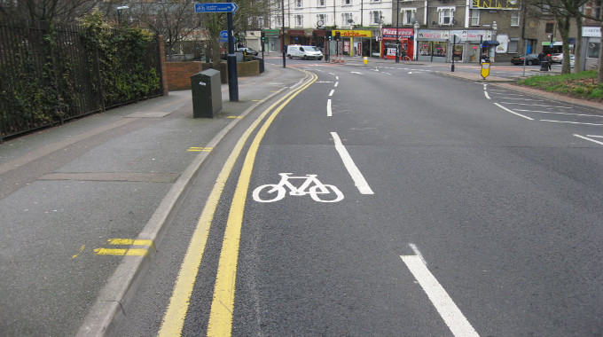
Lanes and Junctions
Cycle lanes are marked by a solid white line meaning you should never drive in that line during the hours mentioned (if they are mentioned).
If a cycle lane is marked by a broken white line, you should never drive in that lane unless it is unavoidable.

Slide 7
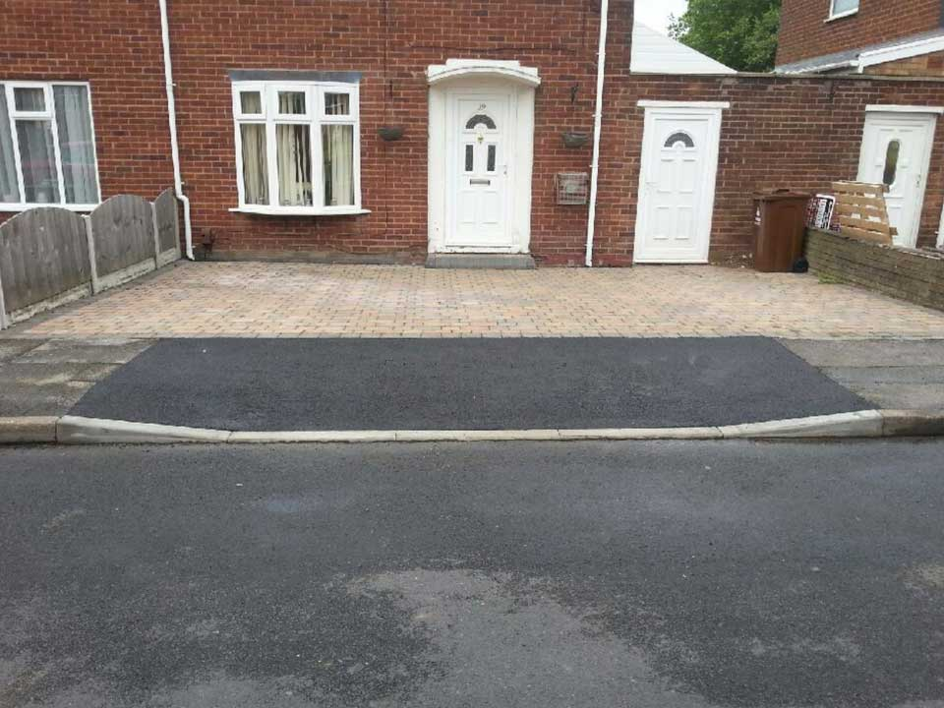
Lanes and Junctions
Footpaths – You should only drive on a footpath/pavement when it is needed to reach your house/property. These footpaths should have a dropped curbs.

Slide 8
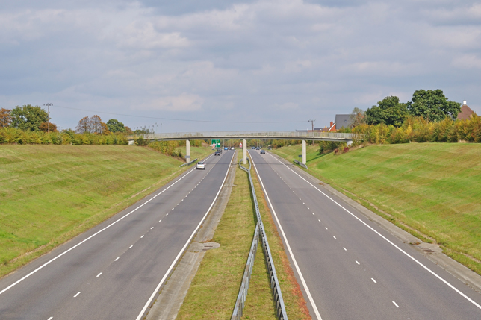
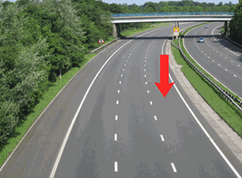
Lanes and Junctions
Dual-carriage or three-lane dual carriageways – Remember the right-hand lane is only for turning right or overtaking. Do not travel in this lane.

Slide 9
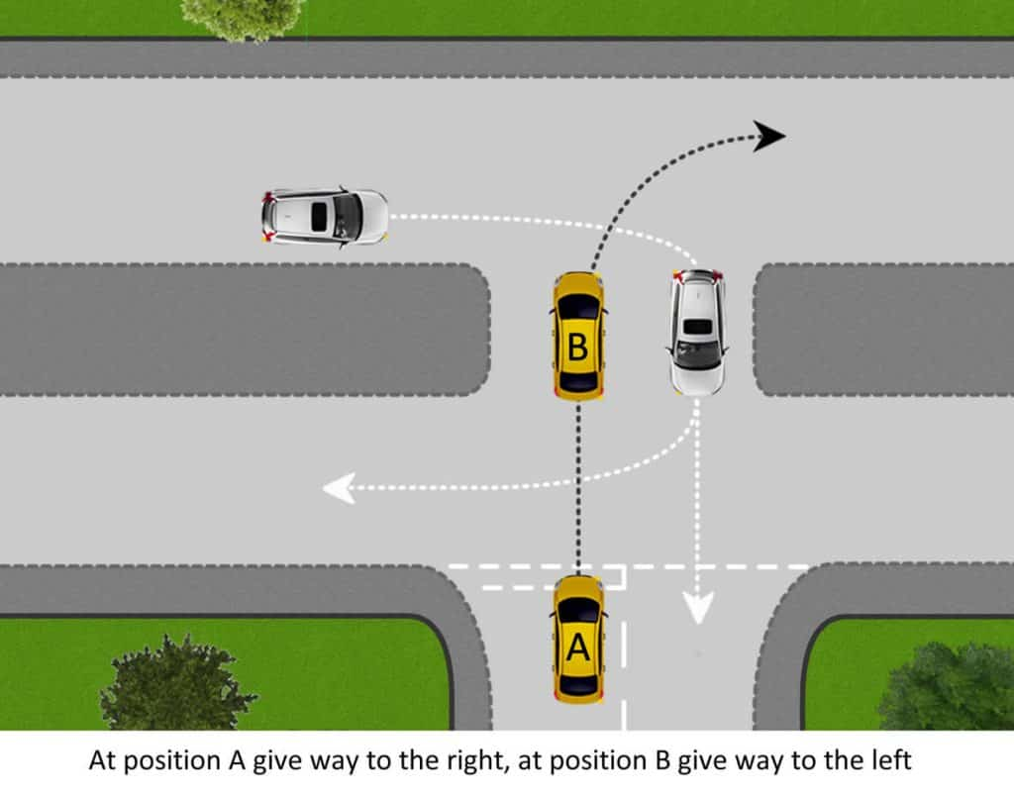
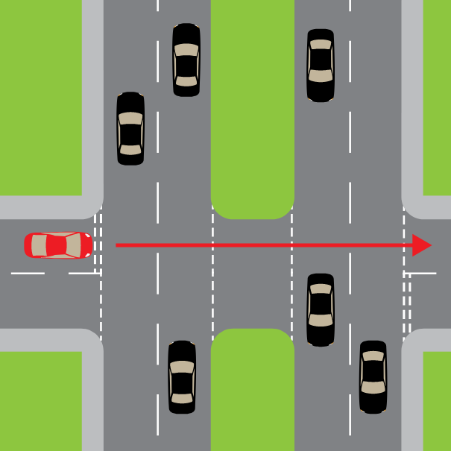
Lanes and Junctions
Dual Carriageways –
A Central reservation is the space between two roads.
If you wish to turn right onto a dual carriageway that has a central reservation, you should first check that your vehicle big or small enough to fit in it.
If it’s too long to fit the length of your vehicle, you should wait until the road is clear in both directions before emerging. Otherwise, you might obstruct (Stop) traffic coming from your right if your vehicle is too long.

Slide 10
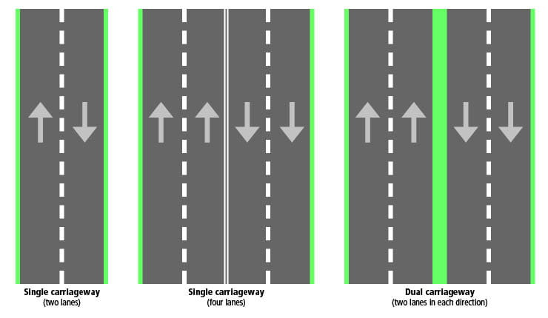
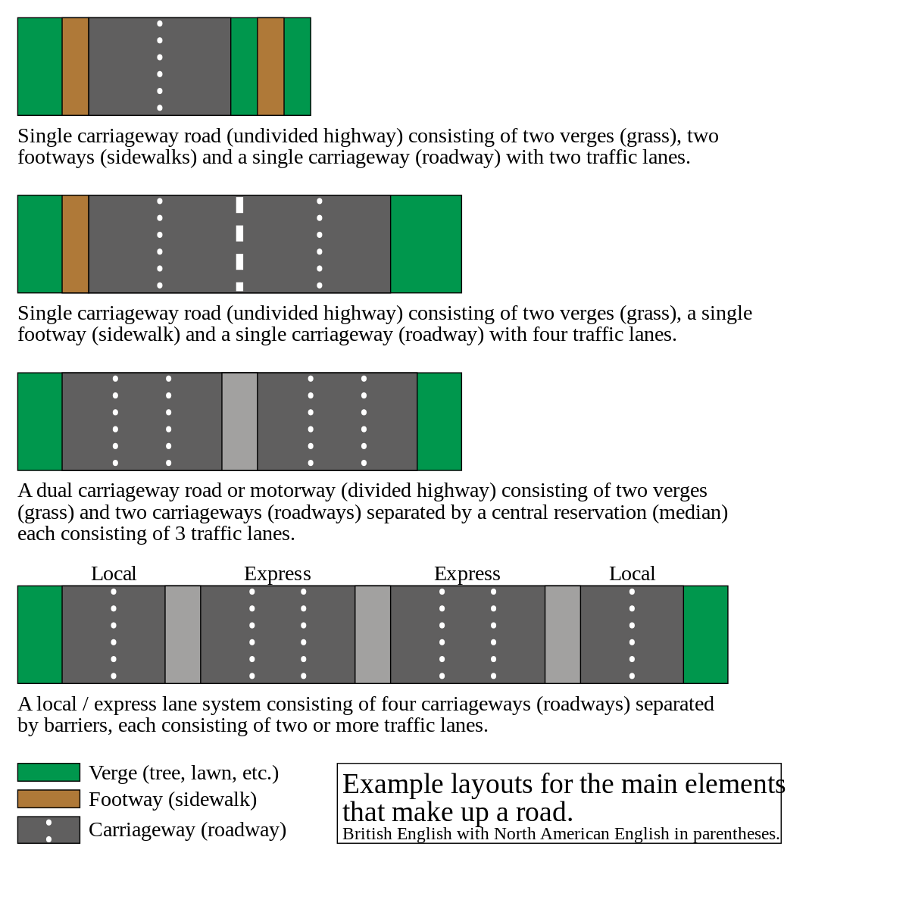

Slide 11
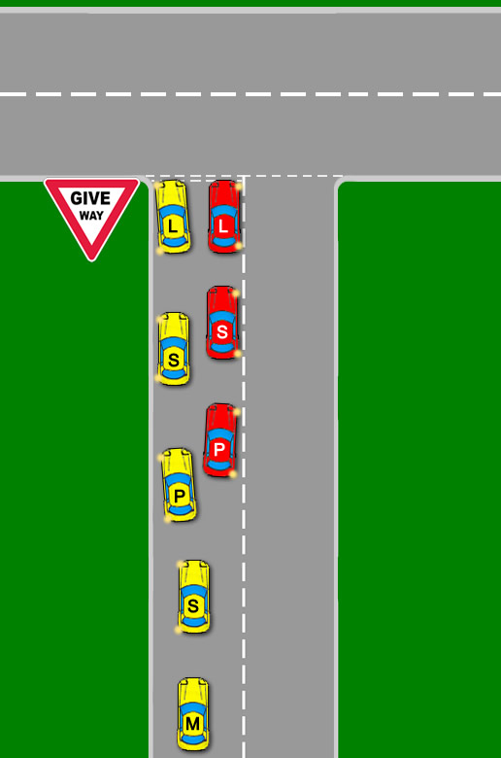
Junctions:
You should always be careful at Junctions and move into the correct position at the right time.
If you are turning left, move slightly to the left of your lane.
If you are turning right, move slightly to the right of your lane.
Remember to wait until it is safe to drive off.
Remember to check for cyclists using both your mirrors.

Slide 12
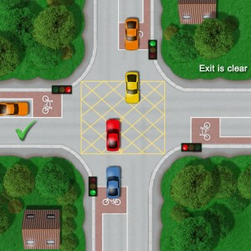
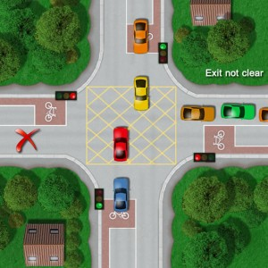
Box Junctions
A box junction is marked by yellow hatched lines.
You should only enter a box junction if your exit is clear/safe.
If your exit is not clear you should stay back and wait on your side of the junction. If you are waiting for a gap in oncoming traffic before turning right, you may enter the junction.
You will be fined if you wait in the box and your exit is not clear as you will be blocking traffic.

Slide 13
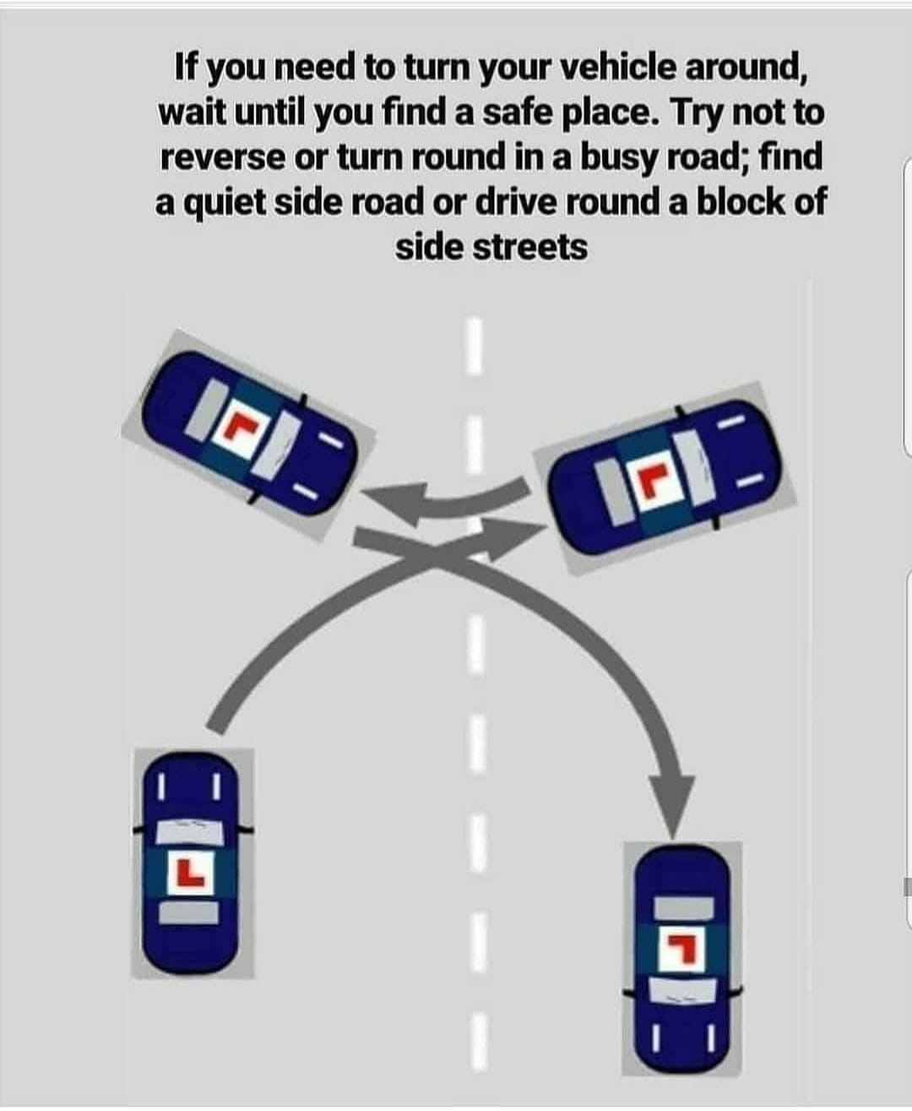
What if you drive in the wrong direction when it is busy?
If you drive in the wrong direction of a busy road, you should continue driving in that road until you find somewhere safe and quiet to turn around (like a quiet side road).
Never attempt to reverse or do a U-Turn.

Slide 14
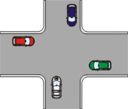
Crossroads
If there aren’t any signs or markings at the crossroads then no one has priority. This has the potential to be dangerous so you should check very carefully in all directions and use all of your mirrors.
But, usually it is ‘first come first serve’, so who ever entered the crossroad first, gets to move first.

Slide 15
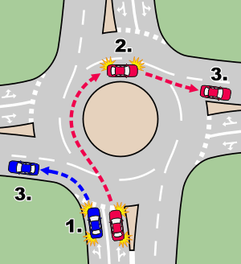
Roundabouts
If you are turning before 12 o’clock, stay on the left side of your lane, and Signal left just after you pass the exit before the one you will take
If you are turning after 12 o’clock, stay on the right side of your lane, signal right, and then Signal left just after you pass the exit before the one you will take, then move into left lane.
Pay attention to the road signs.
Remember to choose the correct lane for the exit you want to leave.
Remember to signal/indicate in good time.
You should signal just before you leave the roundabout.
If you are going straight ahead on the roundabout, you do not need to signal.
Be prepared for: cyclists and horse riders staying in the left-hand lane even if they’re turning right
Also be prepared for long vehicles as they will need more of the road.

Slide 16
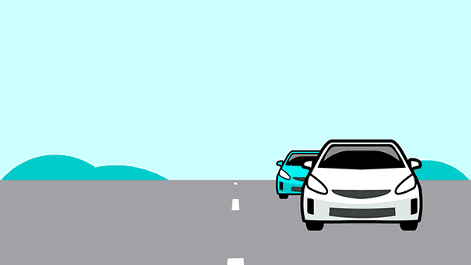
Overtaking
Overtaking should only be done when it is completely necessary and safe
If you’re overtaking on a dual carriageway, you must take extra care and be aware that the right-hand lane can also be used by traffic turning right.

Slide 17
Reversing
Reversing is dangerous, and you should never reverse from a major road into a side road, or reverse for a long distance.
Before you start to reverse you should be completely sure that it is safe. If you’re not, then get out and check before you start reversing.

Slide 18
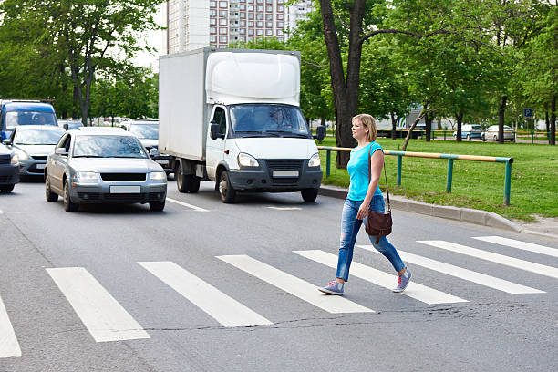
Pedestrian crossings - Zebra crossings
Zebra Crossing – You need to stop and wait if somebody is at the zebra crossing preparing to cross, as long as it is safe to do so.

Slide 19
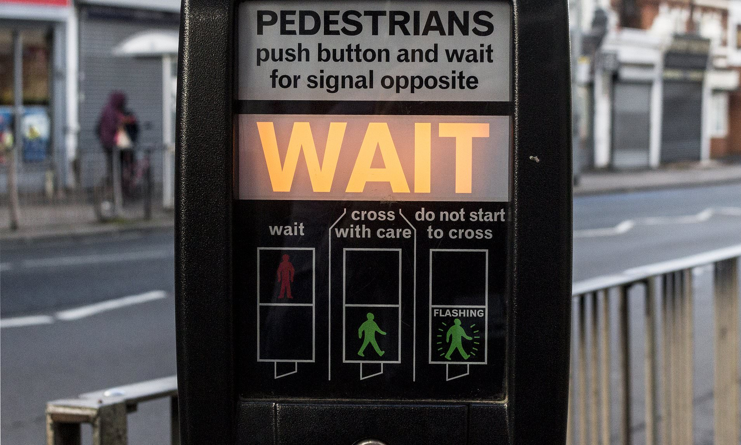
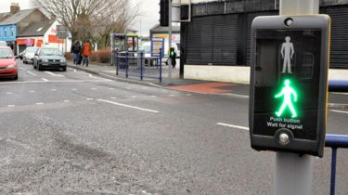
Pedestrian crossings – Pelican crossing
When the red light changes to flashing amber, on a pelican crossing you must wait for any pedestrians to finish their journey crossing the road before you move off.
Pelican crossings are controlled by somebody pressing a button on the side of the road.

Slide 20
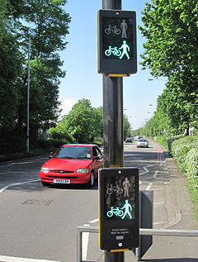
Pedestrian crossings – toucan crossings
Toucan crossings are similar to pelican crossings, but at toucan crossings, cyclists are also allowed to cycle across at the same time as pedestrians.

Slide 21
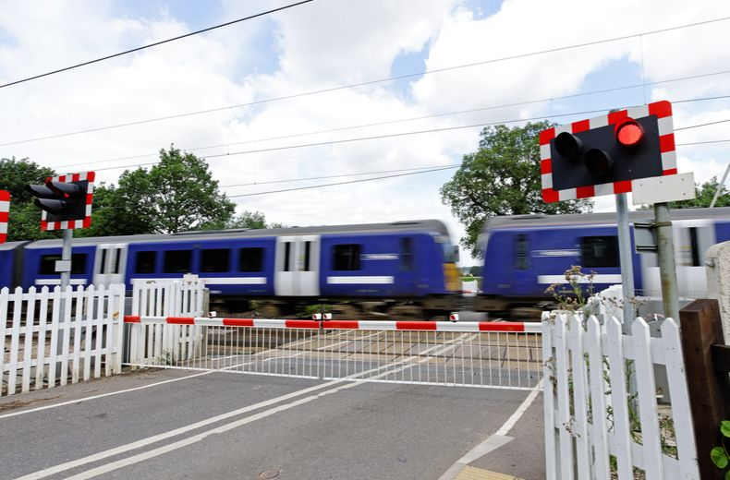
Level crossings
Level crossings are there where there is a railway line and oncoming train.
Some level crossings have traffic-light signals with twin flashing red lights.
Crossings sometimes have barriers present but not always, so you should be careful.
You should stop behind the crossing when it has a steady amber light.
Also, stop behind the crossing when it has twin flashing red lights.

Slide 22
Level crossings – What if?
What If- you’re approaching the crossing and the warning lights come on.
You should – Stop as red lights must always be obeyed by law.
What If - warning lights come on or a bell rings when you’re already on the crossing?
You should - Keep driving and clear the crossing.
What If - The train has passed but the red lights keep flashing when you’re at a level crossing.
You should – Wait as tt is extremely dangerous to move as there might be another train coming.
You should be aware that not all types of level crossings have lights, such as crossings with user-operated gates or barriers and open crossings. You should be extra careful at all types of level crossing

Slide 23
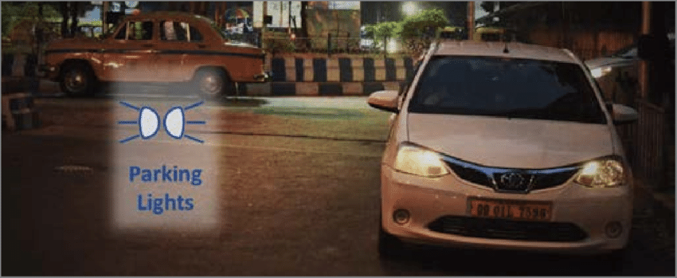
Stopping and Parking
You should always make sure that you’re in a safe and legal place to park before stopping.
If you wish to park at night, you should park in a garage.
If you don’t have a garage you should try to find a secure car park or park in a well-lit (area with lights) area. This is to prevent thieves.
You MUST leave your parking lights on if the speed limit on that road is over 30 mph and you’re parking at night. This is to make sure other road users can see you.

Slide 24
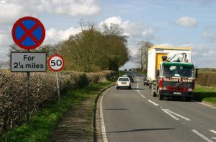
Stopping and parking
A Clearway – Is a road or street where stopping is prohibited
NEVER stop on a clearway. You are only allowed to drop off and pick up passengers if you are on an urban clearway.
If a road is marked with double white lines you may only stop there to pick up or drop off items, or pick up or drop off passengers.

Slide 25
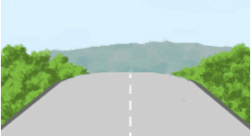
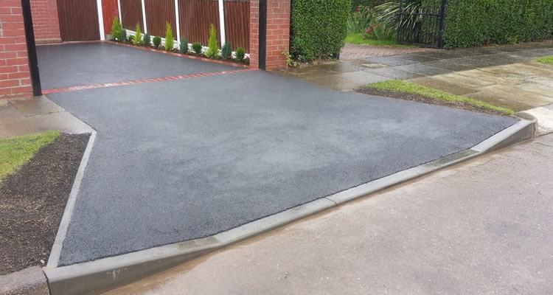
You should never park if you could cause danger or get in the way of other drivers.
Remember do not park:
In front of someone else’s driveway or in front of the entrance to somebody else’s house/property
Near a school entrance
Opposite or within 10 metres (32 feet) of a junction.
At or near a bus stop
Near the middle of a high hill.
Parking here can make it hard for drivers to see if it’s safe to pass or not
At a dropped kerb.
Parking here will make it harder for wheelchair and mobility scooters from getting onto the road or pavement.

Slide 26
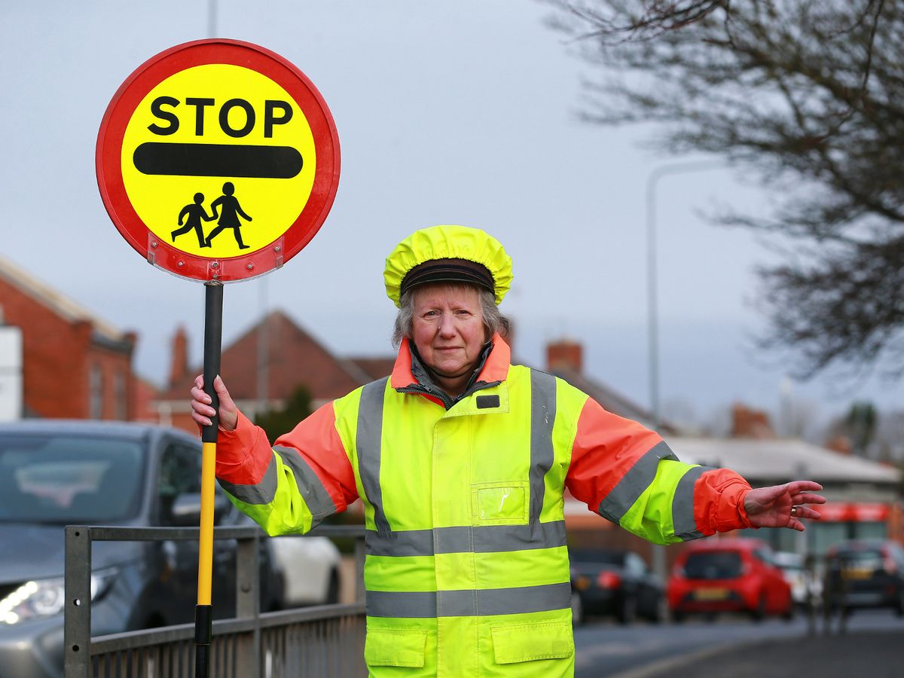
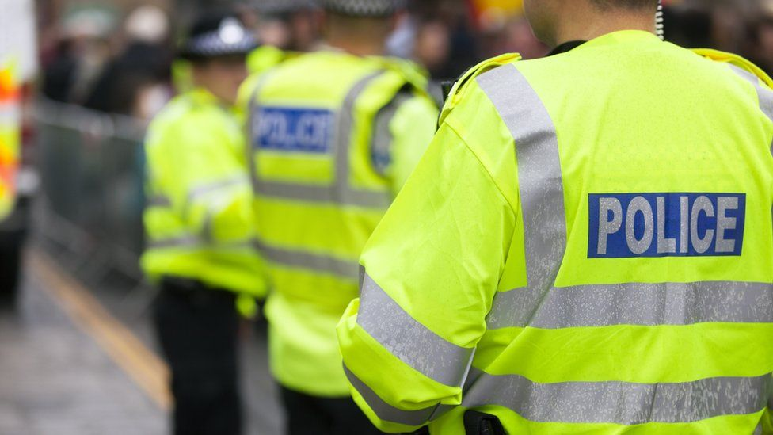
Stopping and parking
You MUST stop, by law, if you:
Have been involved in a road traffic incident or accident
Are at a red traffic light
Have been signalled to do so by a police officer, traffic warden, Driver and Vehicle Standards Agency (DVSA) officer, traffic officer or school crossing patrol (a ‘lollypop lady’).

Slide 27
Practice!
Rules of the road test (with hints) - Highway Code Tests

