Slide 1
Driving Theory Workshop
Topic – 10 – Vulnerable Road Users PART 1

Slide 2
Vulnerable Road Users
We need to understand:
That there are different types of people who use the road.
Different people have different needs on the road.
Some are more vulnerable on the road (more likely to be unsafe when driving).
This means we have to drive in a way to suit everyone’s needs. To make sure everyone is safe.
This section will cover:
Which road users are ‘vulnerable’?
How can we keep other road users safe?

Slide 3
Vulnerable road users.
What is a vulnerable road user?
A vulnerable road user is someone who is more likely to be unsafe when driving. For example, more likely to be involved in an accident.
Who might be a vulnerable road user?
Old people
Those with a disability
Learner drivers
Cyclists
Motorcyclists
Horse riders
Why might these road users be vulnerable?
They are smaller in size
They travel at different speeds
They may have slower reactions
They are unpredictable

Slide 4
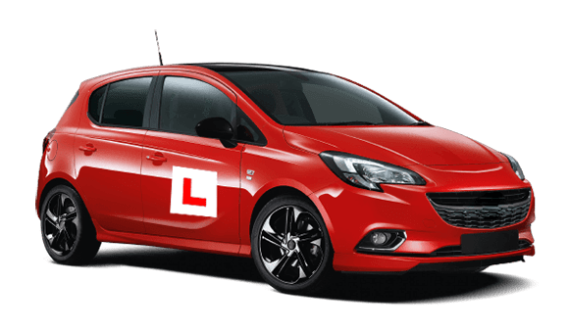
Vulnerable road users: Learner Drivers and Newly Qualified Drivers
Learner drivers are likely to make many mistakes because they don’t have much experience.
They may drive too slow or stall (stop suddenly by accident because the engine doesn’t have enough gas).
Remember you need to be kind, patient, and ready to slow down or stop if a learner makes a mistake.

Slide 5
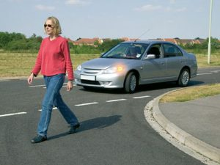
Vulnerable road users: Pedestrians
Pedestrians are vulnerable because they have no protection.
When you see a pedestrian about to cross the road, or if they have already started crossing the road, REMEMBER TO BE PATIENT AND WAIT FOR THEM TO FINISH CROSSING THE ROAD.

Slide 6
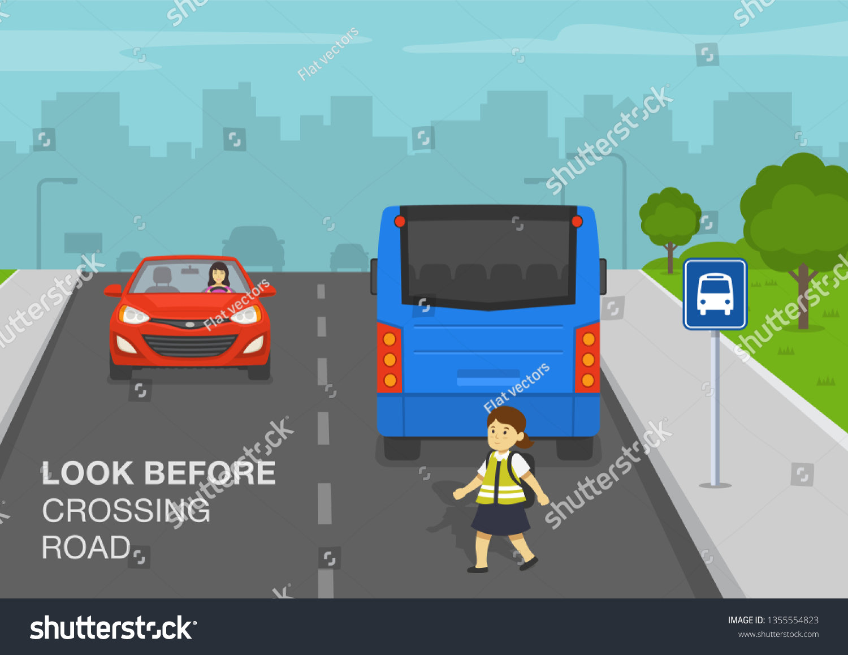
Vulnerable road users: Buses carrying pedestrians
If a bus has stopped on the other side of the road, you should be careful and try to see if there are…
Any pedestrians who might come from behind the bus and cross the road you cannot see.
Any pedestrians who might run across the road to catch the bus.
Therefore, when driving near a bus, be extra careful and look for any hidden pedestrians

Slide 7
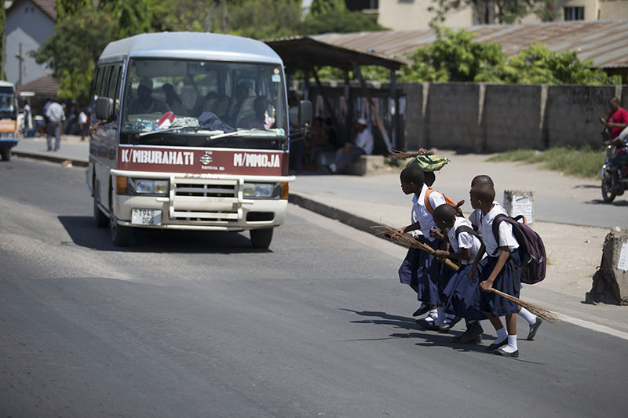
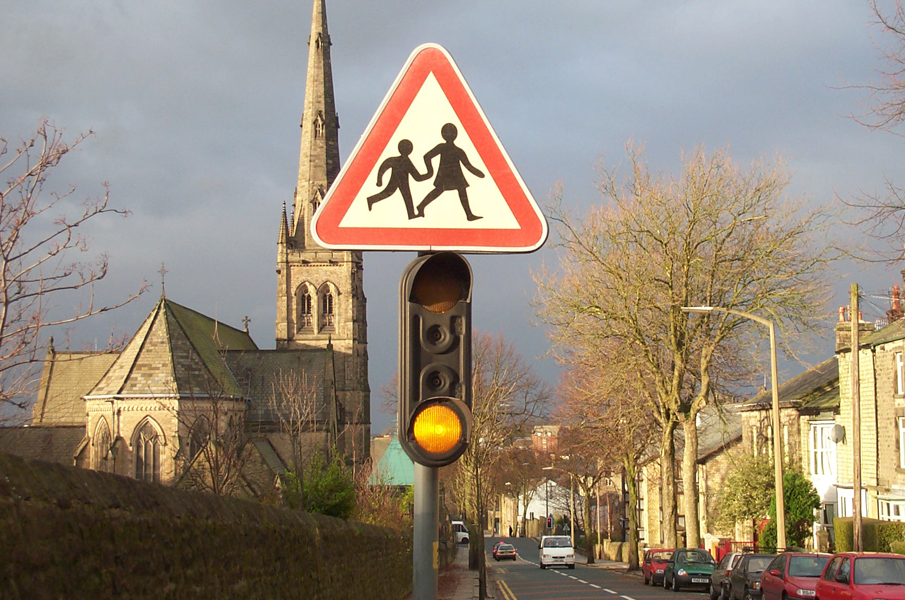
Vulnerable road users: Children
Children are vulnerable when crossing the road. This is because they can be:
Unpredictable – You don’t know what they will do!
They are less likely to look before crossing the road.
They can be easily distracted or not pay attention.
Pay special attention to children, especially near schools.
When driving near a school, you may see a school warning sign
A ‘school warning sign’ may have flashing amber lights
This is to warn you that children are in the area and likely to be crossing the road to or from school.
You should slow down until you are clear from the school.

Slide 8
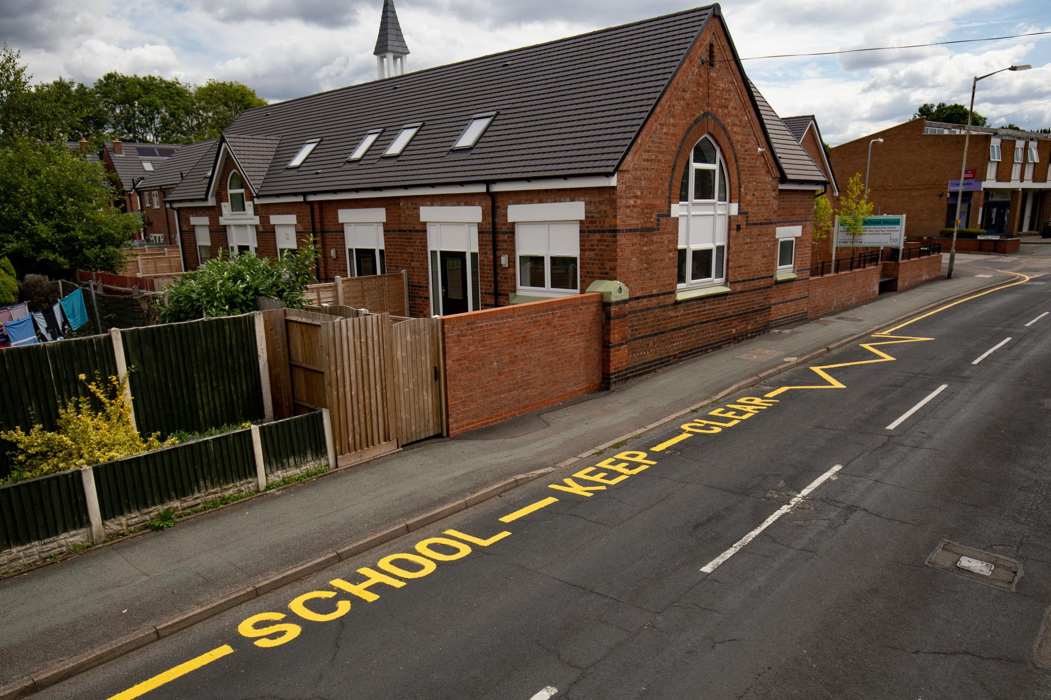
Vulnerable road users: children
Schools may also road markings
For example, you may see yellow zigzag lines outside a school.
This means you SHOULD NOT WAIT OR PARK on the yellow zigzag lines outside a school.
This is so drivers and pedestrians can see the road clearly, and children can cross safely.

Slide 9
Vulnerable road users: Children
Some pedestrian crossings near schools having a school crossing patrol or ‘lollypop lady’ at peak times.
They will stop the traffic by stepping out into the road with a stop sign. You should be prepared for the signal and MUST obey it.

Slide 10
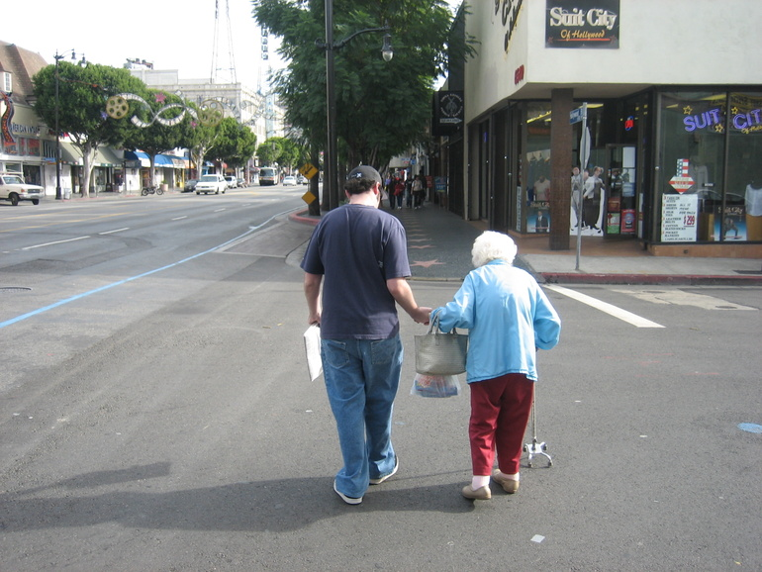
Vulnerable road users: Older and Disabled Pedestrians
Older people on the road are vulnerable as they might have slower reactions.
When you see an elderly person about to cross the road be careful as they might have misjudged your speed or distance.
Misjudged means an opinion or thought that is WRONG.
Remember to give older people extra space and extra time to cross the road safely.

Slide 11
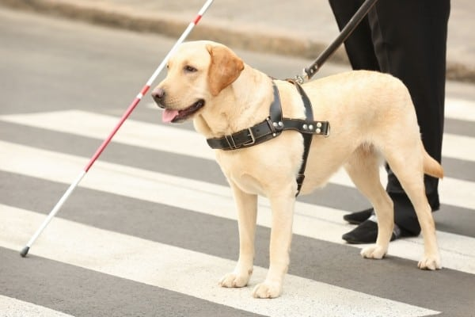
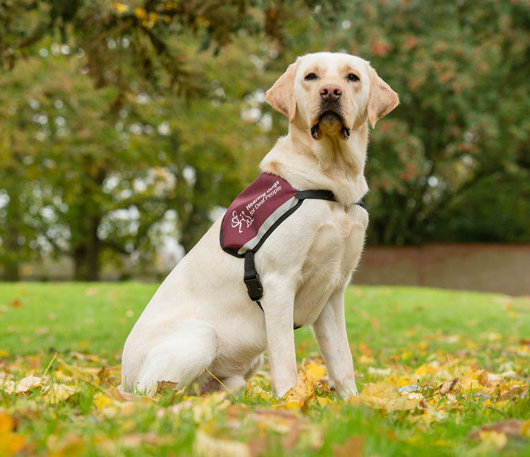
Vulnerable Road Users: Older and Disabled pedestrians
Older people are more likely to have certain disabilities. These are some signs to tell you if they have a disability.
A person who is blind may have a white stick or guide dog.
A person who is both deaf and blind may be carrying a white stick with a red band, and may also have a guide dog with a red and white checked collar.
A person with hearing problems may have a dog with a yellow or burgundy coloured coat.
When you see these signs, remember that someone might have a disability and be extra careful.

Slide 12
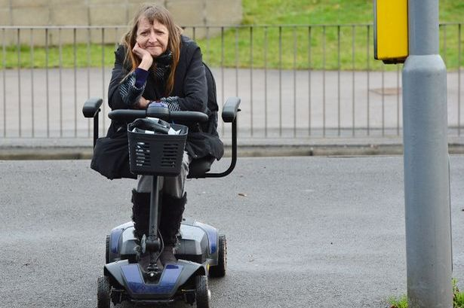
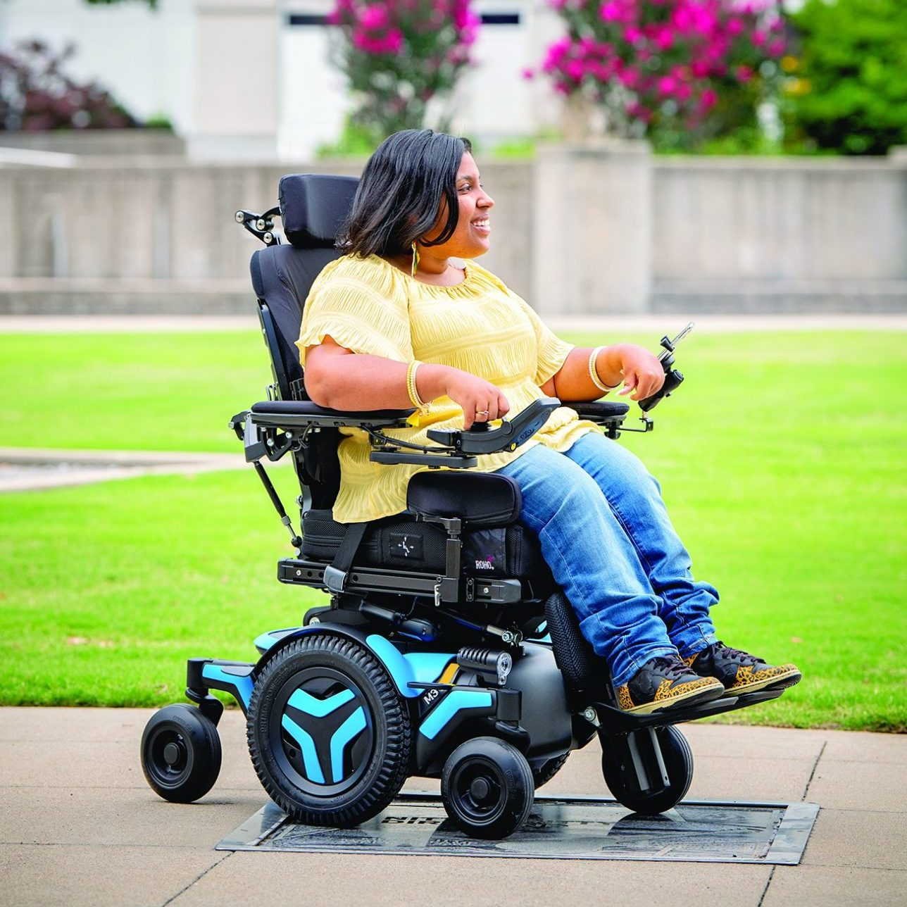
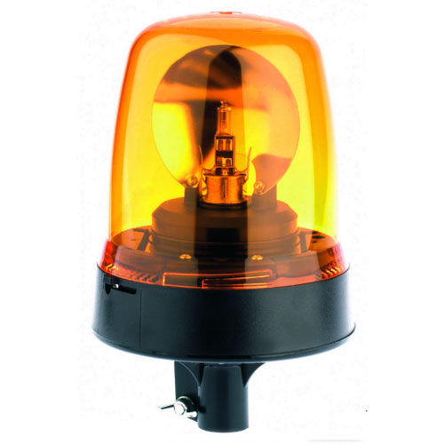
Vulnerable Road Users: Older and Disabled pedestrians
A slow-moving vehicle might have a flashing amber beacon on top of it.
This is usually seen on a powered wheelchair or a mobility scooter used by a disabled person.
They have to use this amber light if they are driving on a dual carriage way with a speed limit that goes over 50mph.

