Slide 1
Driving Theory Workshop
Topic – Motorway rules

Slide 2
Motorway rules
The motorway rules theory test section covers all the driving theory that is needed for motorway travel.
This section aims to help and make you a safe motorway driver by teaching you about:
Road safety on the motorway
Motorway speed limits
Motorway studs
What to do if your car breaks down on the motorway

Slide 3
What to do if your car breaks down on the motorway?
Motorway driving means you have to be more alert as you are driving at higher speeds constantly, and you may need to change your route or react much more quickly than if you were travelling on a single carriageway.
In order to do this safely, you should check your vehicle thoroughly before starting a long motorway journey.
This includes making sure that your water, oil and petrol are all at suitable levels and that your tires are inflated safely.

Slide 4
What to do if your car breaks down on the motorway?
The following groups or vehicles cannot travel on the motorway:
Learner drivers without a registered driving instructor.
Bicycles
Motorcycles with power of under 50 cc
The majority of powered wheelchairs/mobility scooters
Agricultural vehicles
Some slow-moving vehicles
Pedestrians
Horse riders

Slide 5
Joining the motorway
Learning how to safely join a motorway is the first step to safe motorway driving. When you join a motorway you must:
Use the slip road to build up your speed to match the traffic already on the motorway before merging
Give way to traffic already on the motorway.
When you have joined the motorway it’s important to travel in the right lane. This is always the left-hand lane, regardless of what speed you’re travelling.

Slide 6
Joining the motorway
The middle and right-hand lanes are to be used only for overtaking other vehicles, and you must return to the left lane when you’ve finished overtaking.
You may see other drivers breaking this rule, but they are wrong and are driving dangerously. You shouldn’t overtake on the right unless traffic is moving slowly in queues and the queue on your right is moving more slowly than the one you’re in. In this instance, you may overtake on the left.
The flow of traffic along the motorway, particularly at busy times, is aided if you move from the left-hand lane to another lane when traffic is joining from a slip road. You should only do this if you’re able to do so safely.
If signals on the overhead gantries advise you to move over you should do so.

Slide 7
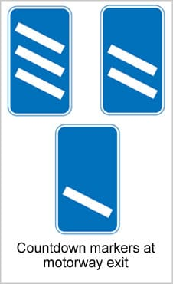
Exiting the motorway
Leaving the motorway safely is just as important as joining safely.
Countdown markers on the left-hand verge will warn you that you’re approaching the next exit.
You should join the left-hand lane in plenty of time if you wish to leave the motorway at the next exit.
You should NEVER reverse on the motorway. Instead, if you accidentally go past the exit you wanted, you should carry on to the next one.

Slide 8
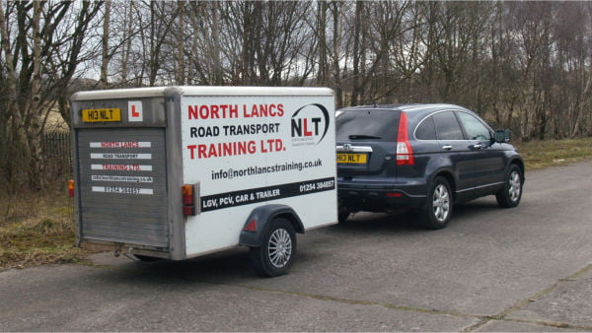
Motorway speed limits
For most vehicles travelling on the motorway the national speed limit applies.
70mph for cars and motorcycles.
This limit applies to all lanes except those with signs showing a lower speed limit, you must obey these.
These rules are different if your vehicle is towing a trailer. In that case, you must not:
Travel any faster than the speed limit of 60 mph.
Travel in the right-hand lane of a motorway with three or more lanes, unless there are lane closures

Slide 9
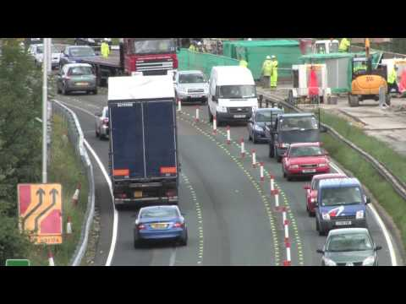
Motorway speed limits
Your hazard lights can be used to warn traffic behind you that the traffic ahead is slowing down or stopping suddenly.
Remember to switch them off as soon as following traffic has reacted to your signal.
Speed limits can change, particularly if you’re approaching roadworks.
You should keep alert to lower speed limits, particularly if there’s a contraflow system (where you travel in the opposite direction of the surrounding lanes) and you should:
Obey all speed limits
Keep a safe distance from the vehicle ahead.

Slide 10
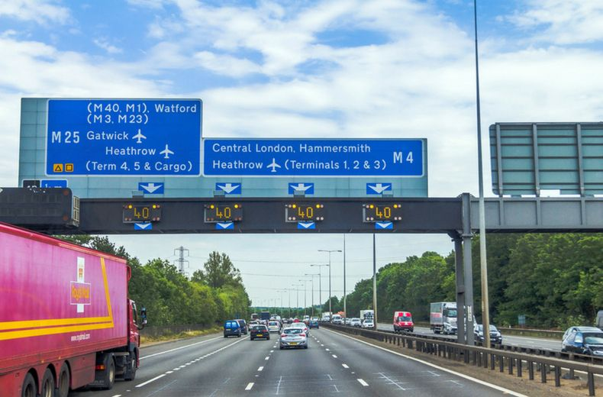
Motorway congestion
Keeping traffic flowing is important in making sure motorways work smoothly and safely.
‘smart motorways’ are one way of achieving this. They are known as Active traffic management (ATM).
Smart Motorways aim to reduce congestion and make journey times more short.
When these are in use, mandatory speed limit signs will show on the gantries (signs above the lanes). The speed limit helps to keep the traffic speed constant so that traffic is less likely to bunch up and journey times can be improved.
mandatory speed limit = the maximum speed at which you may travel
Speeds limits are not a target, they are the MAXIMUM speed at which you can legally travel, when it is safe to do so.
In ATM areas, the hard shoulder is sometimes used as a normal traffic lane. This will be clearly shown by a speed-limit sign being displayed above all lanes, including the hard shoulder.

Slide 11
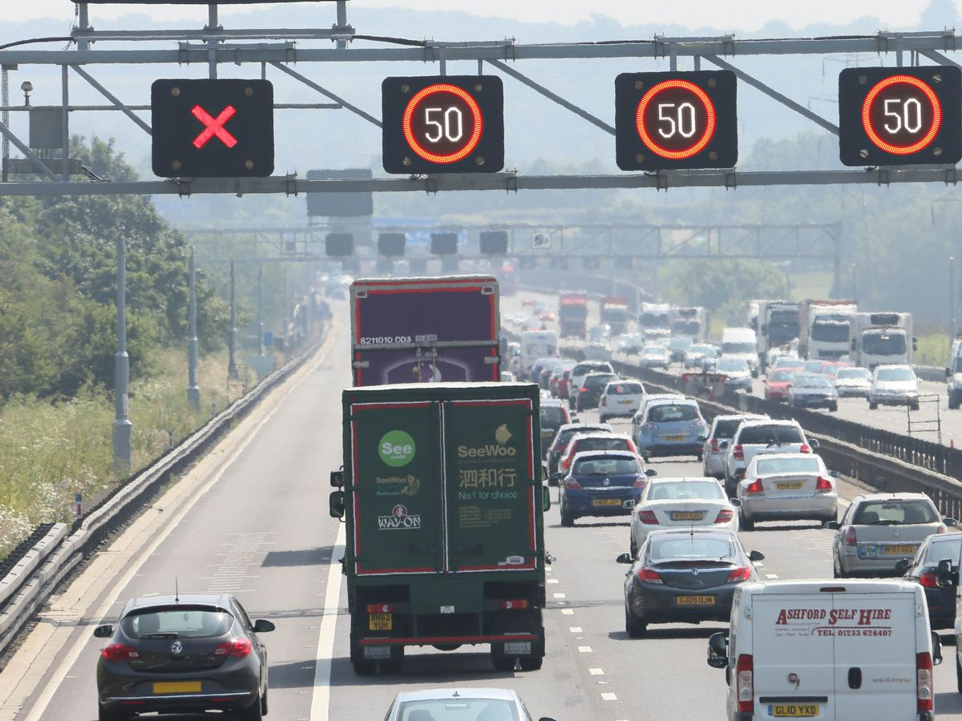
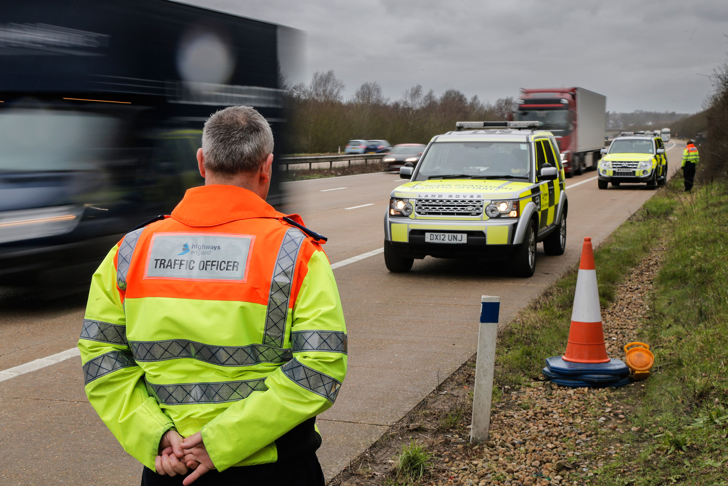
Motorway congestion
If a red cross is shown above the hard shoulder it means that you shouldn’t travel in this lane and it should be used only in an emergency or breakdown.
Emergency refuge areas have been built in these areas for use in cases of emergency or breakdown.
Apart from signs you can be told of changes to normal speed limits by traffic officers. They only operate in England and cover motorways.
They:
Can stop and direct anyone on a motorway.
Respond to calls made on roadside emergency telephones.
You must obey what a traffic officer tells you.

Slide 12
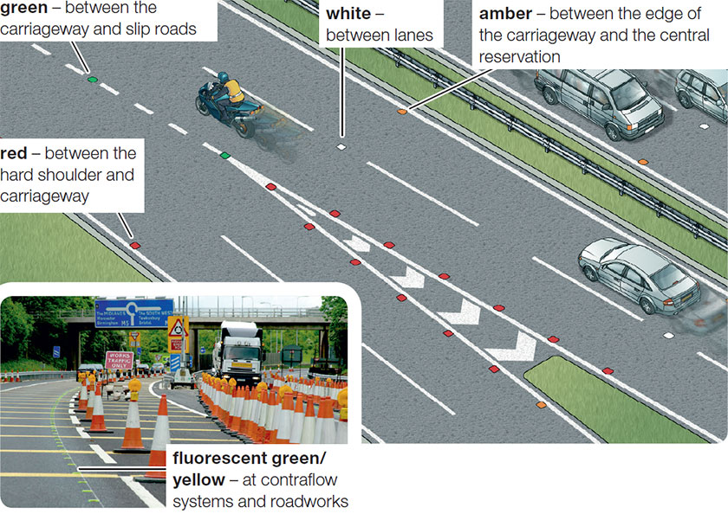
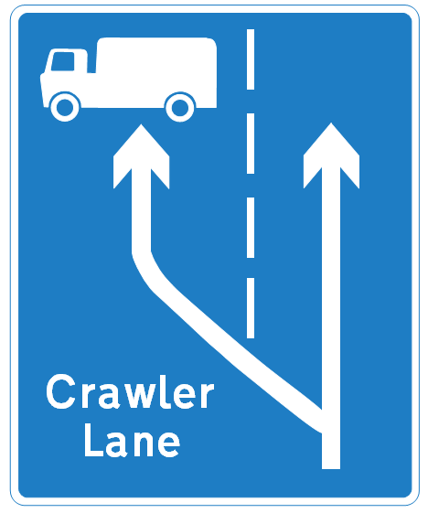
Motorway reflective studs
As well as signs above the lanes, you should look to the ground for information.
Motorway reflective studs help you to see where you are on the carriageway. This is particularly helpful at night or in fog.
Different colours are used in different places as the diagram demonstrates.
Where the motorway goes uphill steeply, there may be a separate lane for slow-moving vehicles, known as a crawler lane. This helps the faster-moving traffic to flow more easily and will be signposted.

Slide 13
What to do if your car breaks down on the motorway?
Stopping on the motorway can be extremely dangerous, they are designed to keep traffic moving, so you must not stop unless it is absolutely necessary.
Only stop on the motorway if:
There are red flashing lights above every lane
You’re told to do so by the police, Driver and Vehicle Standards Agency (DVSA) officers or traffic officers
You’re stuck in a traffic jam
You have an emergency or breakdown.
If there are any other reasons which require you to stop, such as to have a rest, make a phone call or look at a map, you should either leave at the next exit or go to a service area.

Slide 14
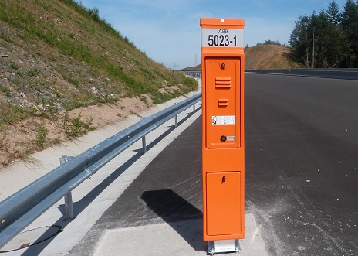
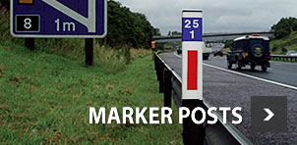
What to do if your car breaks down on the motorway?
Motorway emergency telephone
If you are in a situation where your vehicle breaks down or a tyre puncture you should try to get onto the hard shoulder and call for help. Use one of the emergency telephones if you’re able to. These are:
Normally they are one-mile apart from each other
Marker posts at 100-metre distances point you in the direction of the nearest phone
Connected directly to a control centre, where the operator will deal with your call and direct the appropriate services to help you.
You should stand facing the oncoming traffic if you need to use the emergency telephone. This is so that you can see any hazards approaching – for example, the noise from a large vehicle driving past could take you by surprise.
If you decide to use your mobile phone instead of the emergency telephone you should make a note of your location (the number on the nearest marker post) before you make the call and give this information to the emergency services.

Slide 15
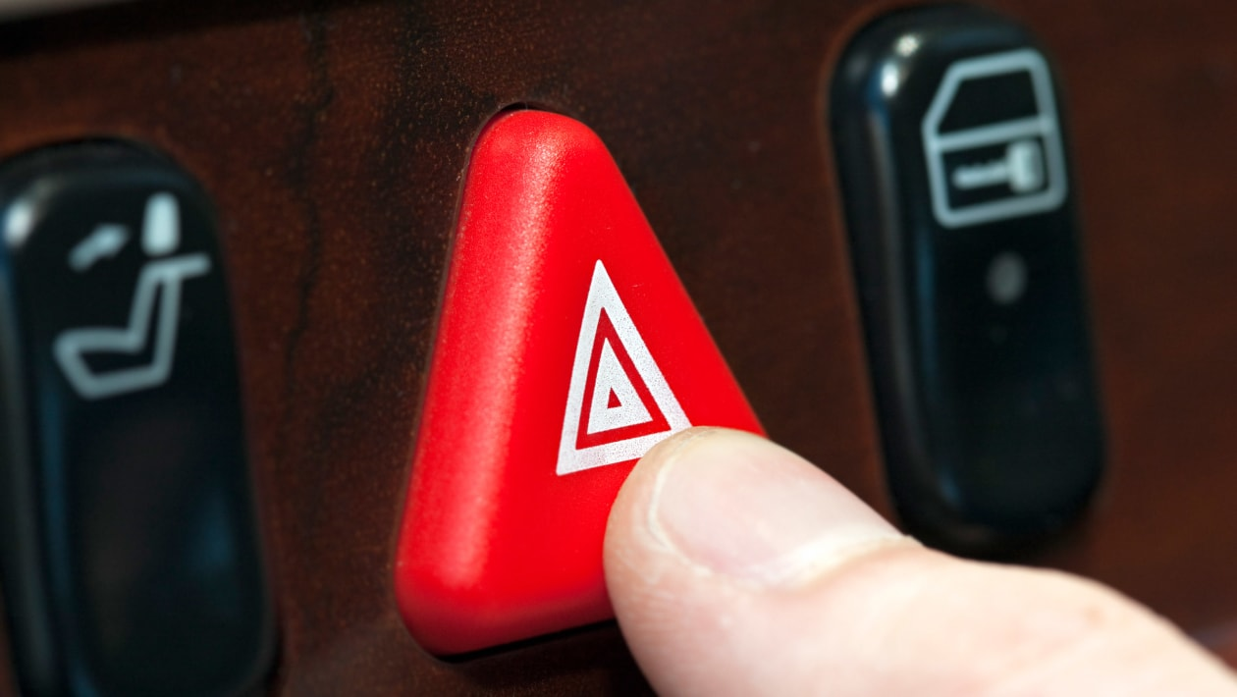
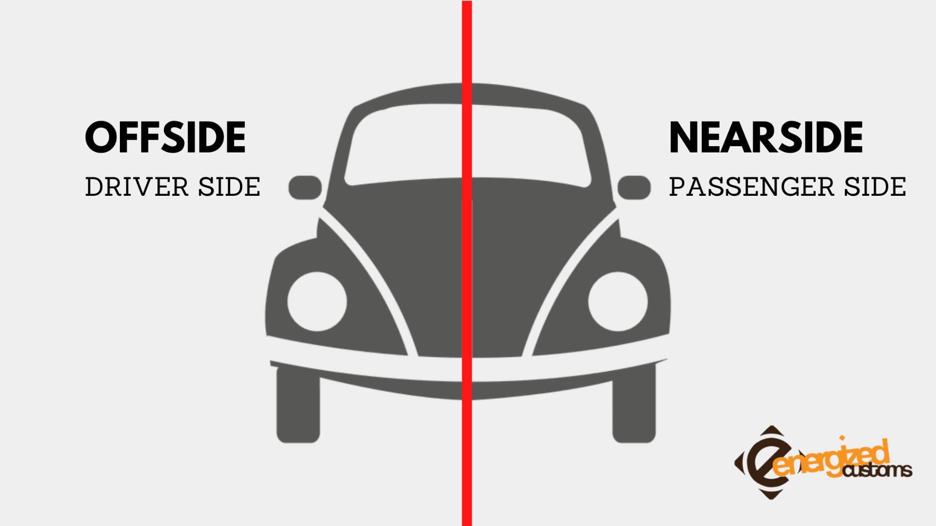
What to do if your car breaks down on the motorway?
Motorway hard shoulder
If you are in the position where you have had to park your car on the motorway hard shoulder, you should:
Warn other drivers that you’ve broken down by switching on your hazard lights
If visibility is poor or its night time, switch on the sidelights and don’t open the offside doors (those nearest the carriageway). Instead, you and your passengers should leave the vehicle by the nearside doors, away from the traffic.
When you’re ready to return to the carriageway you should wait for a safe gap in the traffic and then drive along the hard shoulder to gain speed before moving out onto the main carriageway in the same way you’d use the slip road when first entering the motorway.

Slide 16
What to do if your car breaks down on the motorway?
If you can’t get onto the hard shoulder when you break down, you should:
Switch on your hazard warning lights
Only leave your vehicle when you can get off the carriageway safely.
Breaking down on the motorway can be scary, stay calm and follow the above guidance and you will soon be safe and moving again.

Slide 17
Practice questions
Motorway rules test (with hints) - Highway Code Tests

