Slide 1
Driving Theory Workshop
Topic 7 – Other Types of Vehicles

Slide 2
Other Types of Vehicles
Cars are not the only vehicles that occupy the roads. There are other types of vehicles.
These include motorcyclists, buses, and trams, all of which you must be aware of.
In this theory test section you will learn about:
Different types of vehicles that occupy the roads.
How to drive safely towards or follow different types of vehicles.
When using the same road as these vehicles, you must know what you are able and not able to do, and what they are able or not able to do.
By being aware of these, you will be able to prepare and drive in the correct way that makes the road safe for all types of vehicles and road users.

Slide 3
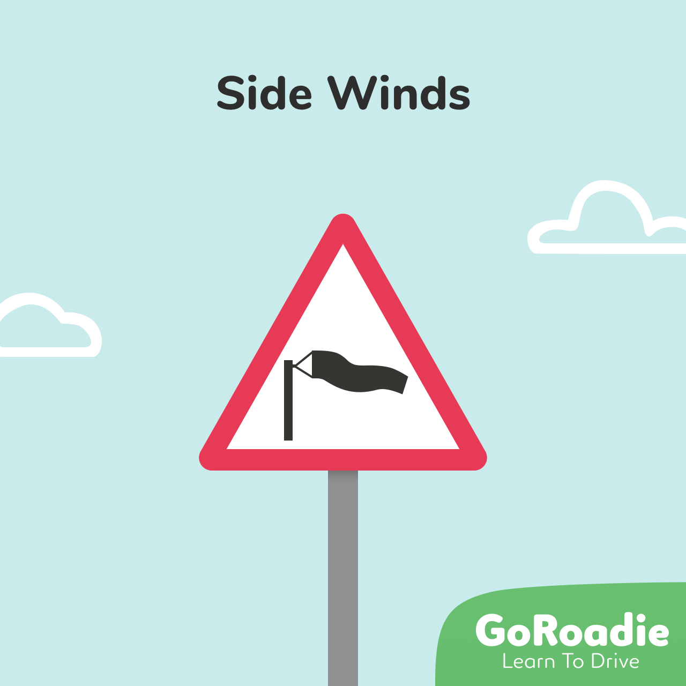
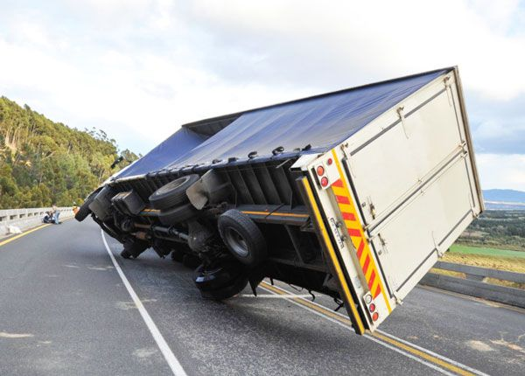
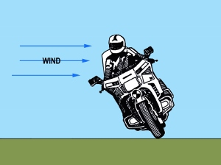
Motorcycles
Motorcycles are lighter and less stable than cars or vans. Therefore, they can be vulnerable, especially in windy weather as the wind can blow them across the road or in front of you. You should:
Allow extra room if overtaking a motorcyclist.
Keep well back if a motorcyclist in front of you is overtaking a high-sided vehicle. They could be blown off course and cause a crash.
Be careful of travelling motorcyclists where there are side-wind warning signs as they are more likely to be blown off in windy weather.

Slide 4
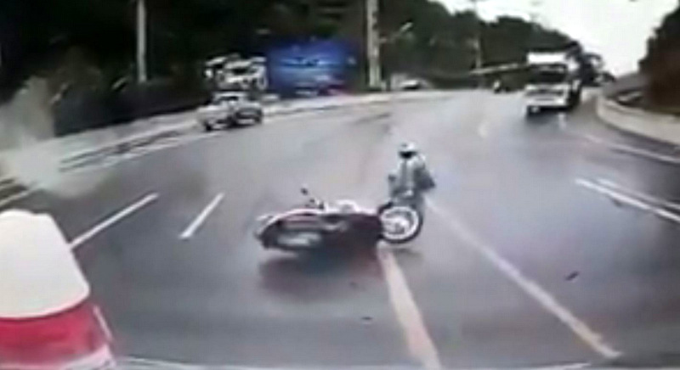
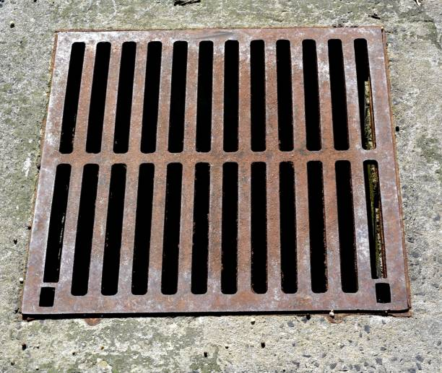
Motorcycles
Side winds can affect all vehicles but cyclists, motorcyclists, drivers towing caravans or trailers and drivers of high-sided vehicles are mainly vulnerable.
Therefore, if you are travelling behind one of these vehicles you should give them extra room. This is to protect you and other road users in case they are blown
Motorcyclists are also more vulnerable to slipping on wet or oily road surfaces.
In these cases, you should be aware that they may move in different directions if they spot uneven or slippery road surfaces.
Metal drain covers may not cause an issue for car drivers but are dangerous for motorcyclists when wet and slippery. If you’re travelling behind a motorcyclist, you should allow plenty of space.

Slide 5
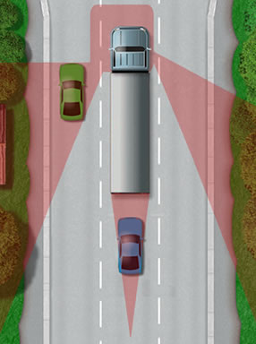
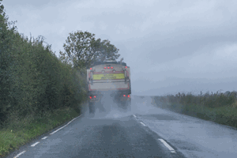
Large vehicles
It can be hard to see the road in front of you if you’re driving really close behind a large vehicle.
You should keep well back to ensure maximum visibility (so you can see more of the road).
Don’t drive too close to large vehicles. This stops you from seeing the road in front of you, and stops the large vehicle from seeing you in their side mirrors.
This is important if you are wishing to overtake,.
If you are planning to overtake, you should drop further back as this will allow you to see more of the road ahead.
You should also be aware that it takes longer to overtake a large vehicle because the vehicle is longer. So make sure the road is safe!
Top tips for overtaking large vehicles include:
Keep well back - Doing this allows the driver of the large vehicle to see you in their mirrors and allows you to see more of the road ahead.
This is also important in wet weather where spray from the road might reduce your visibility (make it harder to see) (large vehicles produce more spray than cars) making it harder to see.
In this case, use dipped headlights.

Slide 6
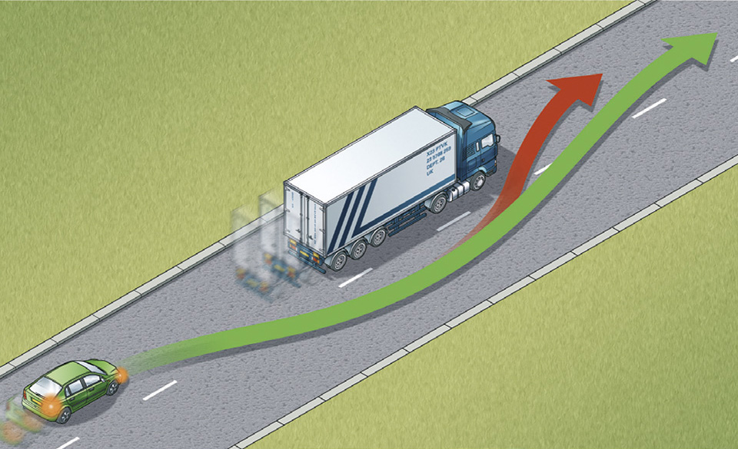
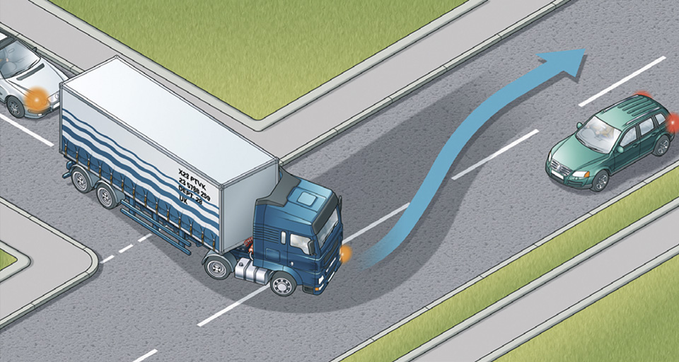
Large vehicles (continued):
Don’t start to overtake until you’re completely sure it’s safe.. If it is not, you must be patient.
Large vehicles need plenty of room as they approach road junctions, crossroads and mini-roundabouts.
Therefore, you should hold back and give them space to conduct their manoeuvres. This is because the back of their car might swing out.

Slide 7
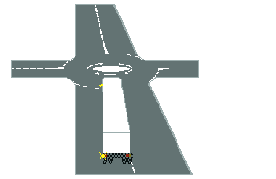
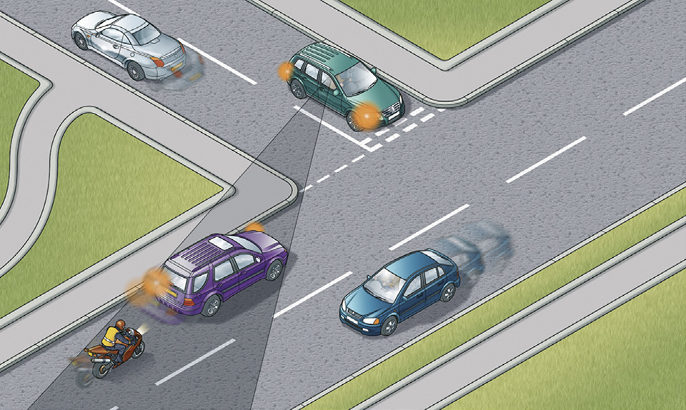
Large vehicles (continued):
Long vehicles might need to move in the opposite direction to the one they are indicating when they are trying to turn on a roundabout.
If they want to turn left, they may indicate left but move to the right side of the road before making the turn.
This may appear confusing but they have to do this turn more easily and safely. Keeping your distance will help them complete the turn safely and allow you to see more of the road ahead.
You should also think about these issues if you’re waiting to turn left from a minor road and a large vehicle is approaching from the right.
This is because there could be an overtaking vehicle you did not see which could lead to an accident.

Slide 8
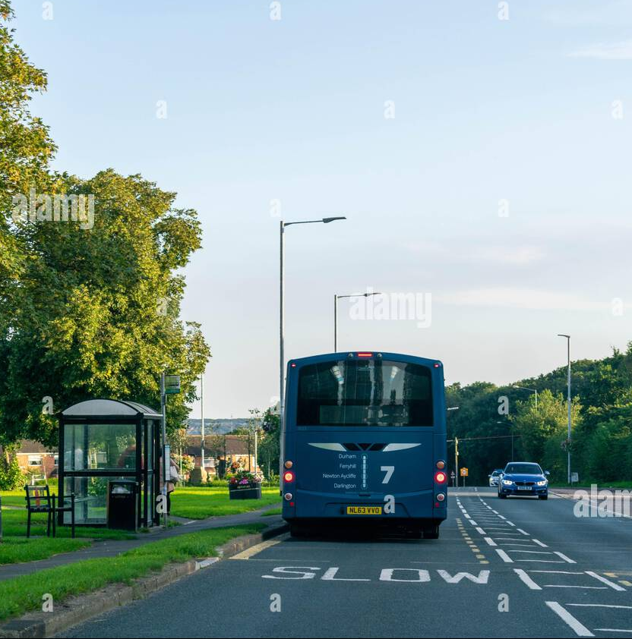
Buses
Buses are one of the most common vehicles that you’re likely to see on the roads, especially if driving in city areas.
You should be alert and remember that bus drivers need to stop regularly to pick up and drop off passengers.
Also people who get off of buses may not always act in a predictable way, they may get off and cross the road in front of or behind the bus, run in the middle of the road, and you might not see them.
Therefore you should be careful when a bus stops at a bus stop, and watch carefully for pedestrians!
You should also be prepared to give way to a bus when it’s attempting to move away from a bus stop. Follow this advice as long as it’s safe to do so.
Trams

Slide 9
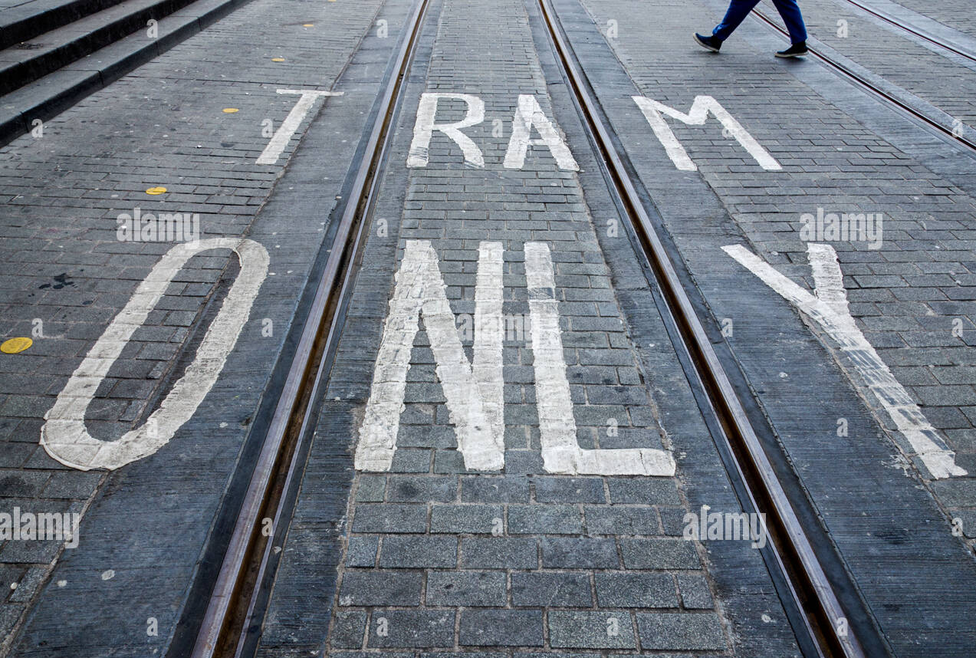
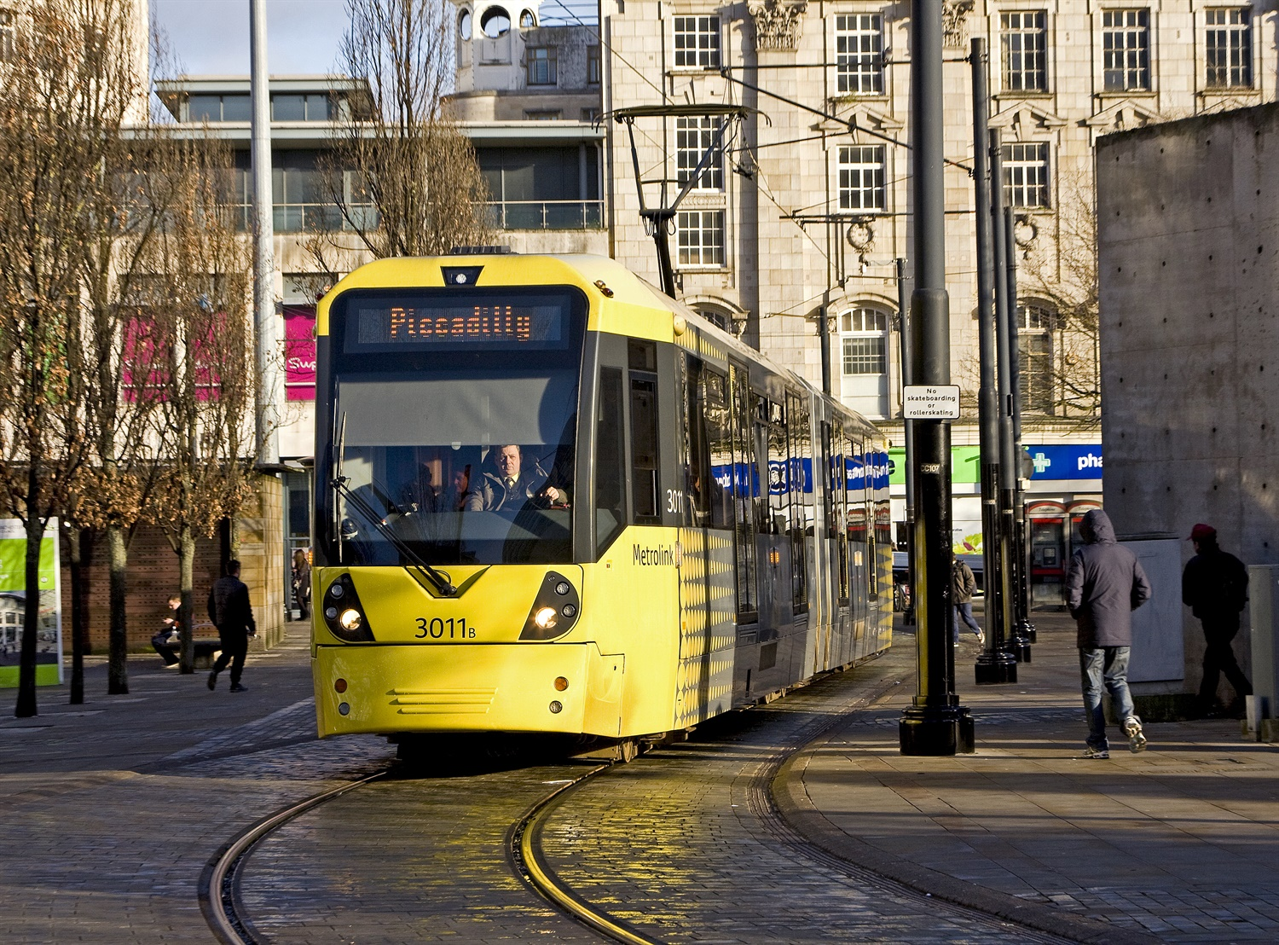
Trams:
Trams are usually found in some UK cities.
Their lines are marked by road signs and there may be extra white light signals present at some traffic lights for them.
They can be difficult to see as they are very quiet, move quickly and are unable to steer which makes it impossible for the driver to avoid you if there is a hazard.

Slide 10
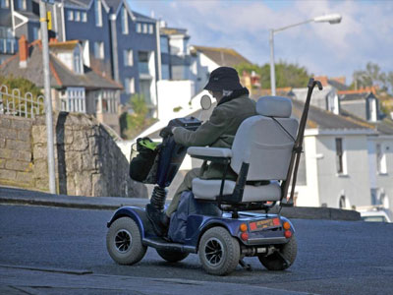
Powered vehicles for disabled people:
Some people with disabilities might use powered vehicles such as wheelchairs and mobility scooters.
These have a maximum speed limit of 8 mph (12 km/h) when used on the road.
They can also be harder to turn and people who use them may have slower reactions, so you should give extra room when you see them on the road, and when they are trying to turn.

Slide 11
Practice questions:
https://highwaycodetest.co.uk/other-types-of-vehicle/

