Slide 1
Driving Theory Workshop
Attitude

Slide 2
Multiple Choice Section:
Alertness
Attitude
Documents
Hazard Awareness
Incidents and Emergencies
Motorway rules
Other types of vehicles
8. Road signs
9. Rules of the road
10. Safety and your vehicle
11. Safety Margins
12. Vulnerable road users
13. Vehicle Handlings
14. Vehicle Loading

Slide 3
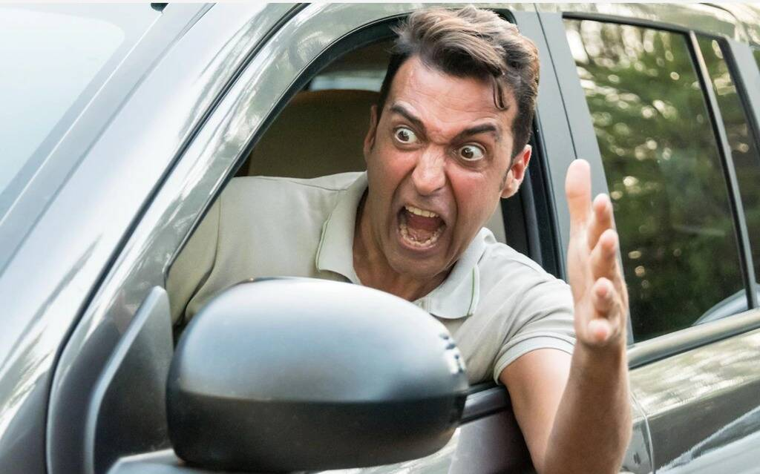
Attitude:
The key to passing your test and being safe on the road all comes down to your ATTITUDE.
Attitude is your behaviour. We should always be calm and focused!
What does this mean when driving?
Your state of mind when you enter the car - You should be calm, ready to concentrate and focused on driving in a safe manner.
How you react to hazards on the road - As much as you can control your own behaviour on the road, you will still have to deal with unexpected hazards. This could be anything from a cat running out in front of the car or bad weather making conditions dangerous. Being focused when driving will allow you to react quickly and calmly, avoiding danger.
How you react to other drivers. The behaviour of other drivers is something you can’t predict. Other road users will make mistakes, for example, they may break abruptly or tailgate. Becoming angry or upset will affect your concentration and make your journey less safe.

Slide 4
Driving with manners
When you’re driving it’s easy to feel like drivers are the only people that you need to think about.
But you need think of other road users. Pedestrians, horse riders and cyclists have the same rights on the road as car drivers.
If you drive in a competitive or aggressive way, you may make the road less safe for everyone.
It is important to be tolerant of other road users.
They may not drive as well as you do. They may stall, become aggressive or pull out unexpectedly.
You should always take a deep breath, remain calm and continue safely on your journey.

Slide 5
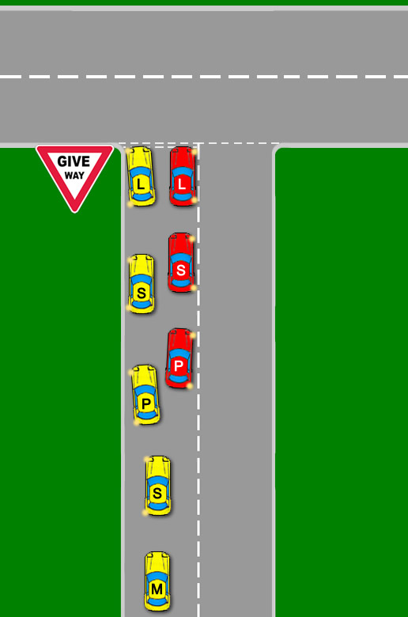
Helping other road users
Ensuring the roads are safe for all means being selfless and helping your fellow road users.
You can do this by making sure that you let others know your intentions or what your trying to do.
One way of doing this is by making sure that you position yourself in good time and use your indicators.
For example, if you were looking to turn right at a junction then you should move into the right-hand lane in good time and signal your intention. Doing this allows other drivers to see what you intend to do, and position themselves accordingly. If you are badly positioned, you could obstruct traffic behind you and cause a hazard.
You can also help other road users is when you’re travelling along the road when in a slow-moving vehicle. In this instance, the flow of traffic will be improved if you regularly pull over, where it’s safe to do so, and allow traffic to pass. If you fail to do this then traffic jams will develop behind you and other users may become irritated.

Slide 6
Helping other road users
It is important to pay attention to what other road users wish to do. If a slow-moving vehicle appears to be struggling to overtake you then it is best to slow down and allow it time to pass.
If another road user is trying to force you to break the speed limit by travelling too closely behind you or flashing their lights, then it is best for everyone’s road safety that you hold your speed and allow the other vehicle to overtake you. They may be in the wrong but trying to force them to slow down may anger them and make the situation more dangerous.

Slide 7
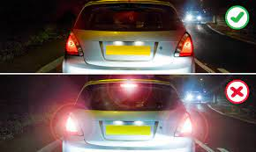
Using horn and lights
Your horn and lights are important to help you signal to other drivers that you are there!
These should not be used to show your anger or frustration, greet others or signal that you’re allowing someone right of way.
You should be careful not to dazzle them with your headlights.
At night, you should dip your lights when either following another vehicle or meeting a vehicle coming towards you.
When you are queuing in traffic in dark conditions, it’s important to think about how your actions affect your lights. If you stop your car with your foot on the brake, your brake lights will be on and could dazzle other road users. It’s safer for everyone if you use your handbrake instead.

Slide 8
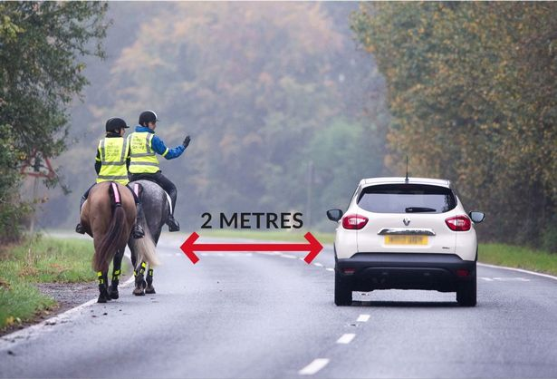
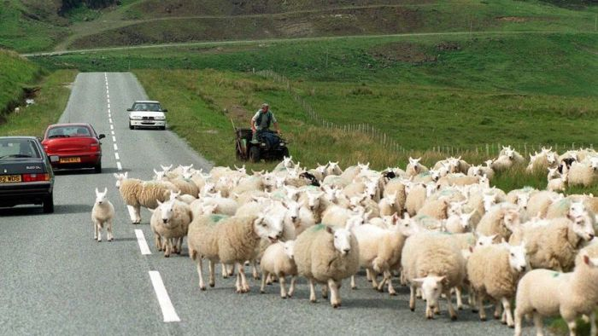
Animals on the road
Horses
Animals on the road are unpredictable.
These may be cats running across the road, low flying birds or, most problematically, horses and other livestock.
Horses can be scared easily which may lead to the horse rider losing control.
When passing horses, it is important to:
Keep your speed down
Allow plenty of room between the horse and vehicle
Livestock
When driving in rural areas, you may see herds of livestock, such as sheep on the road. They may block the whole road and even if this may cause delays and frustration, you should stop and switch off your engine until the road is clear.

Slide 9
Good drivers always…
Drive at the correct speed and for the road and traffic conditions
Observe speed limits, realising that they are limits, not targets
Overtake only when it is safe to do so
Park in safe places where parking is prohibited
Wait patiently if the driver in front is a learner, elderly or hesitant
Look out for vulnerable road users such as cyclists, pedestrians, motorcyclists and children – these are often obscured so using all of your mirrors is essential
Concentrate on the road at all times
Plan their journey so that they have plenty of time to get to their destination if there are delays

Slide 10
Bad drivers always
Allow themselves to become angry and affected by road rage
Break speed limits
Change their driving to match conditions, especially in wet, foggy or icy weather
Accelerate or brake too harshly or at short notice
Overtake and ‘cut in’, forcing others to brake sharply
Put pressure on other drivers by driving too close behind them, flashing headlights or gesturing
Allow their attention to be distracted by passengers, mobile phones, passing scenery, loud music, or what is happening on the road, such as staring at an accident

Slide 11
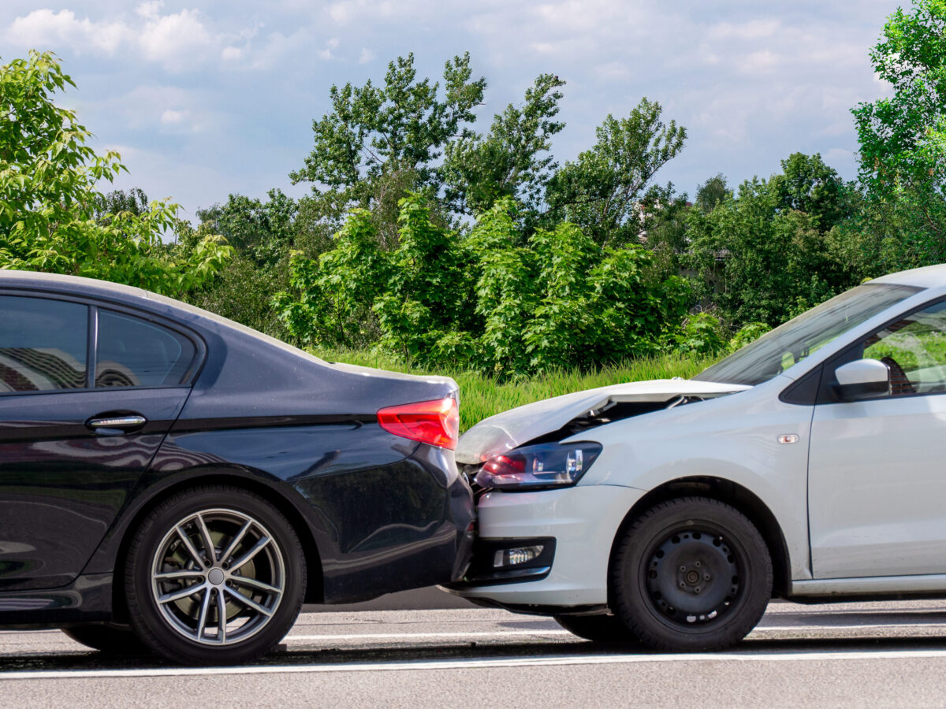
Tailgating
Tailgating is a dangerous practice where a vehicle drives too close to the car in front of it. This means that if the vehicle in front has to stop suddenly, they run the very real risk of being hit by the car following it.
It is important to maintain a 2-second gap between your vehicle and the one in front. This way, if a hazard develops, for example, if a child or animal was to run out into the road, the car could safely break without the risk of being hit from behind.
If you are following a large, slow-moving vehicle. ALWAYS stay well back so you will have a clearer view of the road ahead and be able to safely judge when it’s safe to overtake.
Failure to do this can result in an accident, where you hit the vehicle you’re following. These types of accidents, are the reason for a large percentage of all accidents on the road and are avoidable. If an accident were to occur, the car behind would almost always found to be responsible.

Slide 12
Giving priority to others:
Priority means who has the ‘right’ to go and who doesn’t.
Priority on the road can be difficult at times to assess as it always changes.
Sometimes traffic going in one direction is given priority and sometimes in the other direction.
Therefore, we know who has priority by paying attention to road signs.
Paying attention to these signs will allow you to know who has the priority.
You should remember that having priority doesn’t mean you can demand the right of way.
As always, you should be careful; the driver coming in the opposite direction may have missed or not be paying attention.

Slide 13
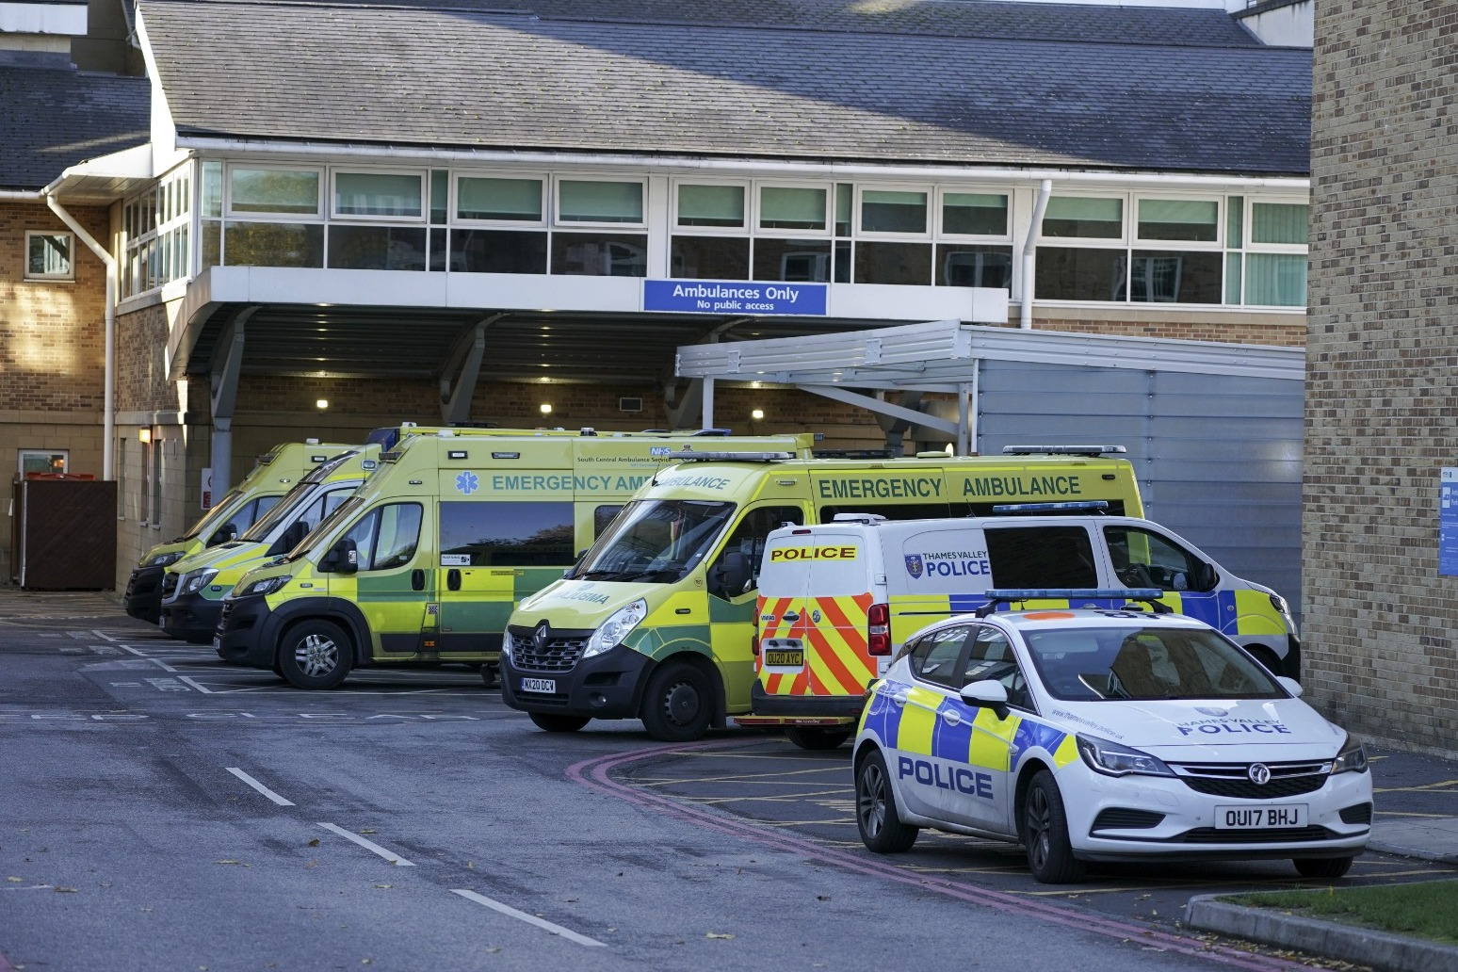
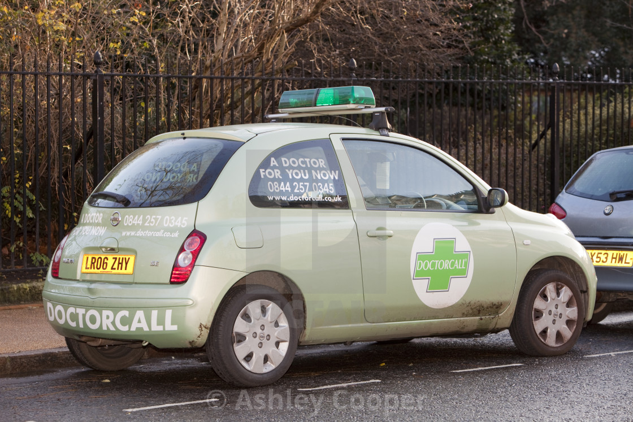
Priority: Emergency vehicles
Emergency vehicles are do not have to pay attention to road signs – they always have priority.
This is because it is important for them to be able move quickly through traffic.
When this happens, pull over to let them through as soon as you can do so safely – doing so may be the difference between someone’s life or death.
Blue Light cars – Are firetrucks, police cars and ambulance services, and other emergency.
Green Light cars – Are Doctors’ vehicles who may be driving to an emergency

Slide 14
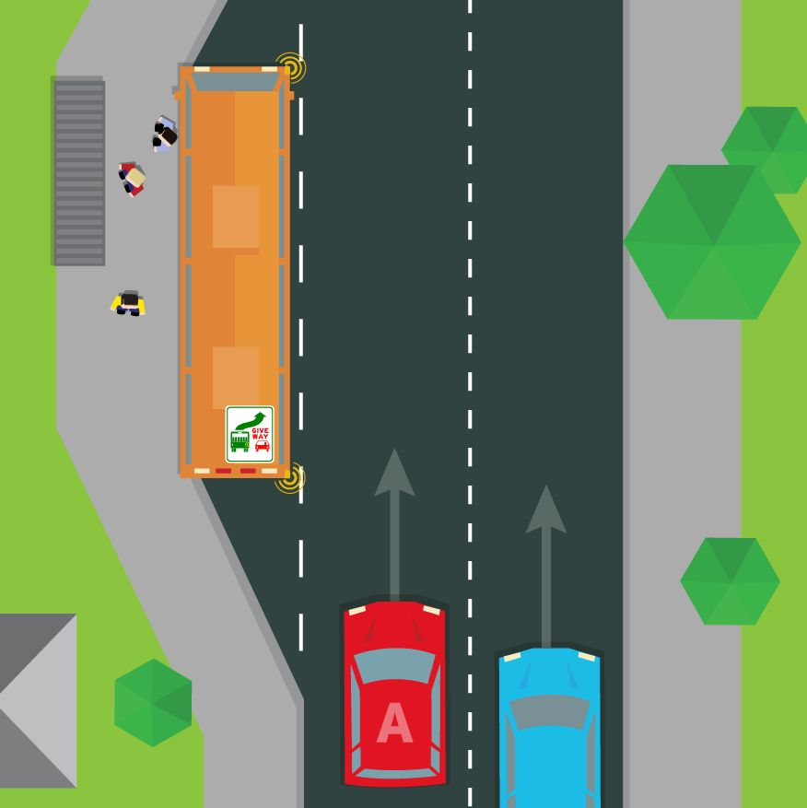
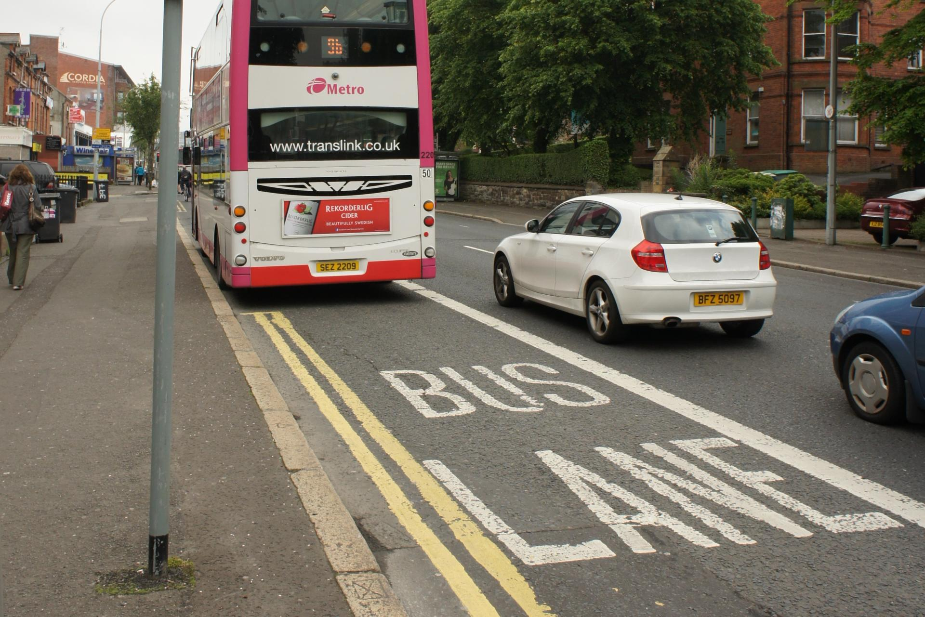
Priority: buses
Buses don’t always have priority but you should give way to buses pulling out from bus stops, if it’s safe to do so.
Sometimes bus lanes allow buses to proceed quickly through traffic – it’s important to be aware of road signs and markings so that you don’t use bus lanes while they’re in operation, or you could face heavy fines.

Slide 15
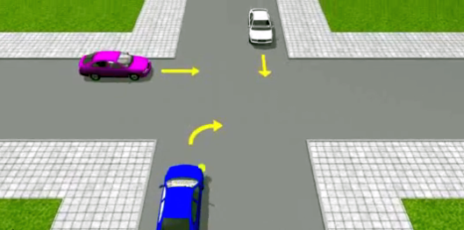
Priority: Unmarked crossroads
No one has priority at unmarked crossroads. Slow down, look both ways and only emerge into the junction when it is safe to do so.

Slide 16
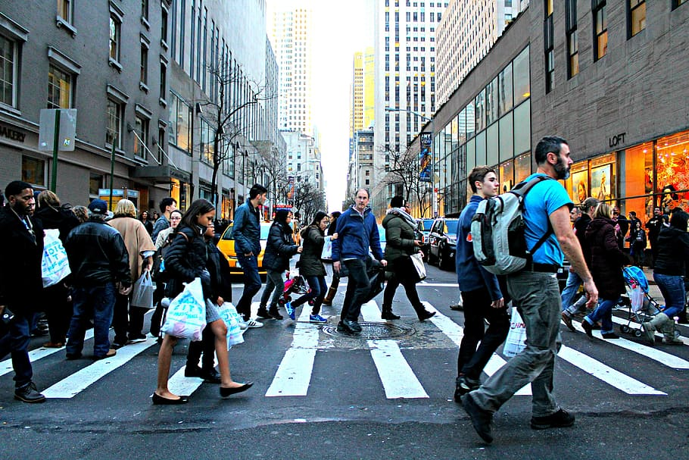
Priority: Pedestrians
Be especially careful around pedestrian crossings so that you’re ready to stop if necessary – people may act unpredictably so always be alert.

Slide 17
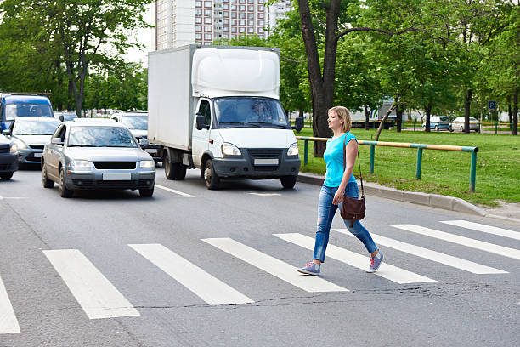
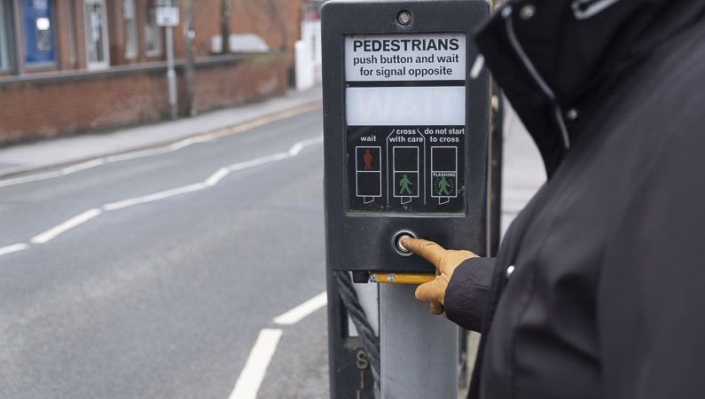
Types of crossings:
Zebra Crossing - You should watch out for pedestrians at or approaching a zebra crossing:
Be prepared to slow down and stop.
Be patient if they cross slowly or hesitantly.
Don’t encourage them to cross by waving or flashing your headlights – there may be another vehicle coming.
Pelican Crossing - If you’re approaching a pelican crossing and the amber light is flashing you should:
Give way to pedestrians already on the crossing.
Don’t move off until the crossing is completely clear.

Slide 18
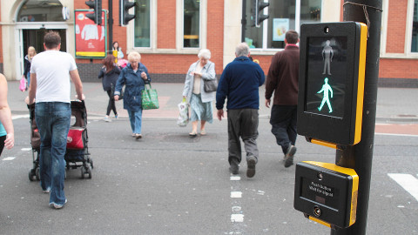
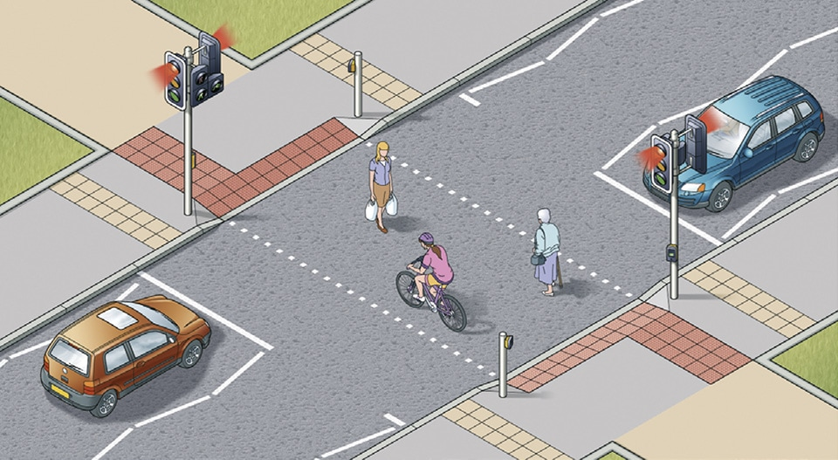
Types of crossings:
Puffin crossings - are electronically controlled. Sensors make sure that the red light shows until the pedestrian has safely crossed the road and the crossing is clear. Unlike pelican crossings, these don’t have a flashing amber light. Instead, they have a steady amber light, just like normal traffic lights.
Toucan crossings - work in a similar way to puffin crossings, but unlike the others, they allow cyclists to cross at the same time as pedestrians.

Slide 19
Useful links and practice questions:
https://highwaycodetest.co.uk/attitude/
https://www.driving-test-success.com/theory-test-attitude/theory-test-attitude.htm

