Slide 1
Driving Theory Workshop

Slide 2
What is the Driving Theory Test?
The Driving Theory Test is designed to test your knowledge of driving, road signs, and hazards.
It is based on the Highway code (rules for pedestrians and road users).
It will last 1 hour and 20 minutes
The Driving Theory Test is split into 2 sections:
Multiple Choice Section.
Hazard Perception.
You need to pass your Driving Theory Test before you can book a Practical Driving Test.
Driving Theory certificates last 2 years

Slide 3
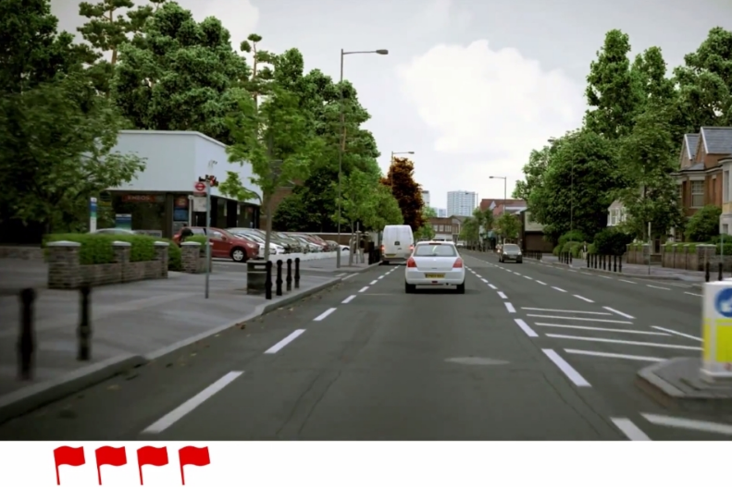
Hazard Perception Section:
You will be given 14 clips of real life driving scenarios.
These clips will last 1 minute each.
You have to ‘click’ the mouse when you see a potential hazard before it becomes dangerous.
Each clip has 1 hazard, but 1 clip will have 2 hazards
This section tests when you respond to a hazard
On each clip, you are scored out of 5.
You score higher the quicker you react to a potential hazard, and score lower if you take to long to respond
You need to score 44/75 points to pass.
You will have 20 minutes to complete this section

Slide 4
Multiple Choice Section – Format
You will be given 50 random questions related to roads signs and general driving.
You need to score 43/50 to pass.
Each question will have 4 possible answers appear on the screen. You have to select one right answer.
Three of the questions are about a short video. It will show a normal driving situation.
You will only have 57 minutes on this section.

Slide 5
Multiple Choice Section:
Alertness
Attitude
Documents
Hazard Awareness
Incidents and Emergencies
Motorway rules
Other types of vehicles
8. Road signs
9. Rules of the road
10. Safety and your vehicle
11. Safety Margins
12. Vulnerable road users
13. Vehicle Handlings
14. Vehicle Loading

Slide 6
Alertness
Alertness questions cover:
anticipation of others’ actions
observation
signalling
reversing safely
using your mirrors
maintaining concentration
getting distracted
feeling drowsy
use of mobile phones of while driving

Slide 7
Alertness
What is alertness?
Alertness is being aware of your surroundings.
How do we make ourselves aware?
By being aware that there are other road users.
By making ourselves visible to other road users.
By anticipating the actions of other road users before they happen.
By being ready for potential hazards.
By focusing on the road.
By paying attention to road signs and road markings.
By resisting distractions. For example, answering your phone whilst driving.

Slide 8
Alertness: Observation
What should you be aware of?
Other road users. For example other cars, trucks, lorries, etc.
Pedestrians.
Cyclists.
Weather conditions.
The surrounding area. For example, if kids are playing on the street.
To stay aware of these factors, make sure that you keep an eye on the road ahead of you, as well as to the sides. This will allow you to notice changing situations as you drive

Slide 9
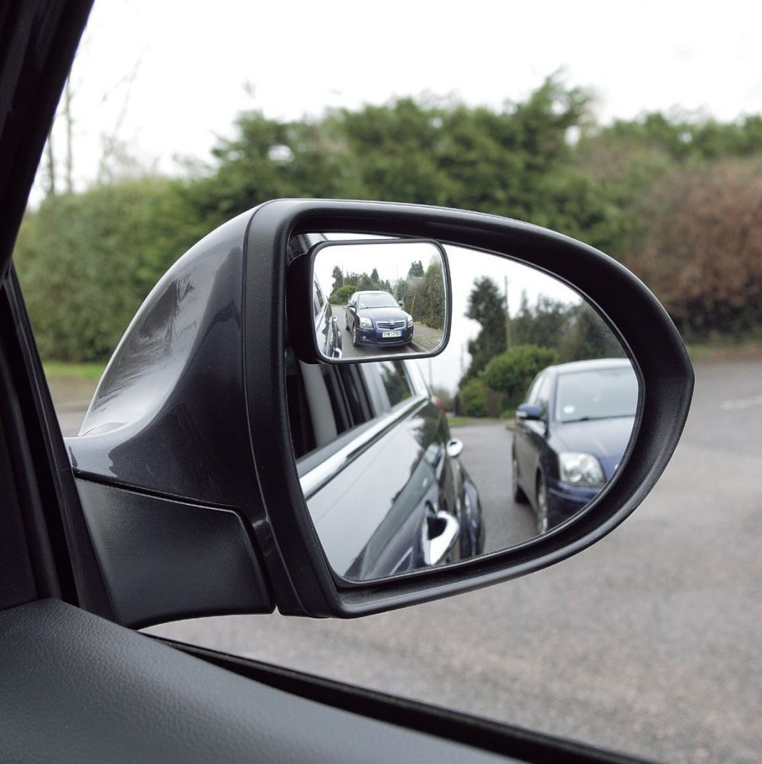
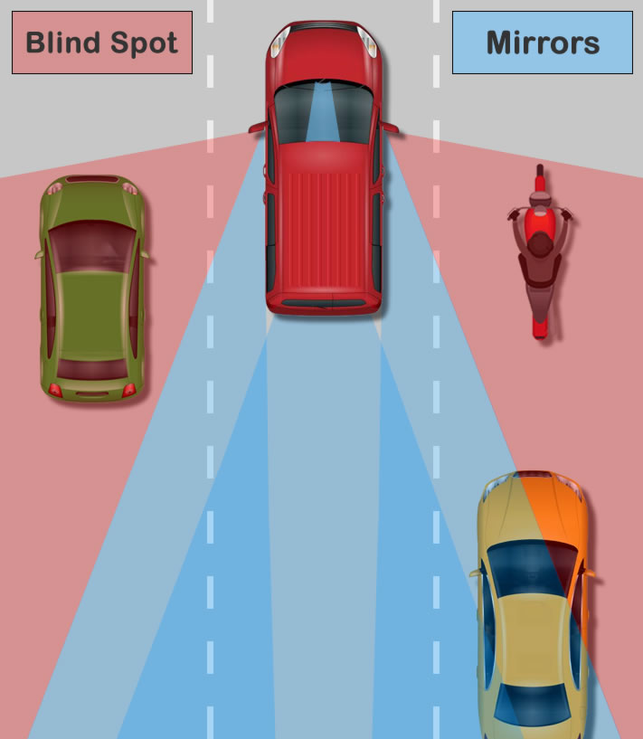
Alertness: Observation:
Before moving off
Use your mirrors to check on the traffic behind you, and how your actions will affect them!
Look around and Check your blind spots.
Blind spots – This is an area not visible to the driver
Once everything is safe, use your signal.
Clear view:
If you are reverse your car and you cannot see behind you, you should ask someone to guide you.
If parked cars block your view as you’re exiting a junction, creep forward slowly and cautiously until you can see clearly.

Slide 10
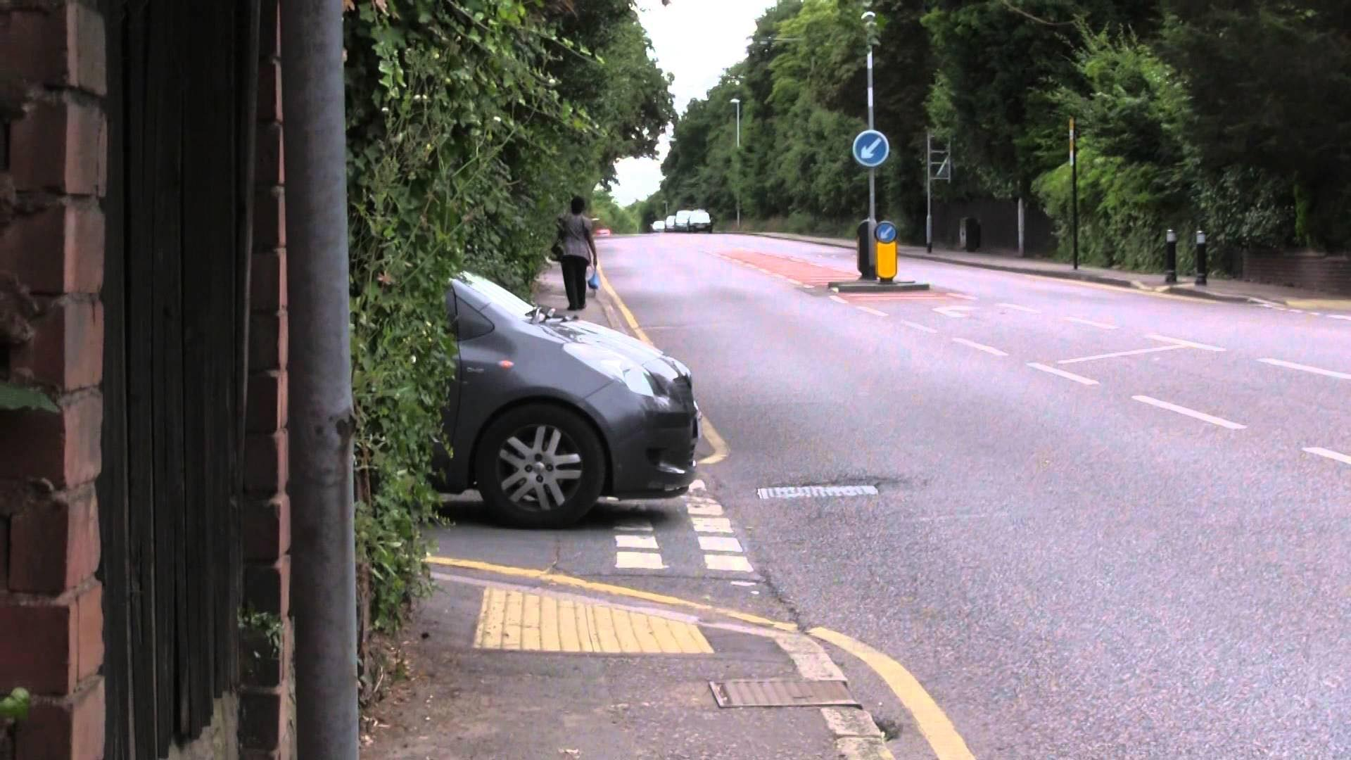
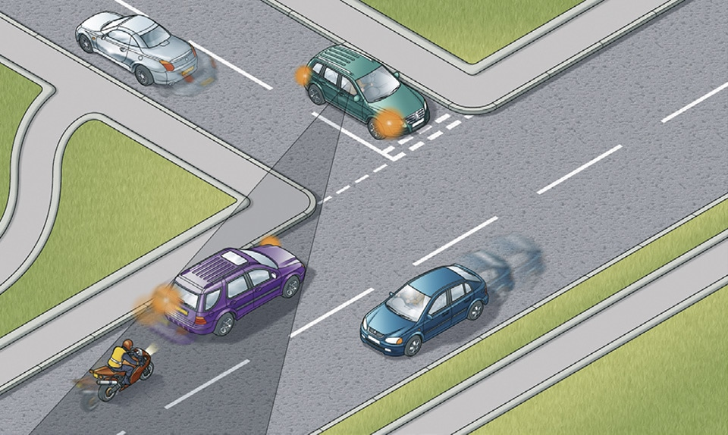
Alertness: Observation:
What should you do if your view is obstructed?
If you are reversing your car and you cannot see behind you, you should ask someone to guide you.
If parked cars block your view as you’re exiting a junction, creep forward slowly and cautiously until you can see clearly.

Slide 11
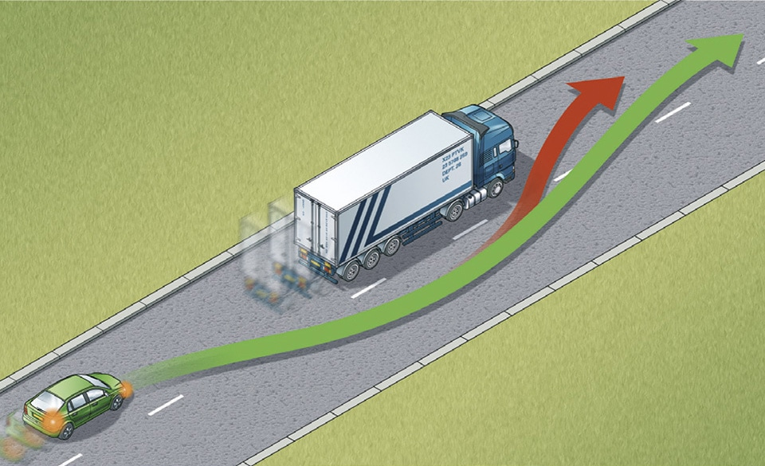
Alertness: Observation:
Overtaking
You must take extra care to be observant when overtaking another vehicle. You must be able to clearly see the road ahead.
Look out for:
Oncoming vehicles
Vehicles exiting junctions ahead
Cyclists
Narrowing of the road, reducing the space to overtake
Changes which make it more difficult to see oncoming traffic such as bends or dips in the road
Road signs which state that you must not overtake
Before overtaking, ensure that: overtaking is safe, legal and necessary
there is enough time to complete the overtaking manoeuvre.

Slide 12
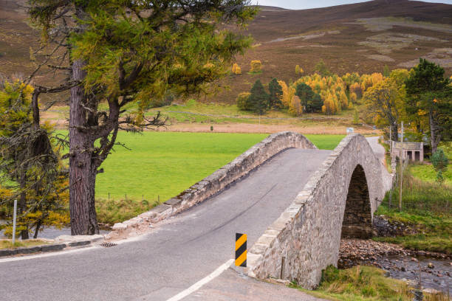
Alertness: Observation:
Being seen by others
To stay safe, other road users must know that you are there.
In dark conditions, turn on your headlights – even if the streetlights are on
In situations where it is difficult for others to see you (e.g. a hump bridge), it may be appropriate to sound your horn
When driving behind a large vehicle, keep your distance and stay well back. This allows the driver to see your vehicle in their mirrors. Staying well back also gives you a better view of the road ahead, as the large vehicle would block less of your view. This is particularly important if you’re about to overtake this vehicle.

Slide 13
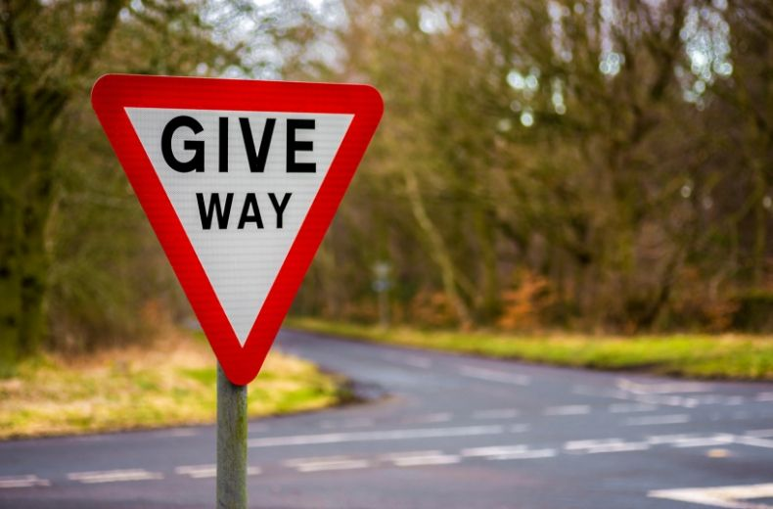
Alertness - Anticipation:
Anticipation means thinking ahead.
For example, a ‘give way’ sign, will warn that a junction is ahead. You can use this information to slow down in good time before you reach the junction.
You should pay special attention to road signs and road markings as they can give you valuable information about hazards ahead.
Do as they advise.
Slow down if instructed to do so.

Slide 14
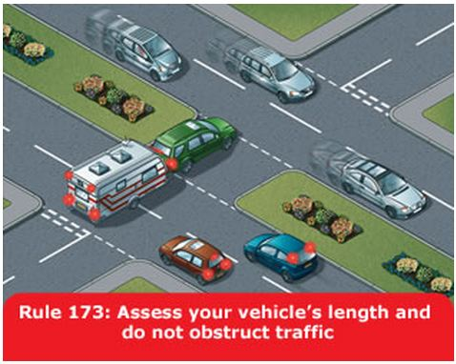
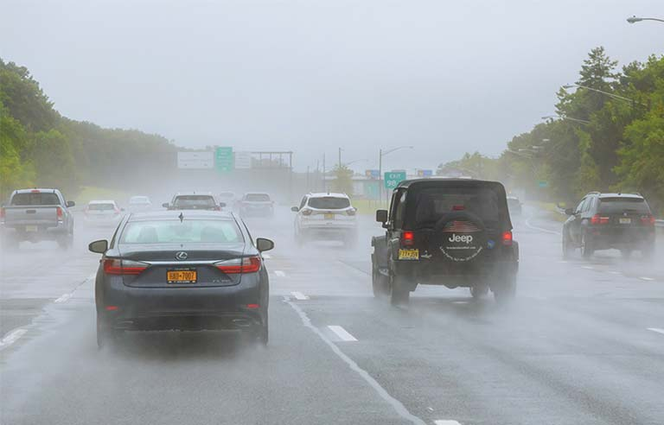
Alertness – Anticipation (2)
If you’re turning right onto a dual carriageway, always check that there is space in the central reservation for your vehicle to stop in. This is particularly important if your vehicle is towing a trailer. This check is necessary because you may have to wait before joining the traffic. If the central reservation isn’t wide enough, only emerge when both the right and left are clear.
If the traffic lights you’re approaching have been green for a while, be ready to stop because they may soon change.
Your ability to anticipate things will be affected by road conditions. It becomes more difficult in:
Very wet or windy weather
Poor lighting
Heavy traffic volume
Driving a route that you haven’t driven before
You need to be especially alert to what’s happening around you, in any of the above conditions

Slide 15
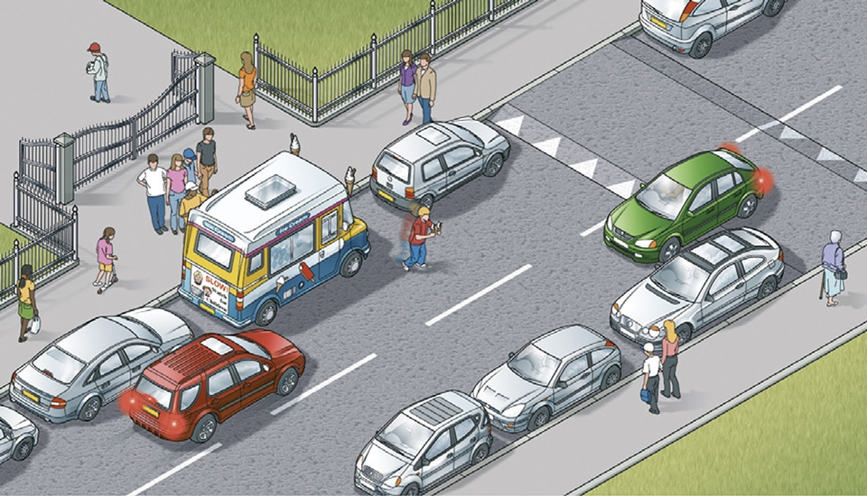
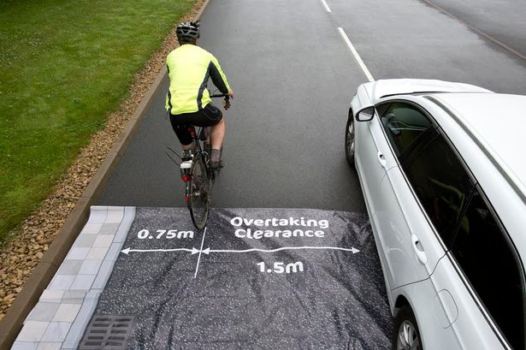
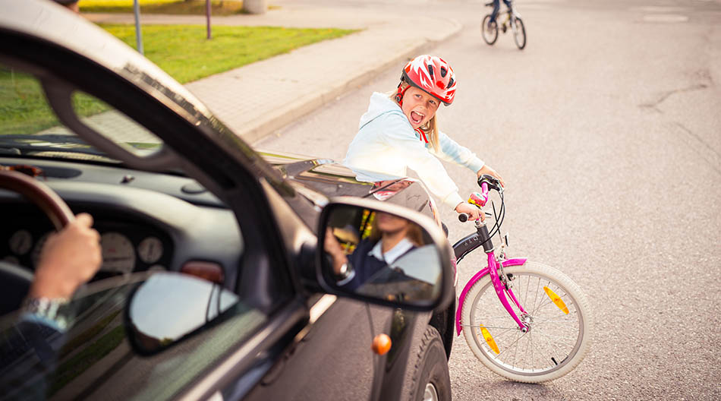
Alertness - Anticipation (3)
Anticipating the actions of other road users
Keep a close eye on other road users. Try to predict what they might do next, so that you’re prepared to reduce your speed or alter your direction.
Look out for:
Pedestrians approaching a crossing – especially those who may need more time to cross the road, such as the elderly, disabled or children
Cyclists – always pass slowly, leaving ample space for them.
Motorcyclists – these may be difficult for you to see
Horses – pass slowly and leave plenty of space as they may become frightened by your vehicle’s noise
Always be prepared to stop
Staying aware of your surroundings, staying alert and anticipating the actions of others will help you stay safe. But, in an emergency, you may still need to stop your vehicle quickly.
As you brake, keep both of your hands on the wheel to maintain control of your vehicle

Slide 16
Alertness: Staying focused
It takes lots of concentration to be a safe driver.
You must:
Concentrate on controlling your vehicle
Be aware of your surroundings
Anticipate what could happen next on the road ahead
To stay focused on all these different aspects of driving, you must try not to get distracted.
Part of this is achieved by good journey planning:
Be familiar with the route you’re taking, as well as alternative routes if needed
Plan to stop regularly so that you do not get too tired
Avoiding tiredness:
Tiredness will make it harder for you to focus on your driving. Driving on the motorway in particular can make you feel very sleepy, even more so at night.
To combat this you should
Avoid continuous driving for more than two hours
Circulate fresh air throughout the car
If you begin to notice feelings of drowsiness, leave the motorway at the next exit or stop at the nearest service area. Find a safe and legal place to stop and have a rest.

Slide 17
Alertness: Are you fit to drive?
Whether you’re ‘fit’ can mean:
Did you consume any alcohol before beginning your journey?
Are you under the influence of illegal drugs?
Do you feel groggy or ill?
Have you been taking prescription medicine which could affect your ability to control the vehicle?
Are you well-rested?
You should not begin a journey if you’re not feeling well:
Reaction times will probably be slower
Judgment of distances will likely be less accurate
Coordination will be worse
Driving in this state, aside from being dangerous to you and other road users, is illegal.

Slide 18
Alertness: Deciding if your fit to drive
Deciding if you’re fit to drive
You, as the driver, are responsible for deciding whether you are fit to safely drive your vehicle.
To be fit to drive, you must not be:
tired
unwell
emotional
under the influence of drugs or alcohol
If you have decided you are fit, you must then:
Manage any passengers travelling with you, so that they don’t prevent you from driving safely
Be aware of your surroundings at all times – both close and far away
Maintain a speed at which you are always able to stop in the clear stretch of road in front of you

Slide 19
Practice Questions
https://highwaycodetest.co.uk/alertness/

Slide 20
https://assets.publishing.service.gov.uk/government/uploads/system/uploads/attachment_data/file/519129/know-your-traffic-signs.pdf
https://assets.publishing.service.gov.uk/media/58170307ed915d61c5000000/the-highway-code-traffic-signs.pdf

